Slide 1



Slide 2
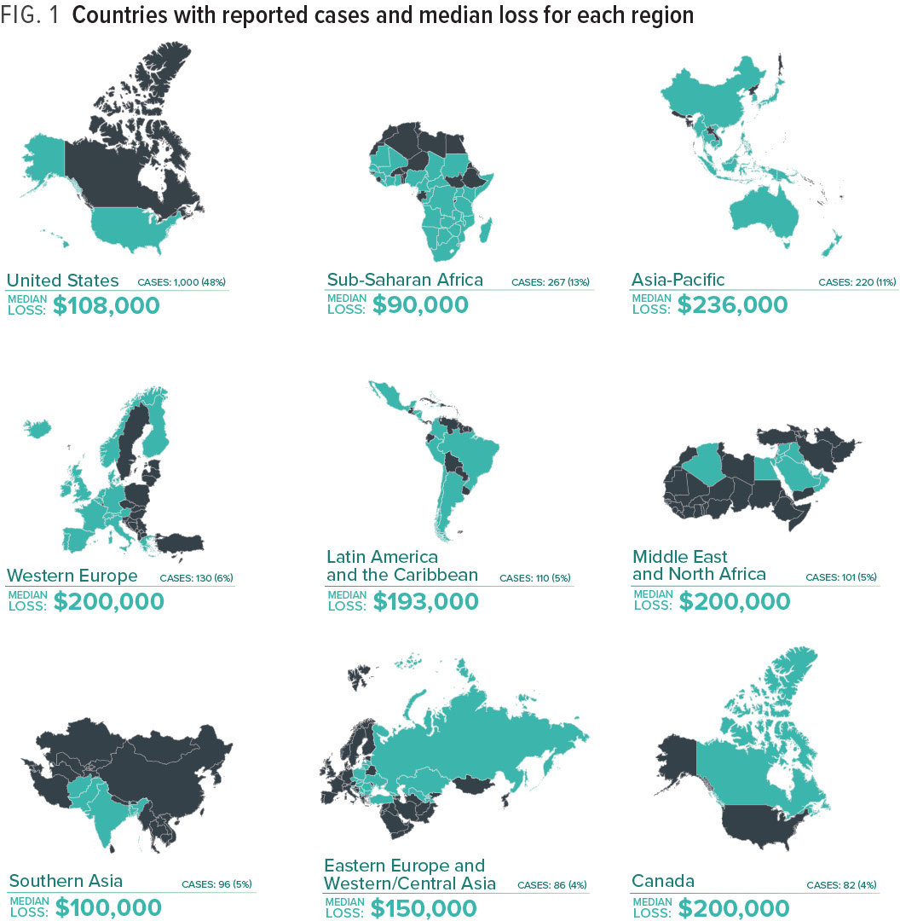
Notes:
The cases we studied occurred in 125 countries throughout the world, which helps us develop a global view of the costs, methods, victims, and perpetrators of these crimes. Figure 1 shows the number of cases from nine key geographical regions, along with the median loss per fraud in each of those regions. (Readers should note that the number of cases per region largely reflects the geographical distribution of ACFE membership, so this data should not be taken to mean that fraud is more or less likely in any particular region.)

Slide 3
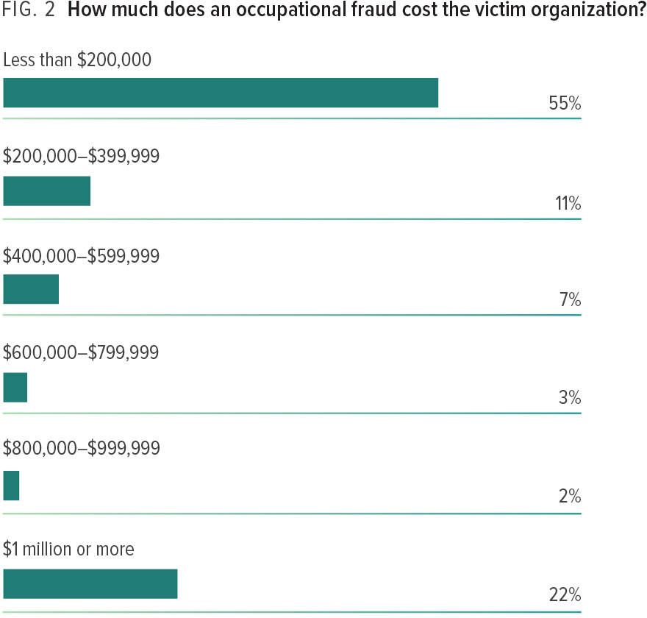
Notes:
The median loss for all cases in our study was USD 130,000. Figure 2 shows the loss distribution of the cases. While 55% caused less than USD 200,000 in financial damage, more than one-fifth resulted in a loss of at least USD 1 million.

Slide 4
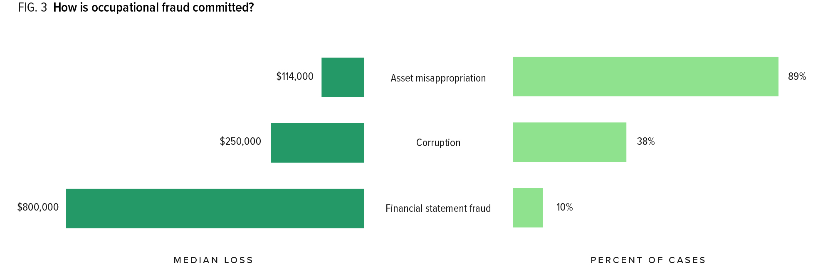
Notes:
Of the three primary categories of occupational fraud, asset misappropriations are by far the most common, occurring in 89% of the cases in our study. However, they are also the least costly, causing a median loss of USD 114,000. Corruption schemes are the next most common form of occupational fraud; 38% of the cases in our study involved some form of corrupt act. These schemes resulted in a median loss to the victim organizations of USD 250,000. The least common and most costly form of occupational fraud is financial statement fraud, which occurred in 10% of the cases and caused a median loss of USD 800,000.

Slide 5
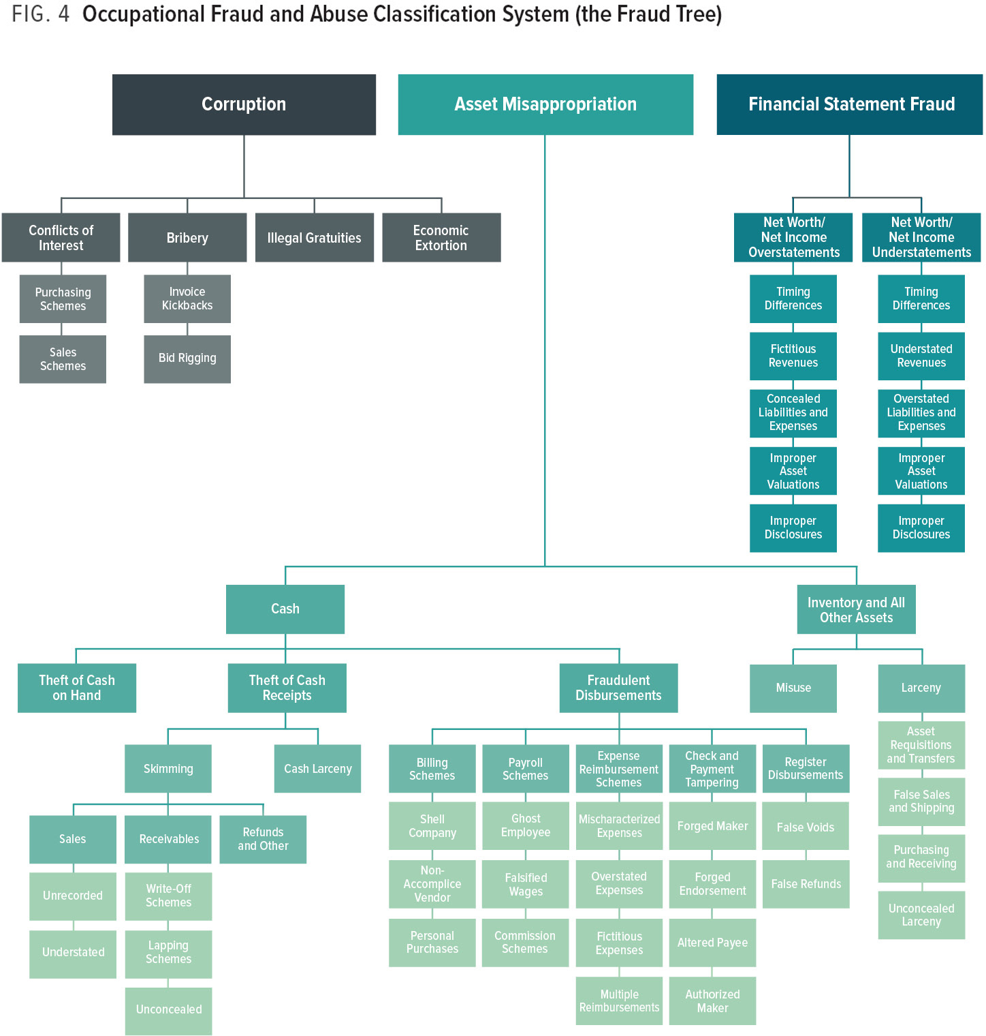
Notes:
One of the goals of the first Report to the Nation was to examine the methods by which fraudsters commit their schemes, and we have continued this line of study in every subsequent report. Over the last two decades, even with tremendous technological development and numerous changes in the global business and regulatory environments, our research shows that occupational fraud falls into several time-tested categories. The taxonomy of these categories is illustrated in the Occupational Fraud and Abuse Classification System, also known as the Fraud Tree, as depicted in Figure 4.

Slide 6
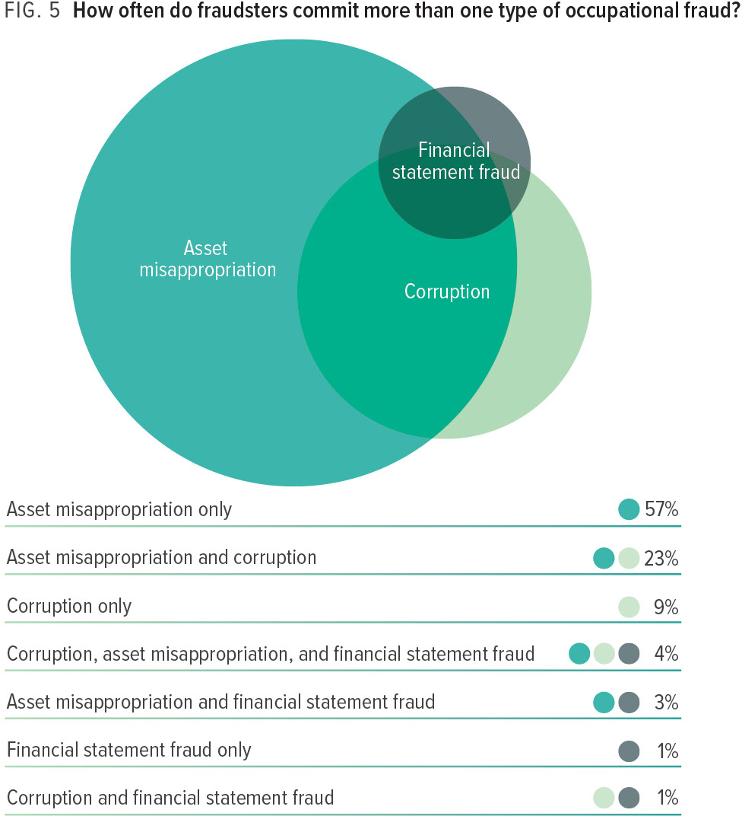
Notes:
When assessing an organization’s fraud risks and designing anti-fraud controls, it is important to remember that fraudsters typically seize whatever opportunity arises when committing their schemes. Thus, many frauds— including nearly one-third of the cases in our study, as illustrated in Figure 5—involve more than one form of occupational fraud.

Slide 7
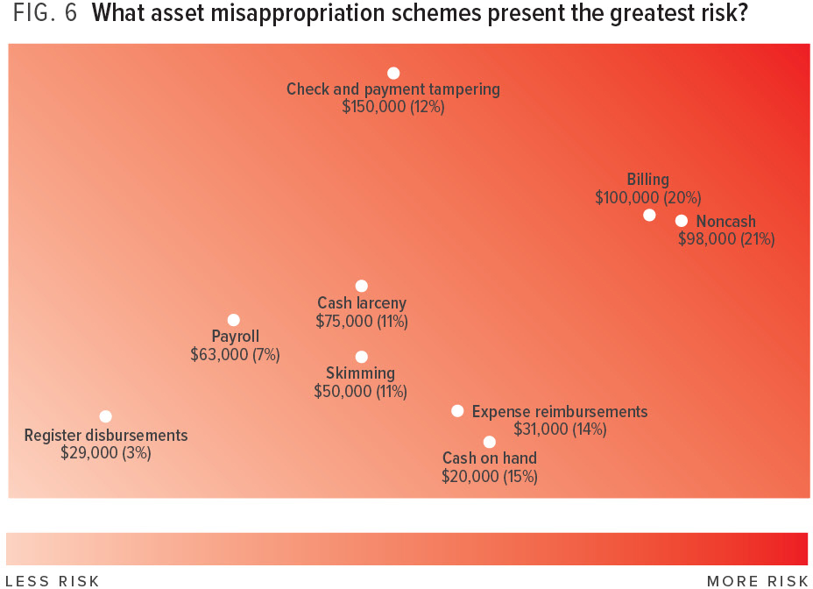
Notes:
Within the category of asset misappropriation, our research shows that there are several distinct sub-categories of schemes. The heat map in Figure 6 illustrates the relative frequency and cost of each of these scheme types. The schemes falling in the darkest area of the heat map—check and payment tampering*, billing, and theft of noncash assets—rank among the most common and the costliest scheme types and thus typically pose the greatest risk to organizations.
*In previous reports, this category was referred to simply as check tampering. However, to better reflect the increasing shift toward electronic payment methods, we have changed the category title to check and payment tampering.

Slide 8
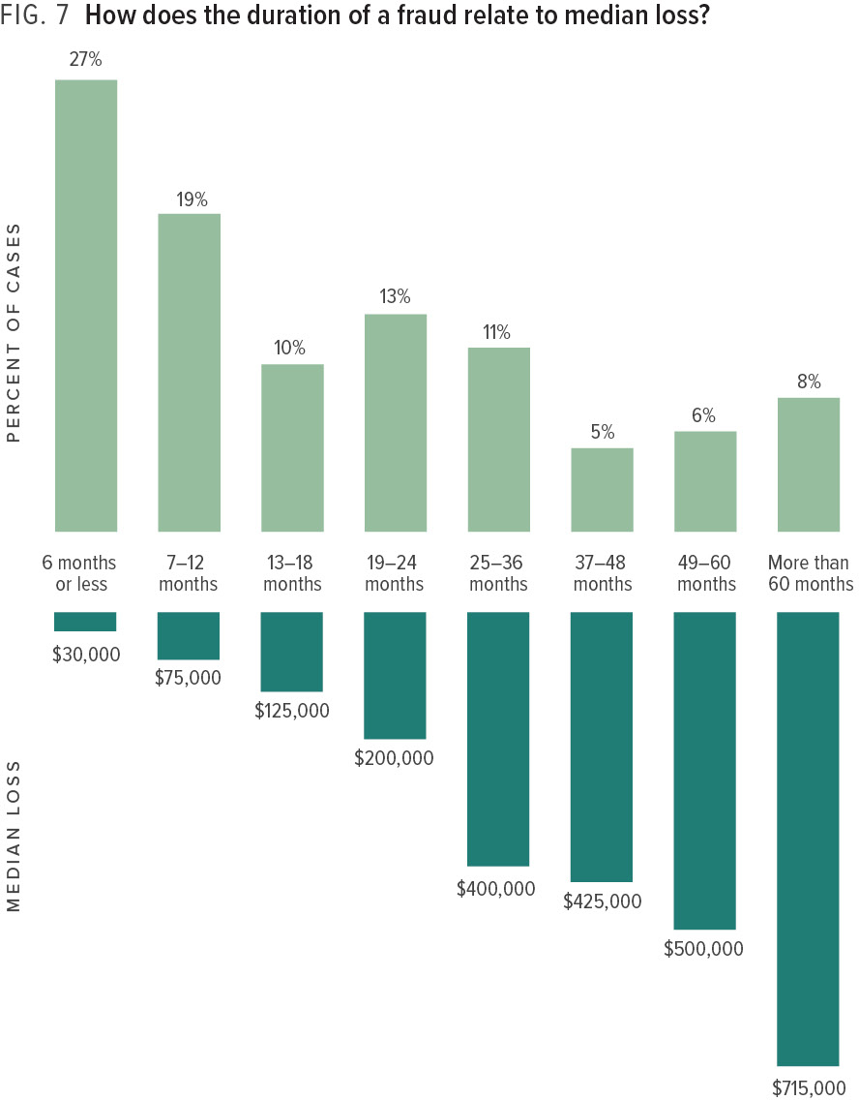
Notes:
Examining how long frauds tend to last can also provide insight into how they affect their victims. The median duration for all of the fraud cases in our study was 16 months. However, it stands to reason that the longer a fraud goes undetected, the larger the scheme will grow. Figure 7 shows that frauds that last over 60 months are more than 20 times as costly as those that are caught in the first six months. Our data also indicates that fraudsters tend to start small and increase their frauds rapidly over the first three years. Thus, it is incredibly important for organizations to implement proactive fraud detection mechanisms to catch frauds quickly and minimize their damage.

Slide 9
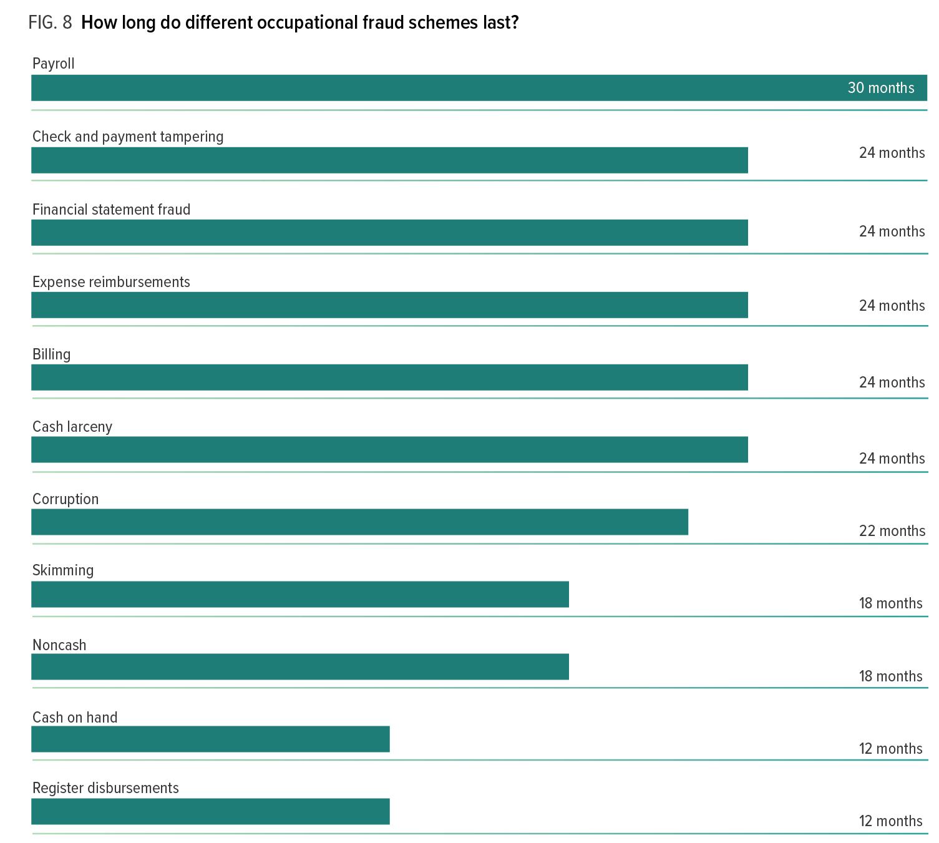
Notes:
We also examined the duration of the cases reported to us based on the type of scheme involved. Figure 8 shows the result of this analysis. The payroll schemes in our study tended to last the longest, with a median duration of 30 months, while schemes involving cash on hand and register disbursements were both typically uncovered one year after they began.

Slide 10
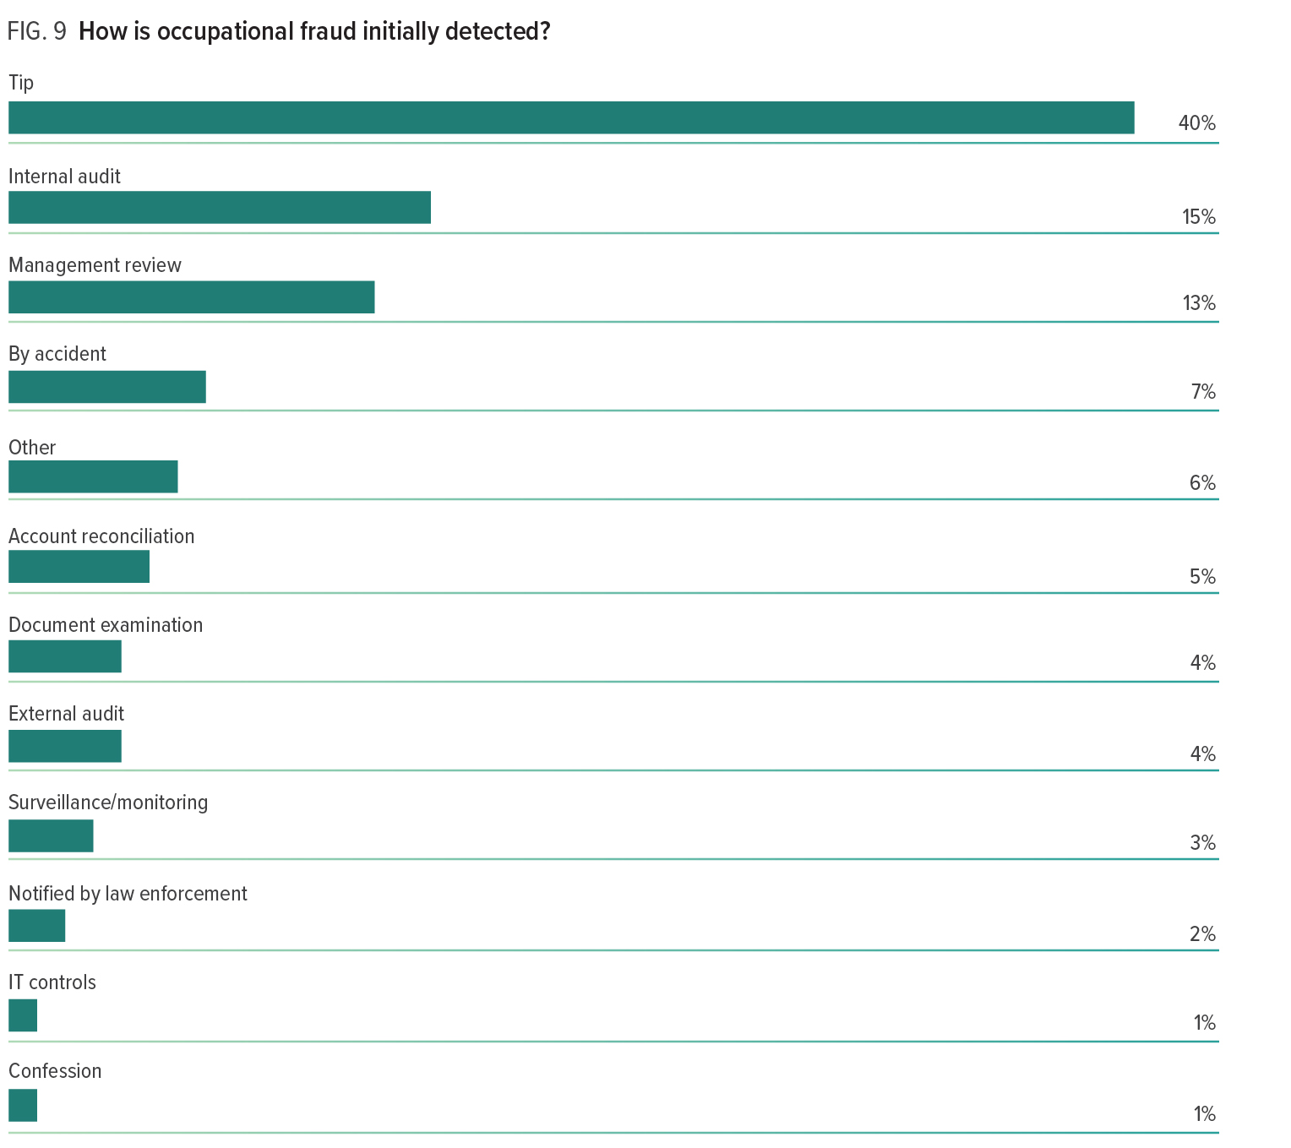
Notes:
Figure 9 shows that the leading detection methods are tips, internal audit, and management review. This finding is not surprising, as these have been the three most com-mon means of detecting occupational fraud in every edition of the report since 2010. Collectively, these three detection methods were cited in 68% of the cases in our current study. Tips were by far the most common means of detection at 40% of cases—more than internal audit (15%) and management review (13%) combined.

Slide 11
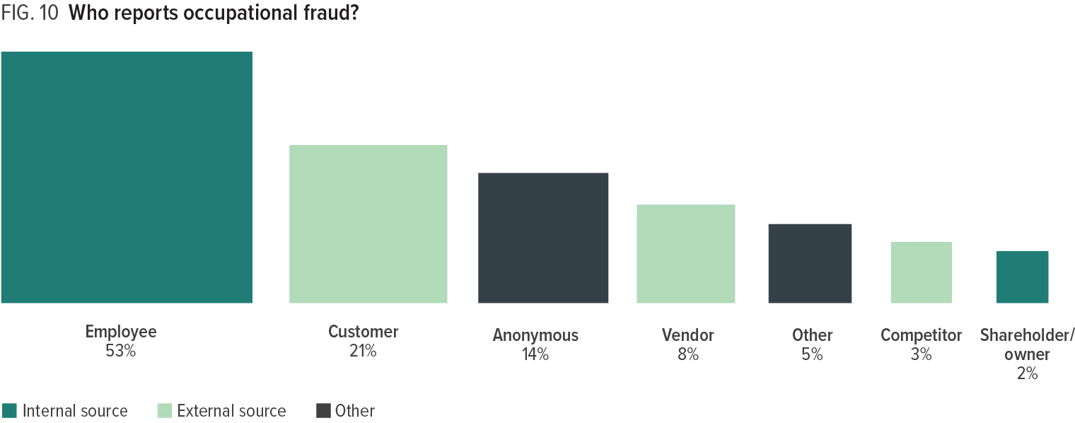
Notes:
Since tips are the most common detection method, it is important to understand where those tips come from. Figure 10 shows that slightly more than half of all tips (53%) were provided by employees of the victim organizations. Meanwhile, nearly one-third (32%) of the tips that led to fraud detection came from people outside the organization: customers, vendors, and competitors. Active cultivation of tips and complaints, such as the promotion of fraud hotlines, is often geared primarily toward employees, but this data suggests organizations should also consider promoting reporting mechanisms to outside parties, especially customers and vendors. Addition-ally, 14% of tips came from an anonymous source, demonstrating that a significant portion of those who reported fraud did not want their identities known. Whistleblowers often have a fear of being identified or retaliated against, which is why it is important that they be able to make reports anonymously where such practice is legally permissible.

Slide 12
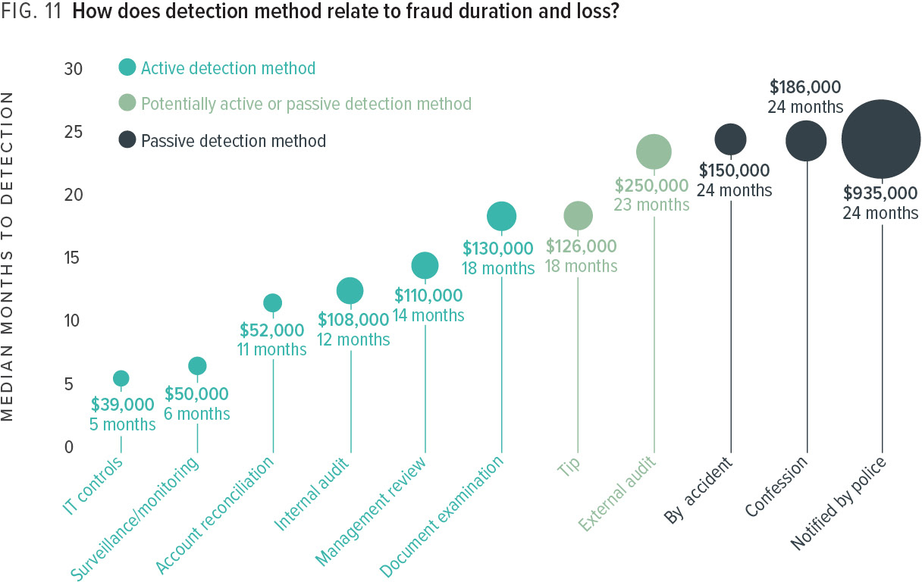
Notes:
In addition to determining the most common methods of detection, we also analyzed the median loss and duration of fraud schemes based on how they were uncovered. Our results indicate that there is a correlation between the way in which occupational fraud schemes are detected and the severity of the fraud. More importantly, the data points to steps organizations can take to detect fraud proactively and, in doing so, mitigate losses.
Figure 11 portrays the median loss and median duration for all cases, based on the method by which they were detected. We grouped each of these detection methods into three categories: active, passive, or potentially active or passive. Active detection methods (shaded teal) involve a deliberate search for misconduct from someone within the organization or an internal control designed to detect fraud. Passive detection methods (shaded black) refer to cases in which the organization discovers the fraud by accident, confession, or unsolicited notification by another party. We classified tips and external audit as potentially active or passive detection methods because those mechanisms might or might not involve proactive efforts specifically to identify fraud, depending on the circumstances.
Our findings show that median duration and median loss were relatively low in frauds that were detected by active methods. Frauds detected passively tended to last much longer and have larger median losses. For instance, frauds detected actively by IT controls tended to last five months and cause a median loss of USD 39,000, compared to schemes detected passively through notification from law enforcement, which tended to last two years and cause a median loss of almost USD 1 million. The key takeaway from this data is that organizations can reduce the impact of fraud by pursuing internal controls and policies that actively detect fraud, such as thorough management review, account reconciliation, and surveillance/monitoring. Organizations that do not actively seek out fraud are likely to experience schemes that continue for much longer and at a higher cost.

Slide 13
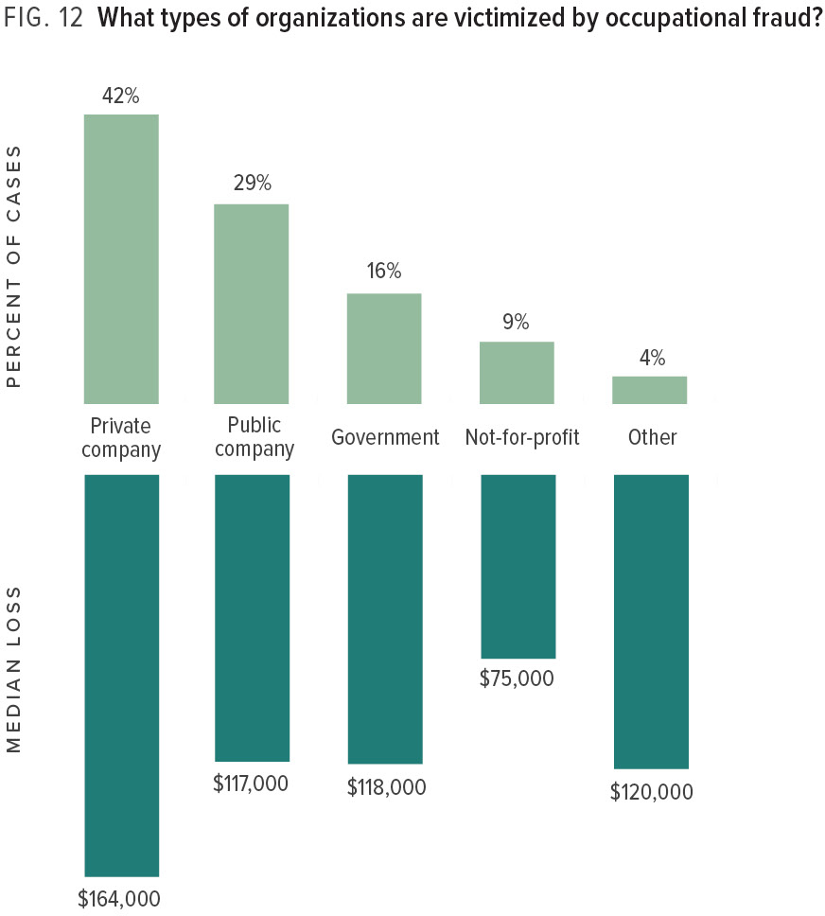
Notes:
As shown in Figure 12, more than 70% of the frauds in our study occurred at for-profit organizations, with 42% of the victim organizations being private companies and 29% being public companies. The private companies in our study suffered the greatest median loss, at USD 164,000. Not-for-profit organizations were the victim in only 9% of frauds and had the smallest median loss of USD 75,000; however, for many not-for-profit entities, financial resources are extremely limited and a loss of USD 75,000 can be particularly devastating.

Slide 14
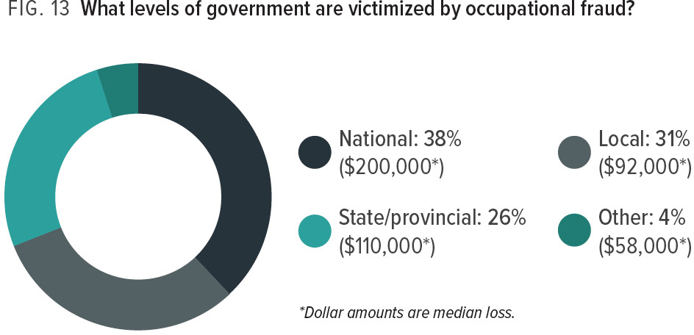
Notes:
Resources and operations vary greatly by level of government, meaning that fraud can affect these organizations differently. Consequently, we broke down the government fraud cases in our study based on the level of government agency involved. While there was not a large variation in the percentage of schemes that occurred at local, state/provincial, and national levels, the frauds at national-level agencies tended to be much larger, causing a median loss approximately twice as large as the losses experienced by local and state/provincial governments (see Figure 13).

Slide 15
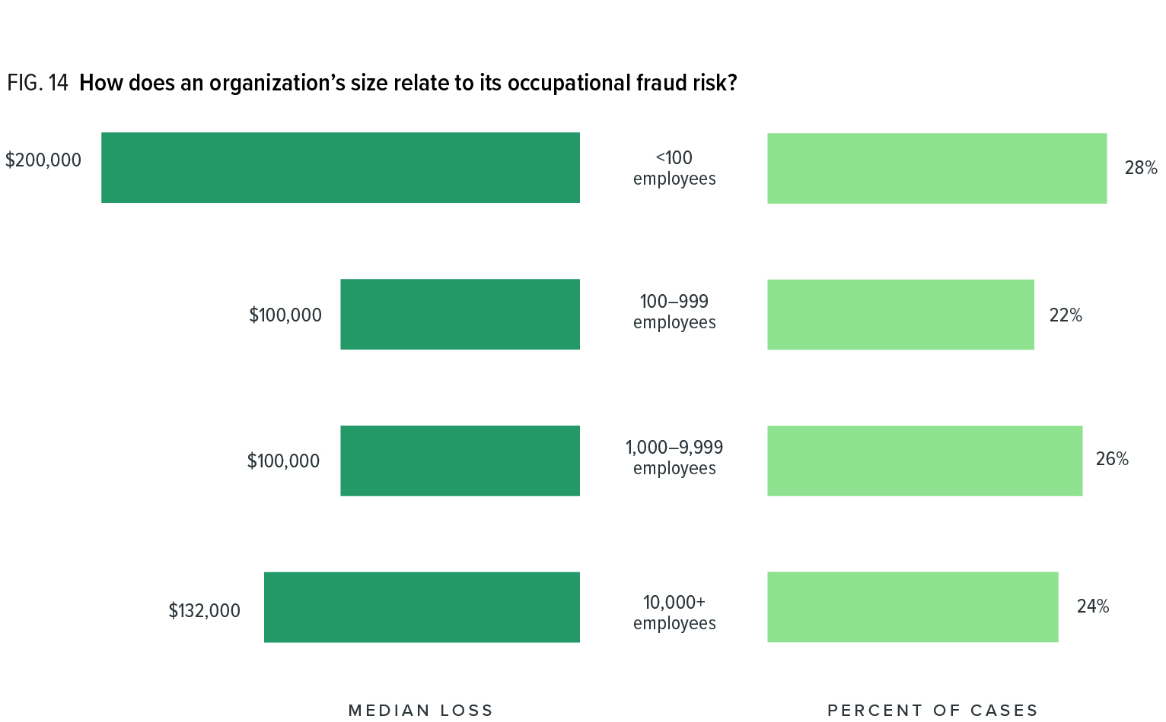
Notes:
The size of an organization’s staff can directly affect both the opportunity for fraud and the ability to enact certain anti-fraud mechanisms. Larger entities typically have more resources to invest in their anti-fraud programs, as well as a greater ability to separate duties among staff members to help prevent fraud; however, the large staff size can also mean more potentially dishonest employees who might attempt schemes and more complex processes and transactions, which can increase the risk of fraud.
To provide some insight into the relative risks of fraud for organizations of various sizes, we analyzed the cases reported to us based on the number of employees at the victim organization. Figure 14 shows that small organizations (those with fewer than 100 employees) both experienced the greatest percentage of cases in our study (28%) and suffered the largest median loss (USD 200,000). See “Fraud in Small Businesses” infographic for more information about how fraud affects these organizations.

Slide 16
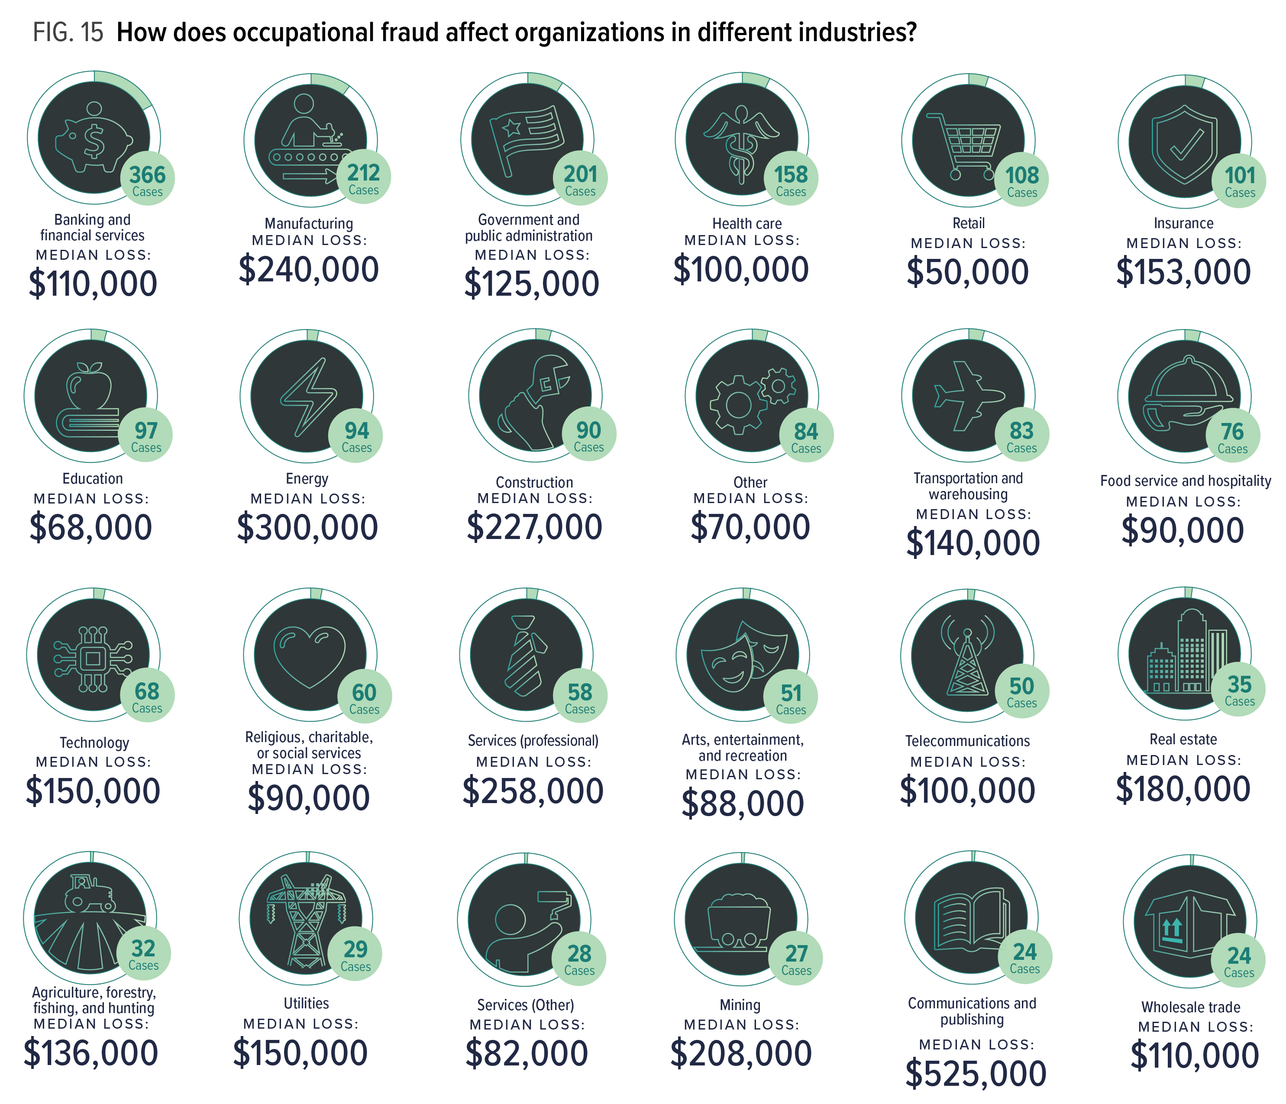
Notes:
In addition, we examined the cases reported to us based on the industry of the victim organization. The greatest number of cases in our study occurred in the banking and financial services, manufacturing, and government and public administration sectors. Readers should note that this data likely represents the industries that most often employ CFEs, rather than the industries that are most susceptible to fraud. However, information about occupational fraud in various industries can be useful for benchmarking purposes.

Slide 17
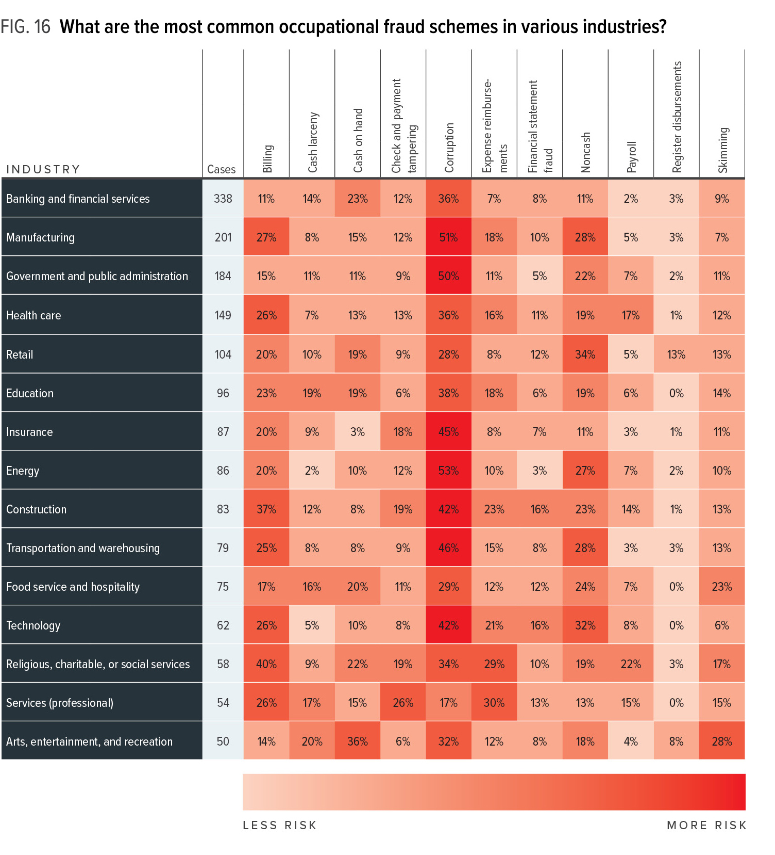
Notes:
Understanding the frequency of specific fraud schemes within different industries can help organizations assess and design controls to guard against the schemes that pose the most significant threats. Figure 16 provides a heat map showing the relevant risk for each category of occupational fraud in every industry that had at least 50 reported cases in our study. Boxes are shaded from light to dark red based on the respective level of occurrence, with darker boxes indicating higher-frequency schemes.
Corruption poses a significant risk to several industries, with the most common occurrence of corruption schemes in the energy, manufacturing, and government and public administration sectors. Skimming schemes were also notably more common in the arts, entertainment, and recreation and the food service and hospitality industries than elsewhere, while payroll schemes occurred more frequently in the religious, charitable, or social services and the health care sectors. Interestingly, the cases that occurred in religious, charitable, or social services organizations also tended to involve the most crossover between scheme types, meaning the perpetrators in these cases used many different schemes to defraud the victims, rather than limiting their frauds to one specific area.

Slide 18
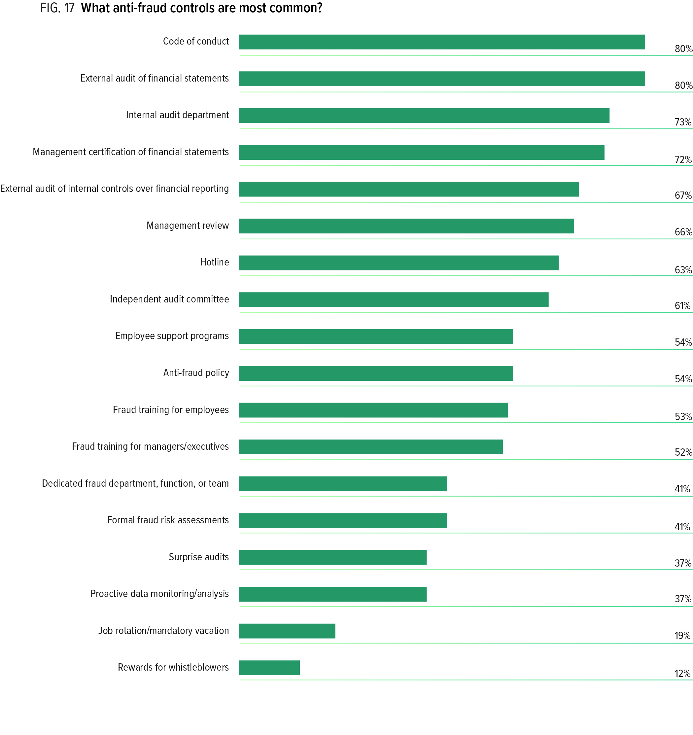
Notes:
The presence of a robust system of anti-fraud controls can be a powerful deterrent, as well as a proactive prevention and detection mechanism, in the fight against fraud. Thus, organizations can benefit from knowing which anti-fraud controls are commonly used by their peers, as well as which tend to be the most effective. To help explore this information, we provided survey respondents with a list of 18 entity-level, anti-fraud controls and asked which, if any, were present at the victim organization at the time the fraud occurred. As noted in Figure 17, 80% of the organizations had a code of conduct and underwent external financial statement audits, while 73% had internal audit departments, and 72% had company management certify the financial statements. On the other end of the spectrum, 19% of organizations had policies requiring job rotation or mandatory vacation, and only 12% provided rewards for whistleblowers.

Slide 19
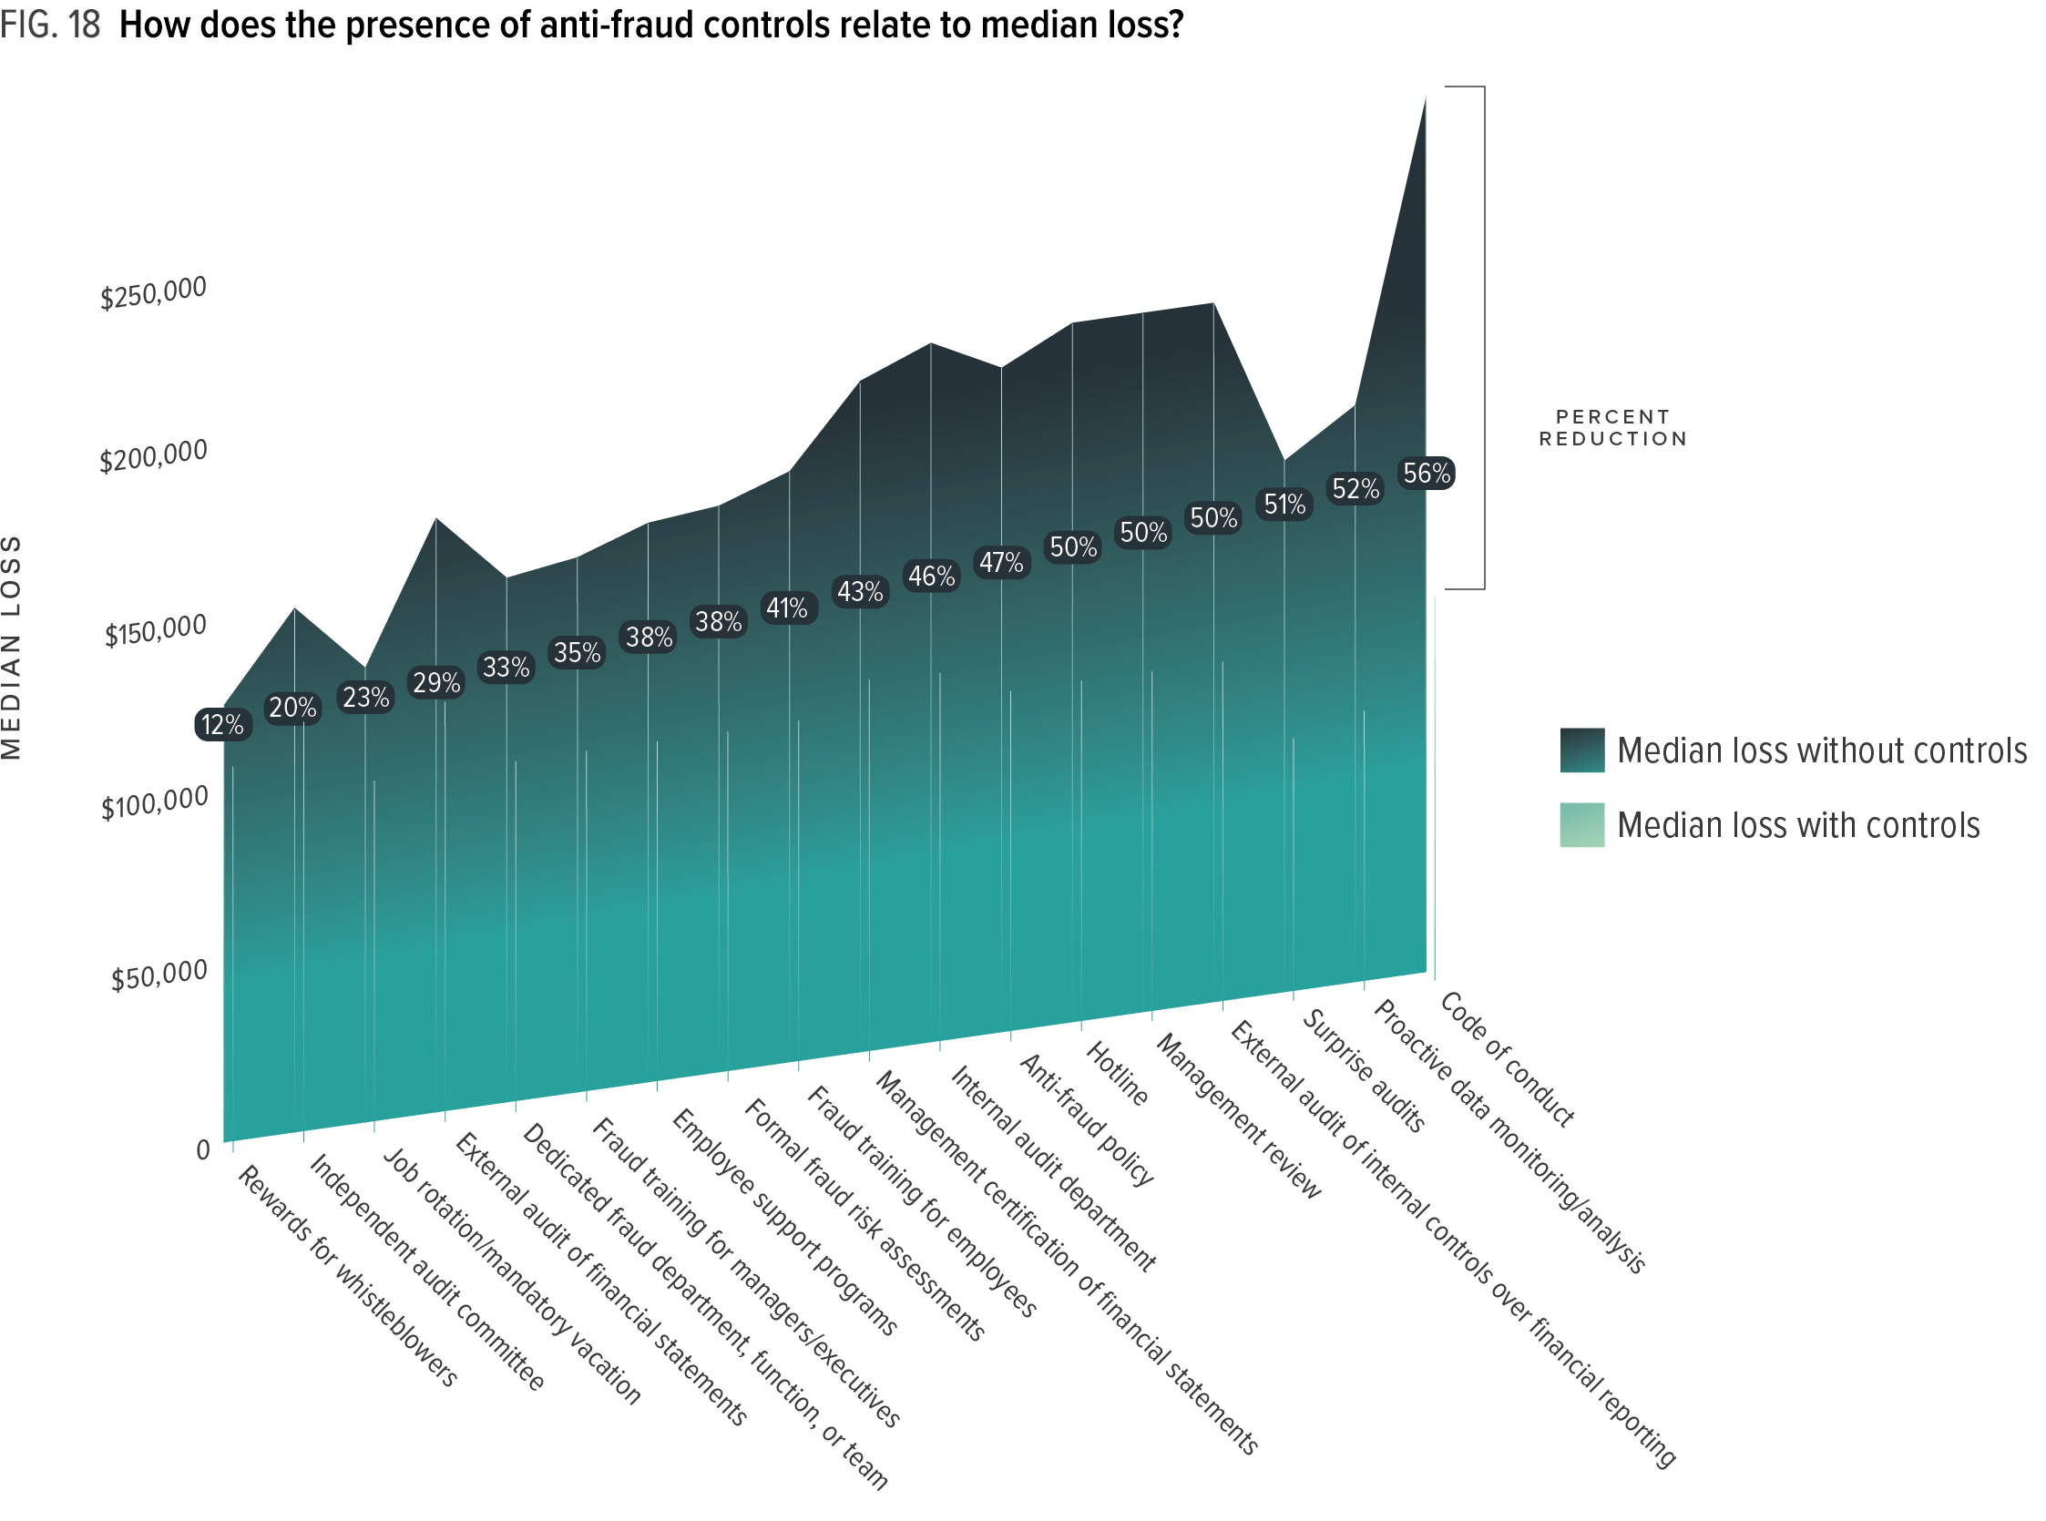
Notes:
Demonstrating the return on investment in anti-fraud initiatives can be a difficult task, as it is nearly impossible to measure the amount of fraud prevented by a specific control. However, many anti-fraud professionals find themselves needing to make a business case to justify additional fraud prevention and detection initiatives. To provide some visibility into the relative effectiveness of various anti-fraud controls, we compared the losses experienced by the victim organizations that had specific controls in place against the losses experienced by those that had not implemented each control. The results of this analysis are provided in Figure 18. Interestingly, the presence of every control we analyzed was correlated with lower fraud losses. For example, the use of proactive data monitoring and analysis and surprise audits was associated with a more than 50% reduction in fraud losses.

Slide 20
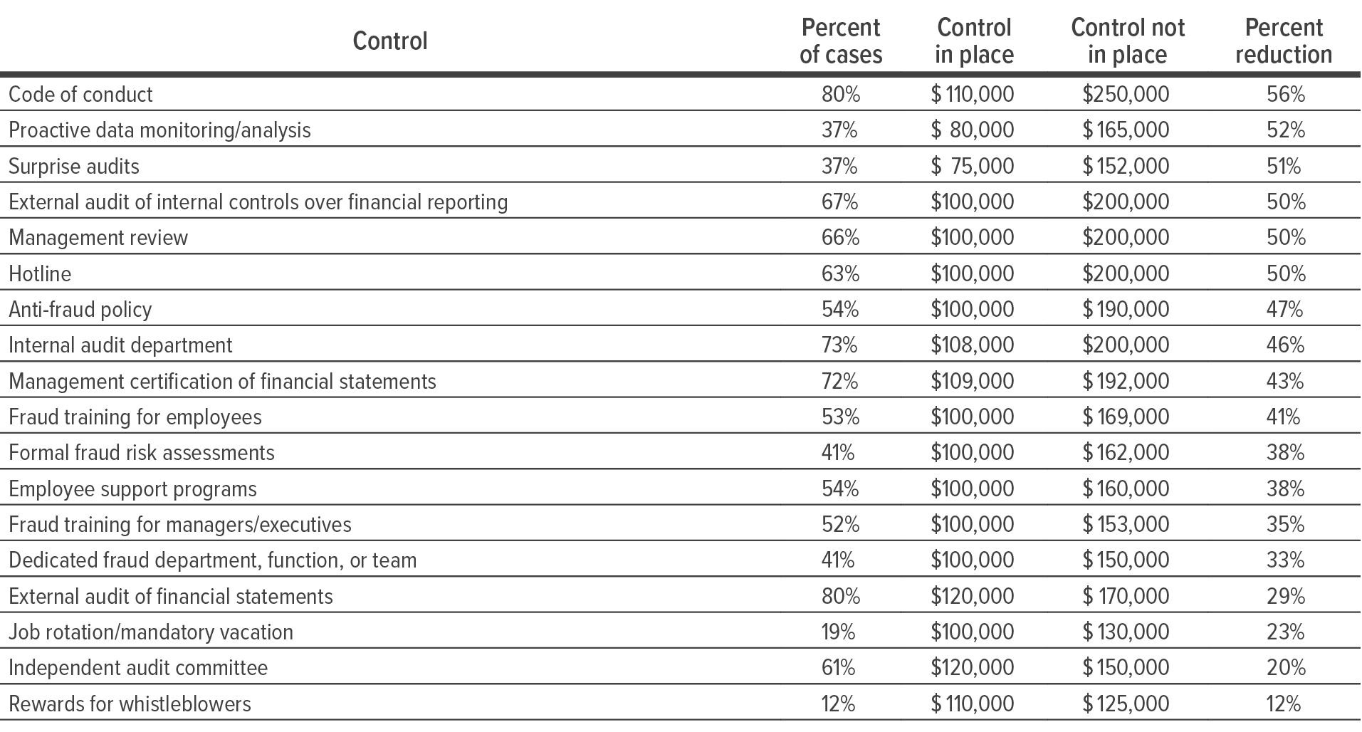
Notes:
Demonstrating the return on investment in anti-fraud initiatives can be a difficult task, as it is nearly impossible to measure the amount of fraud prevented by a specific control. However, many anti-fraud professionals find themselves needing to make a business case to justify additional fraud prevention and detection initiatives. To provide some visibility into the relative effectiveness of various anti-fraud controls, we compared the losses experienced by the victim organizations that had specific controls in place against the losses experienced by those that had not implemented each control. The results of this analysis are provided in Figure 18. Interestingly, the presence of every control we analyzed was correlated with lower fraud losses. For example, the use of proactive data monitoring and analysis and surprise audits was associated with a more than 50% reduction in fraud losses.

Slide 21
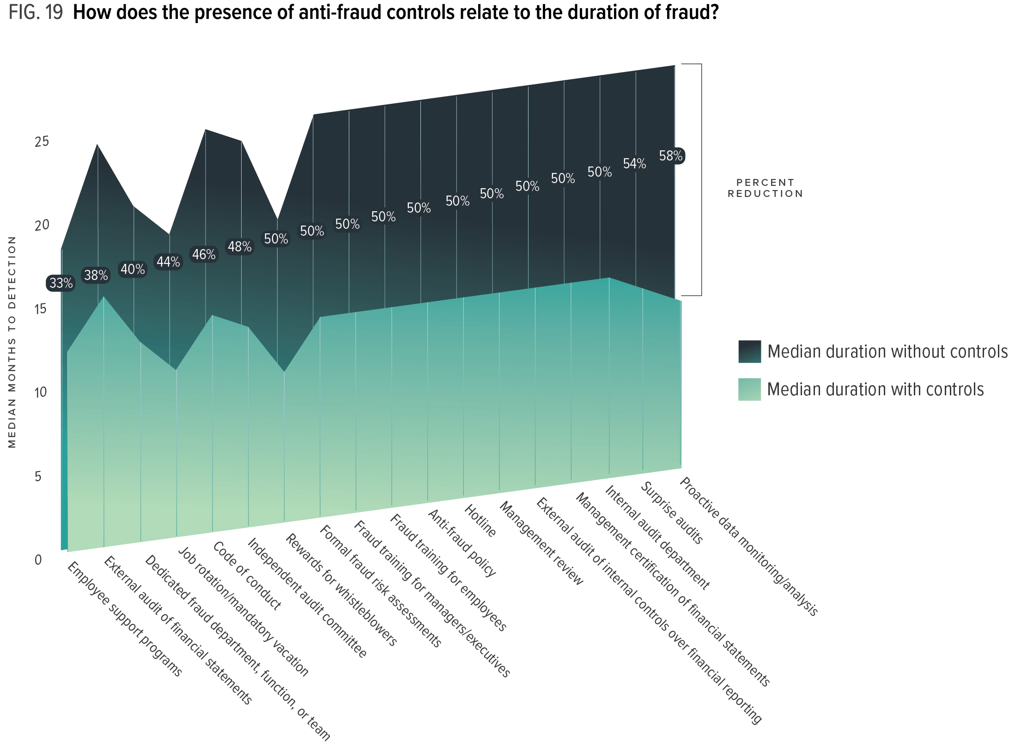
Notes:
We similarly analyzed the duration of fraud schemes based on the presence or absence of each anti-fraud control (see Figure 19). Data monitoring and analysis and surprise audits were correlated with the most significant reductions in fraud duration; as these two controls were also associated with some of the largest loss reductions, our data indicates that they are among the most useful tools in the fight against fraud.

Slide 22
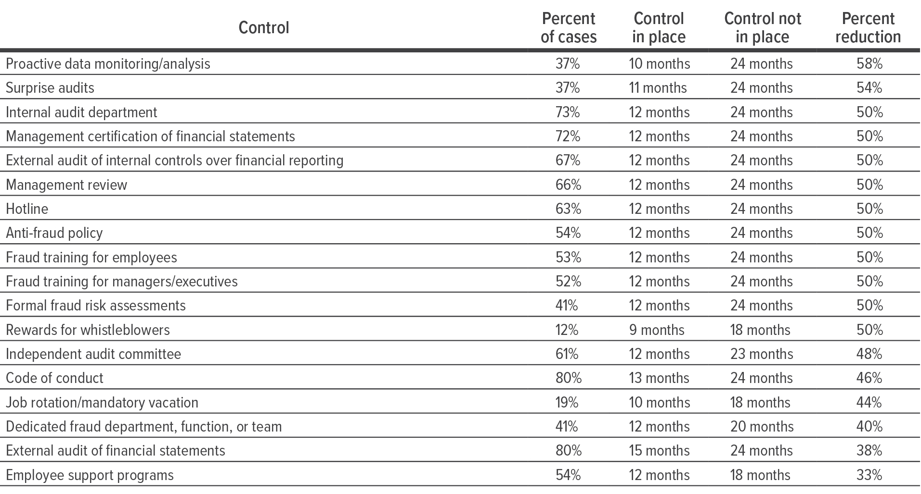
Notes:
We similarly analyzed the duration of fraud schemes based on the presence or absence of each anti-fraud control (see Figure 19). Data monitoring and analysis and surprise audits were correlated with the most significant reductions in fraud duration; as these two controls were also associated with some of the largest loss reductions, our data indicates that they are among the most useful tools in the fight against fraud.

Slide 23
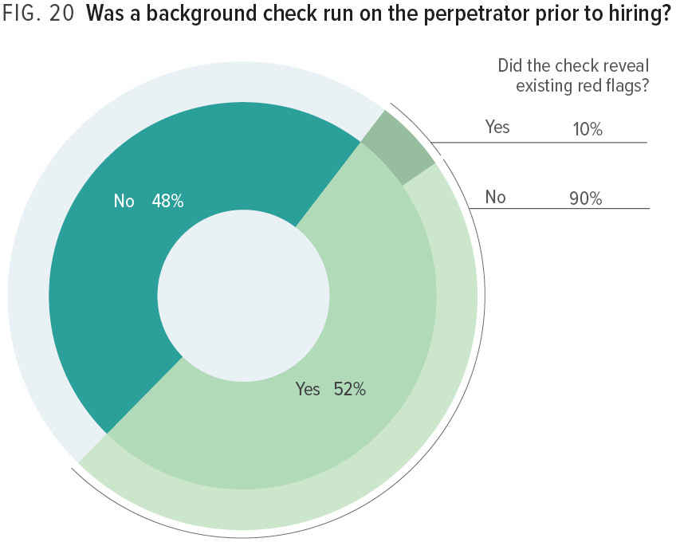
Notes:
Effectively preventing fraud begins with ensuring that the organization hires ethical employees. As part of our study, we examined whether the victim organizations ran a background check on the perpetrator prior to hiring him or her, as well as whether the background check revealed any potential indicators of the employee’s dishonesty. As noted in Figure 20, 52% of the organizations ran background checks, while 48% did not. Of the organizations that did run a check before hiring the perpetrator, 10% were alerted to a red flag regarding the perpetrator but chose to hire the person anyway.

Slide 24
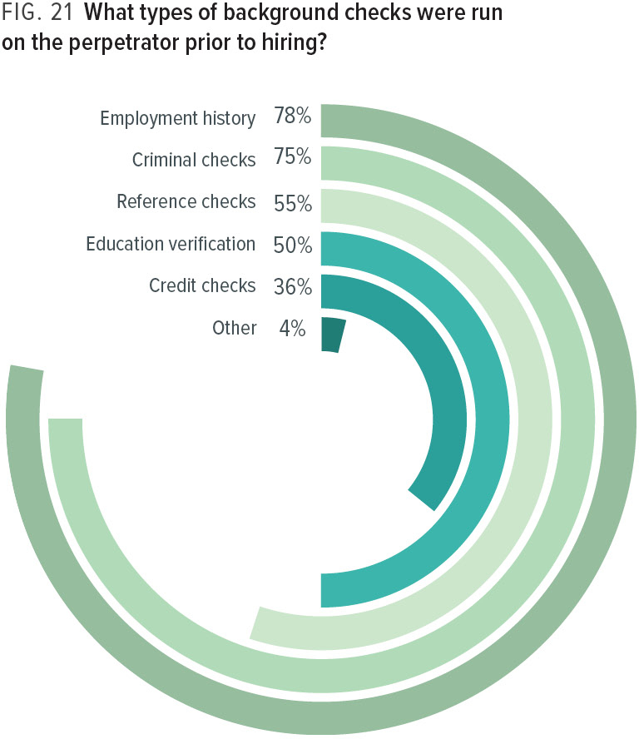
Notes:
We also asked about the types of background checks used by the victim organizations in our study. Figure 21 shows that these organizations were most likely to look into the individual’s employment and criminal history, with three-quarters or more of the background checks covering these areas.

Slide 25
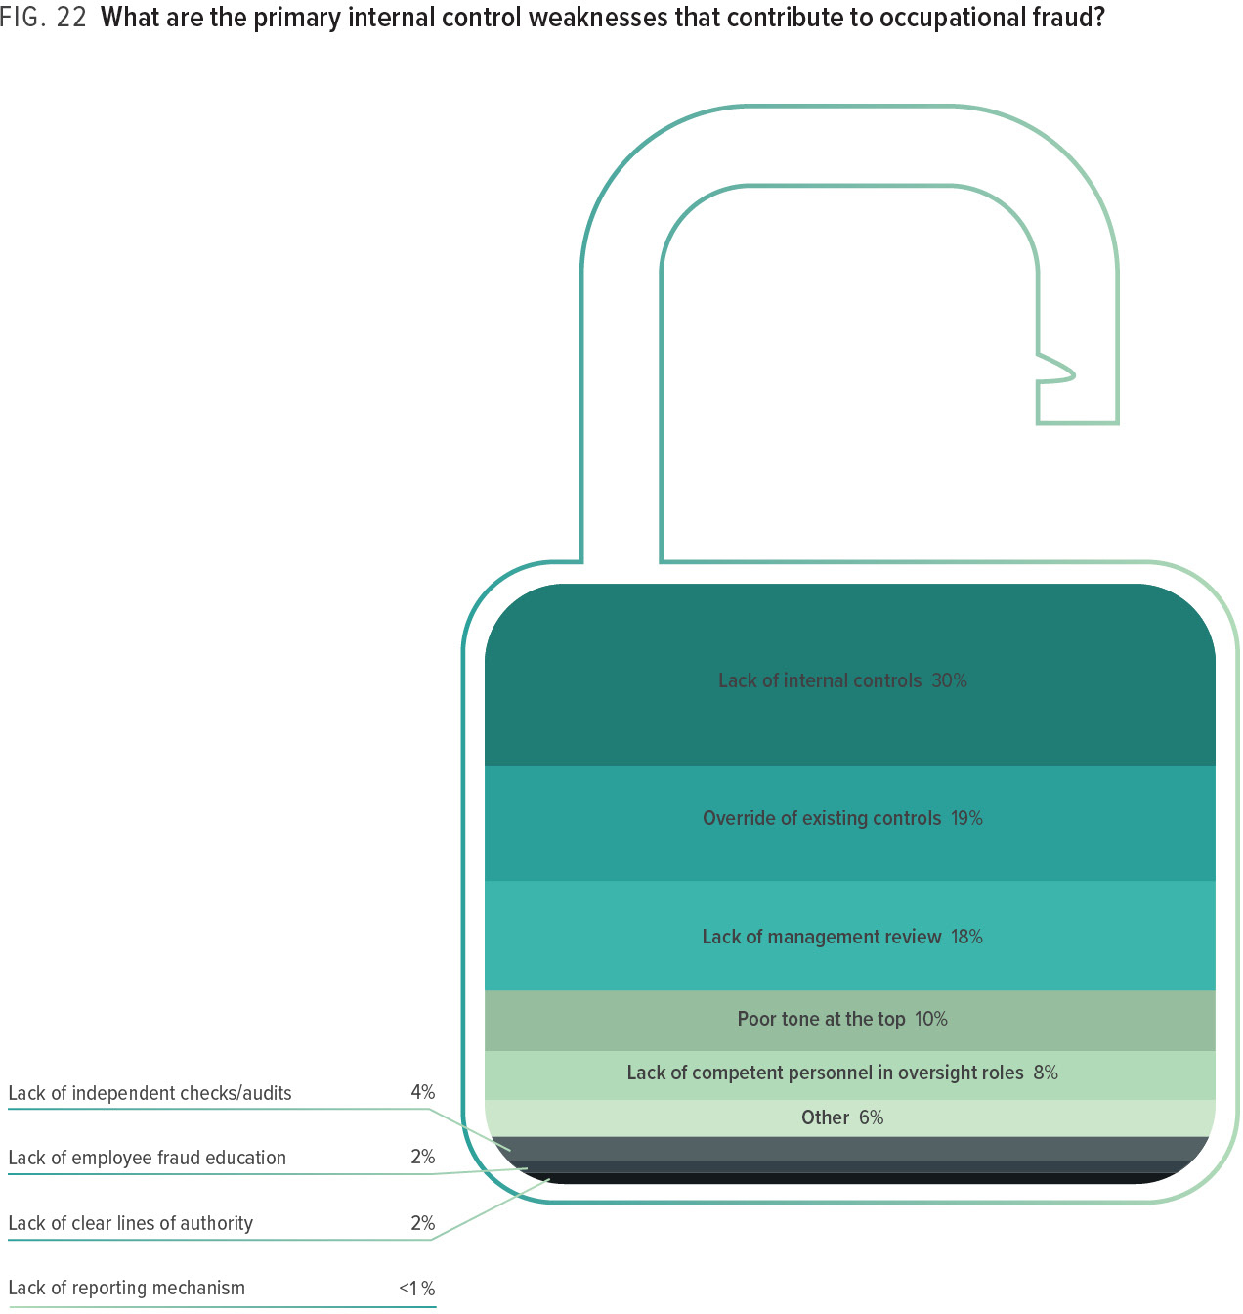
Notes:
Understanding the factors that can lead to fraud is the foundation of preventing future occurrences. Consequently, we asked survey respondents what they perceived to be the primary internal control weakness that contributed to the fraud they reported. In 30% of cases, a simple lack of controls was the main factor that enabled the fraud to occur, while another 19% of cases occurred because the perpetrator was able to override the controls that had been put in place.

Slide 26
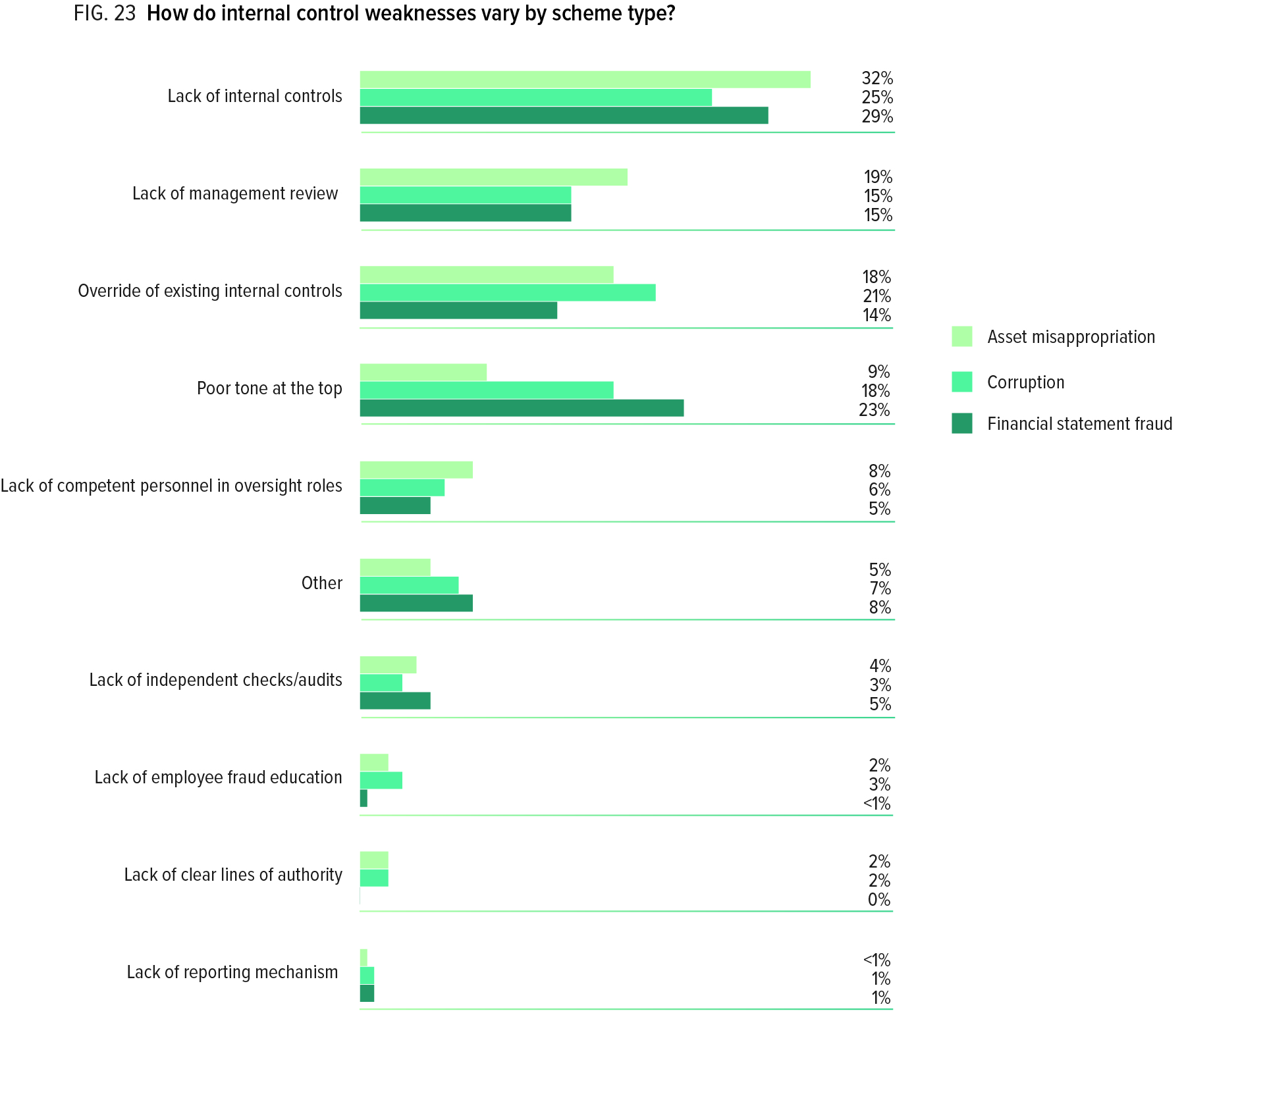
Notes:
We also analyzed these control weaknesses based on the category of fraud involved in the scheme (see Figure 23). Not surprisingly, a poor tone at the top was much more likely to be the primary factor in financial statement fraud and corruption cases than in asset misappropriation cases. However, it is interesting to note that a lack of internal controls is more common in asset misappropriation and financial statement frauds, while corruption schemes are more likely than other schemes to involve an override of existing controls. In addition, a lack of management review is more commonly the reason for asset misappropriation schemes than other forms of fraud.

Slide 27
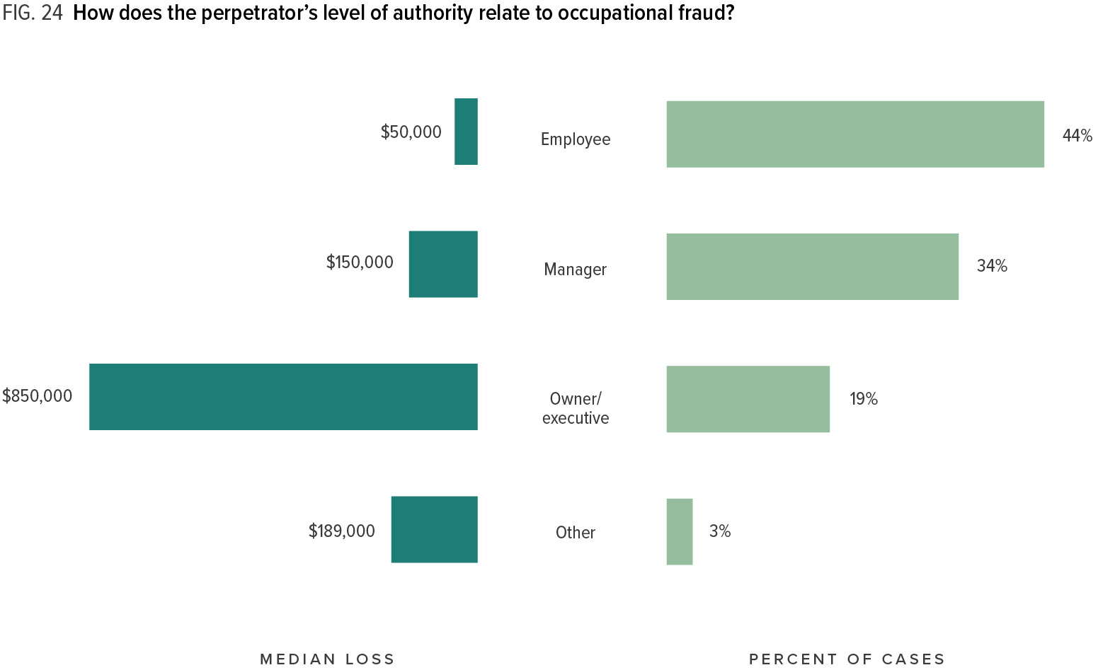
Notes:
As seen in Figure 24, there is a strong correlation between the fraud perpetrator’s level of authority and the size of the fraud. While owners/executives only committed 19% of the frauds in our study, the schemes committed by these individuals resulted in a median loss of USD 850,000, which was nearly six times larger than the median loss caused by managers, and 17 times larger than the median loss caused by low-level employees. A significant correlation between authority and fraud loss has been found in every edition of the report dating back to 1996. This correlation likely reflects the fact that high-level fraudsters tend to have greater access to an organization’s assets than low-level personnel. They may also have greater technical ability to commit and conceal fraud, and they might be able to use their authority to override or conceal their crimes in ways that low-level employees cannot.

Slide 28
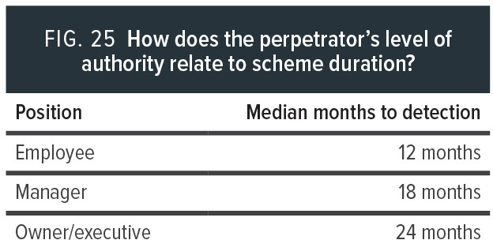
Notes:
One reason frauds committed by high-level perpetrators are more costly could be that their schemes tend to last longer. The median duration of a scheme committed by an owner/executive was 24 months, compared to 18 months for schemes committed by managers and 12 months for those committed by employees (See Figure 7 for more information on the correlation between fraud duration and median loss.).

Slide 29
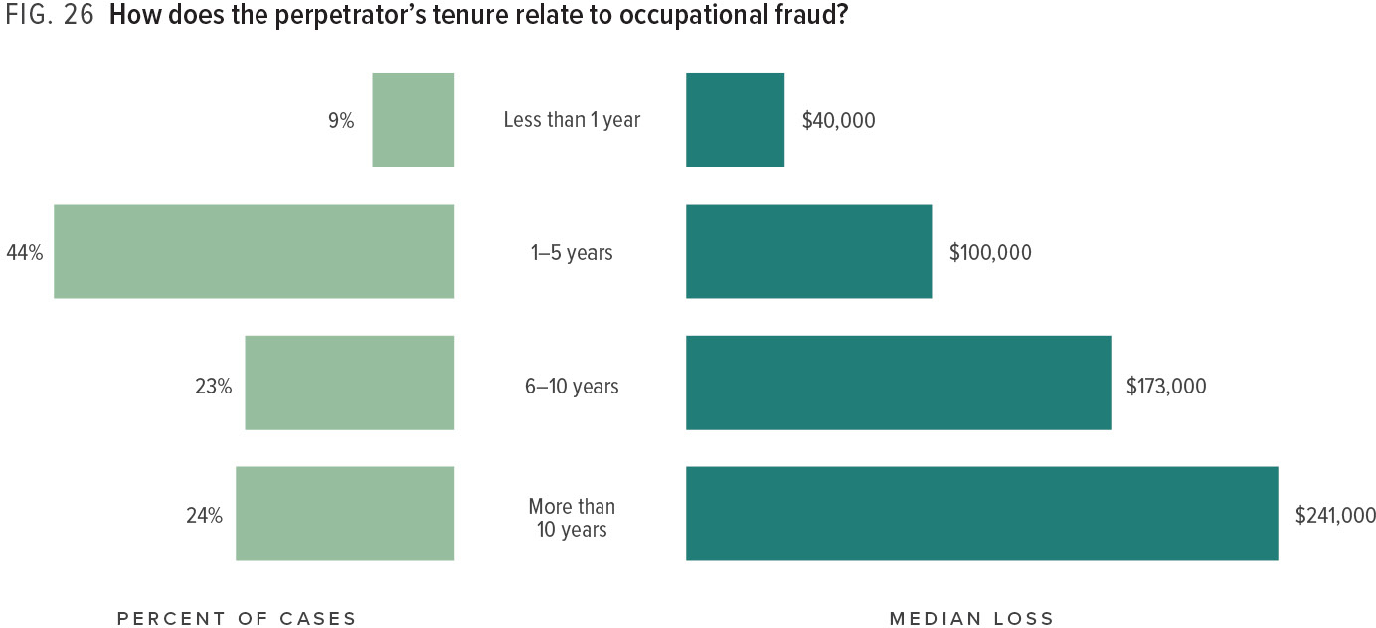
Notes:
As Figure 26 shows, fraud losses tend to increase based on how long the fraud perpetrator worked for the victim organization. Perpetrators with less than one year of tenure caused a median loss of USD 40,000, while those with more than ten years’ experience at the victim organization caused a median loss of USD 241,000, more than six times as high.
One possible explanation for the correlation be-tween tenure and fraud loss might be that employees who have been with an organization for long periods of time are often promoted to positions of greater authority. As seen in Figure 24, there is a strong correlation between authority and fraud loss.

Slide 30
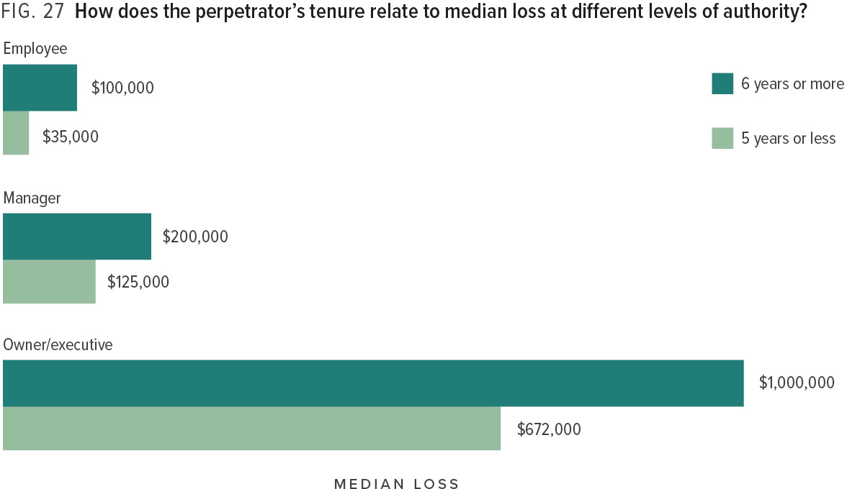
Notes:
To test this explanation, we separated all fraud offenders into two groups: those who had been with their organizations five years or fewer, and those who had been with their organizations six years or more. We then compared the median loss for these two groups across similar levels of authority. Interestingly, at every level, the more tenured fraudsters caused significantly larger losses than their less tenured counterparts. This indicates that the correlation between tenure and fraud loss to some extent operates independently from the offender’s level of authority. We believe it is likely that those with longer tenure at a victim organization tend to have a better understanding of the organization’s controls and processes—including gaps or weaknesses in those processes—which may enable them to do a better job of committing and concealing fraud. In a sense, these perpetrators are learning from experience how to steal from their employers.

Slide 31
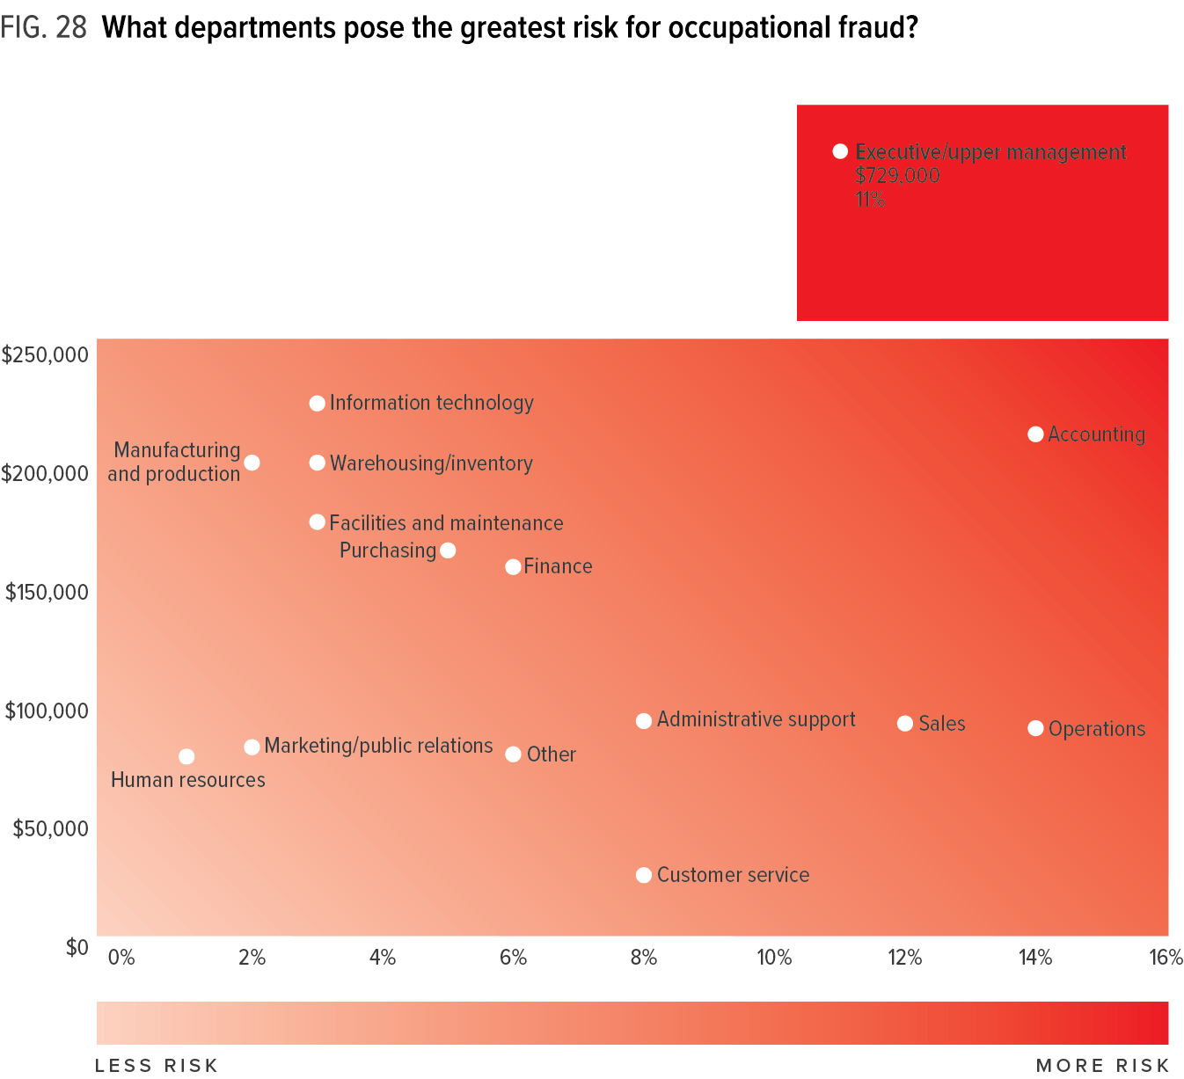
Notes:
Figure 28 shows the frequency and median loss in fraud cases based on where the fraudster worked within the victim organization. This heat map provides a visual representation of the relative fraud risks posed by various departments. For example, we can see that accounting and operations were each responsible for 14% of the frauds in our study, but the median loss caused by those in the accounting department (USD 212,000) was significantly larger than the median loss from operations (USD 88,000). Frauds committed by those in executive or upper-management roles were slightly less common, but much costlier.

Slide 32
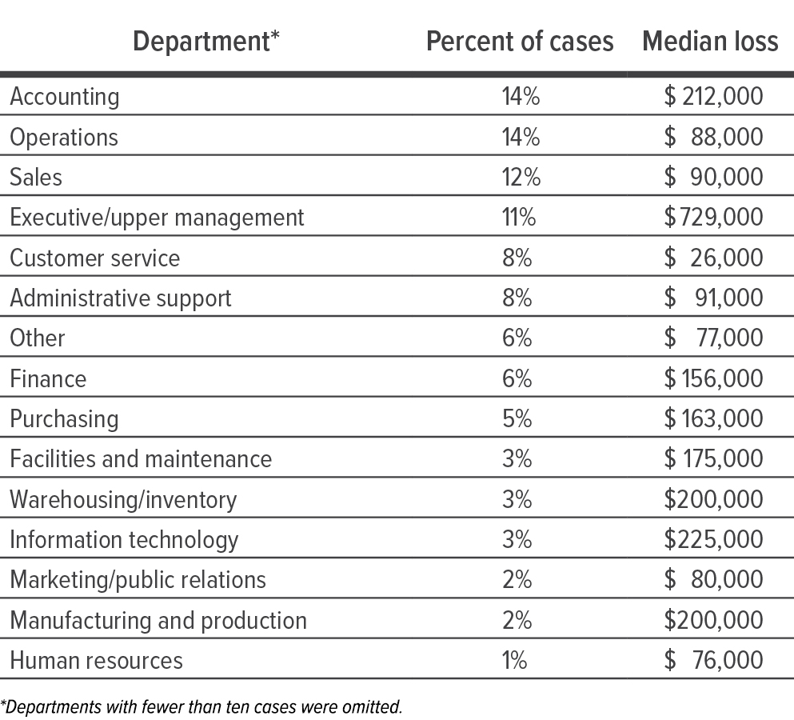
Notes:
Figure 28 shows the frequency and median loss in fraud cases based on where the fraudster worked within the victim organization. This heat map provides a visual representation of the relative fraud risks posed by various departments. For example, we can see that accounting and operations were each responsible for 14% of the frauds in our study, but the median loss caused by those in the accounting department (USD 212,000) was significantly larger than the median loss from operations (USD 88,000). Frauds committed by those in executive or upper-management roles were slightly less common, but much costlier.

Slide 33
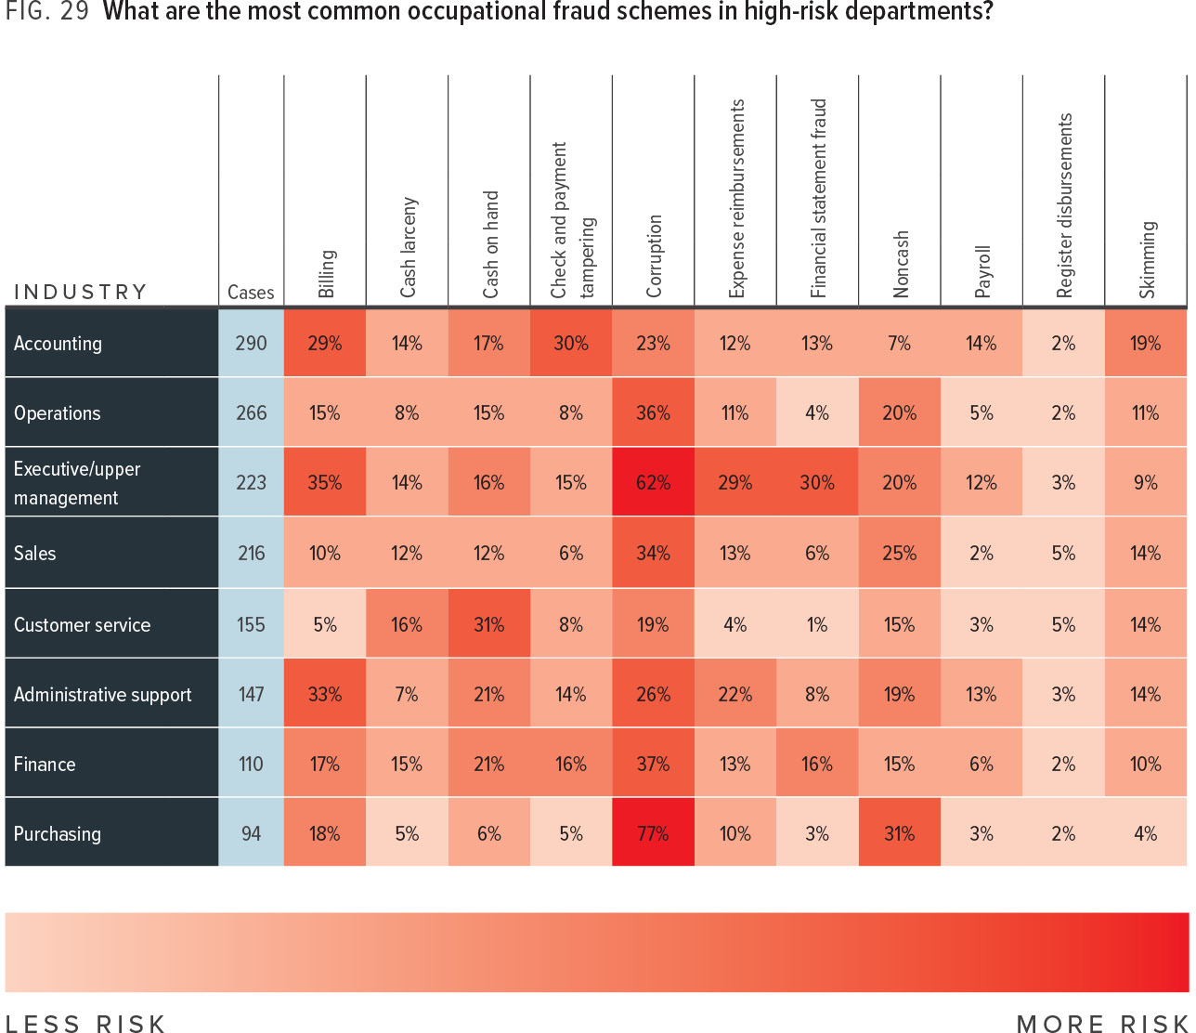
Notes:
Overall, 77% of the occupational frauds in our study came from eight departments: accounting, operations, sales, executive/upper management, customer service, administrative support, finance, and purchasing. Figure 29 shows the relative frequency of various fraud schemes in each of those departments. Boxes are shaded from light to dark red based on the frequency for each particular scheme, with darker boxes indicating higher levels of risk. This data should be useful for organizations to assess risk and develop effective anti-fraud controls in the departments most likely to be occupational fraud hotspots.

Slide 34
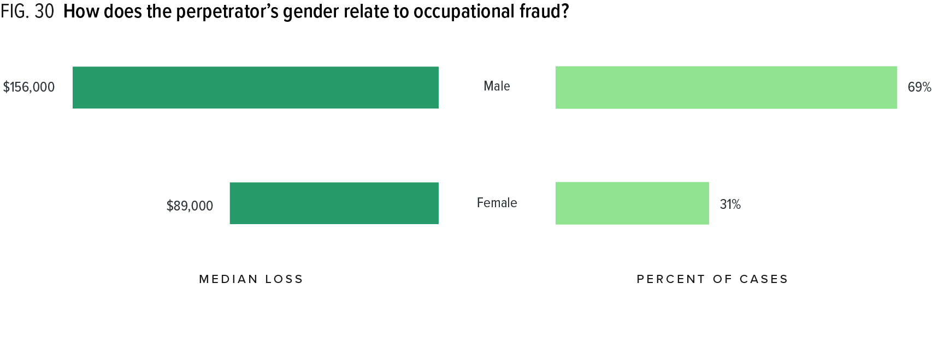
Notes:
Figure 30 shows that a sizeable majority of the fraudsters in our study (69%) were males. Men also caused much larger median losses (USD 156,000) than females (USD 89,000). This is consistent with our past studies, which have all shown males to be responsible for between 65% and 70% of frauds along with a significant disparity in fraud loss.

Slide 35
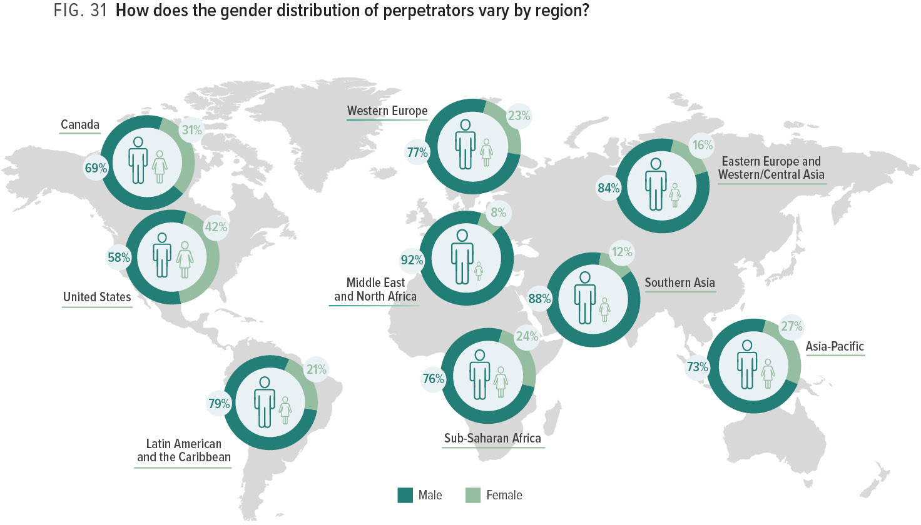
Notes:
The gender distribution of occupational fraudsters varies significantly by region. As seen in Figure 31, in the United States men accounted for 58% of all occupational frauds, whereas in the Middle East and North Africa this figure was 92%.

Slide 36
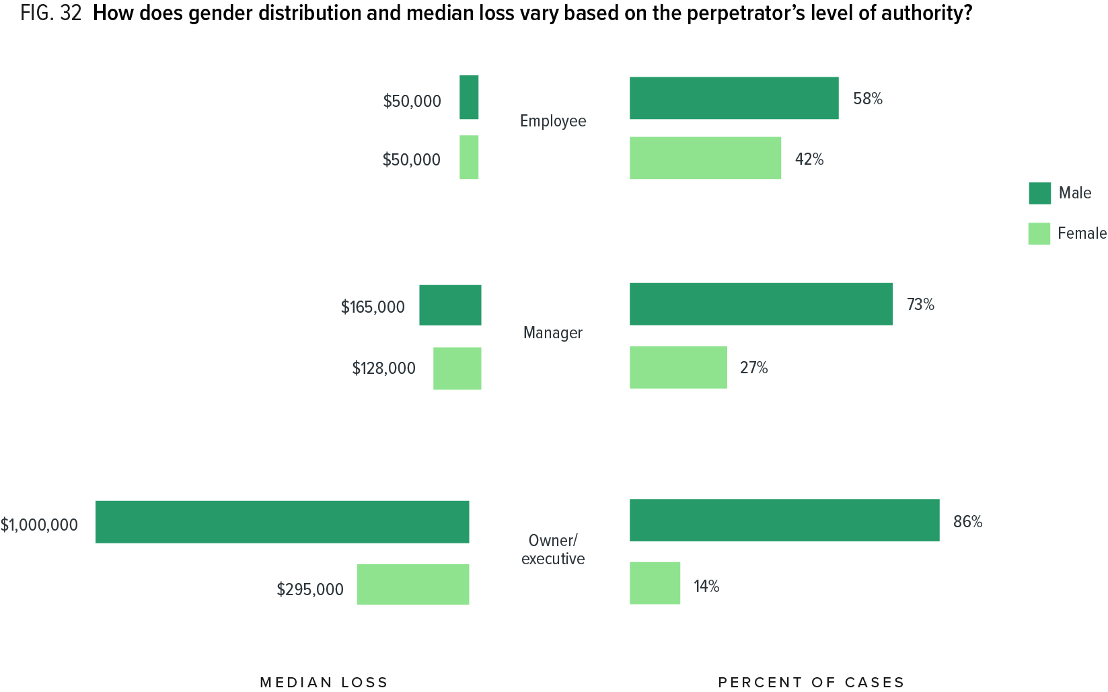
Notes:
One possible reason that fraud losses caused by men are larger than those caused by women could be related to levels of authority. As shown in Figure 24, fraudsters with high levels of authority (e.g., executives and owners) tend to cause much larger losses than those with low authority (e.g., rank-and-file employees).
Figure 32 shows that the pro-portion of male fraudsters rises with the perpetrators’ level of authority. At the employee level, only 58% of fraudsters were male, but that number increased to 73% for managers and 86% for owners/executives. Given that there were far more men than women in higher levels of authority in our dataset, we would expect the median loss for males to be larger.
But interestingly, even when we account for authority level, males still tend to cause significantly larger losses than females in managerial and owner/executive roles. Male owners/executives caused a median loss of USD 1 million, as opposed to a median loss of USD 295,000 caused by female owners/executives. Among managers there was also a gender discrepancy in median loss, although not nearly as large. At the employee level, male and female median losses were equal.

Slide 37
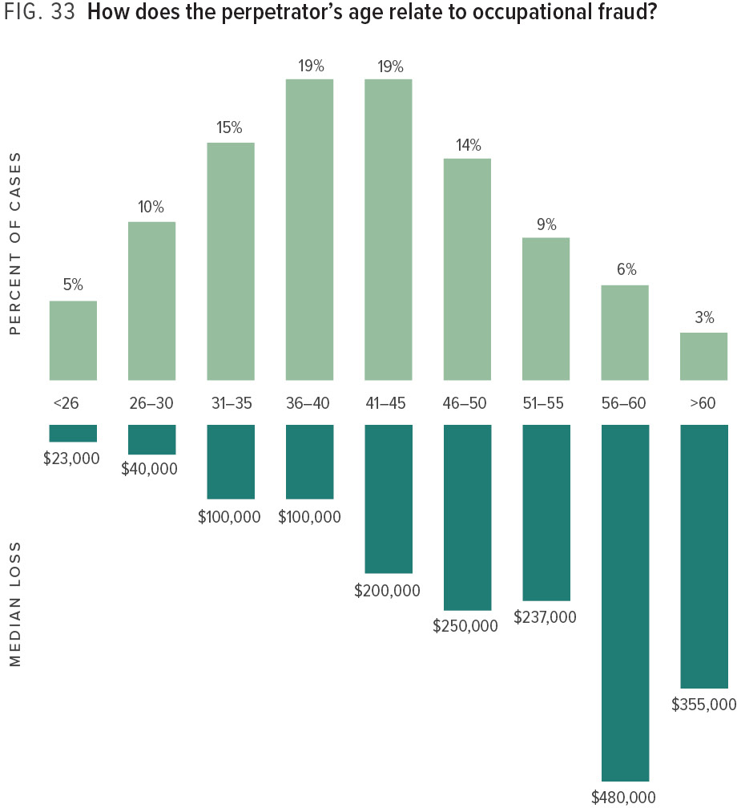
Notes:
The age distribution of occupational fraudsters is roughly bell-shaped, as seen in Figure 33. Losses, however, tend to rise with the age of the fraudster. The largest median losses in our study were caused by fraudsters in the oldest age ranges (56 and older), while those who were 30 or younger caused a much smaller amount of damage.

Slide 38
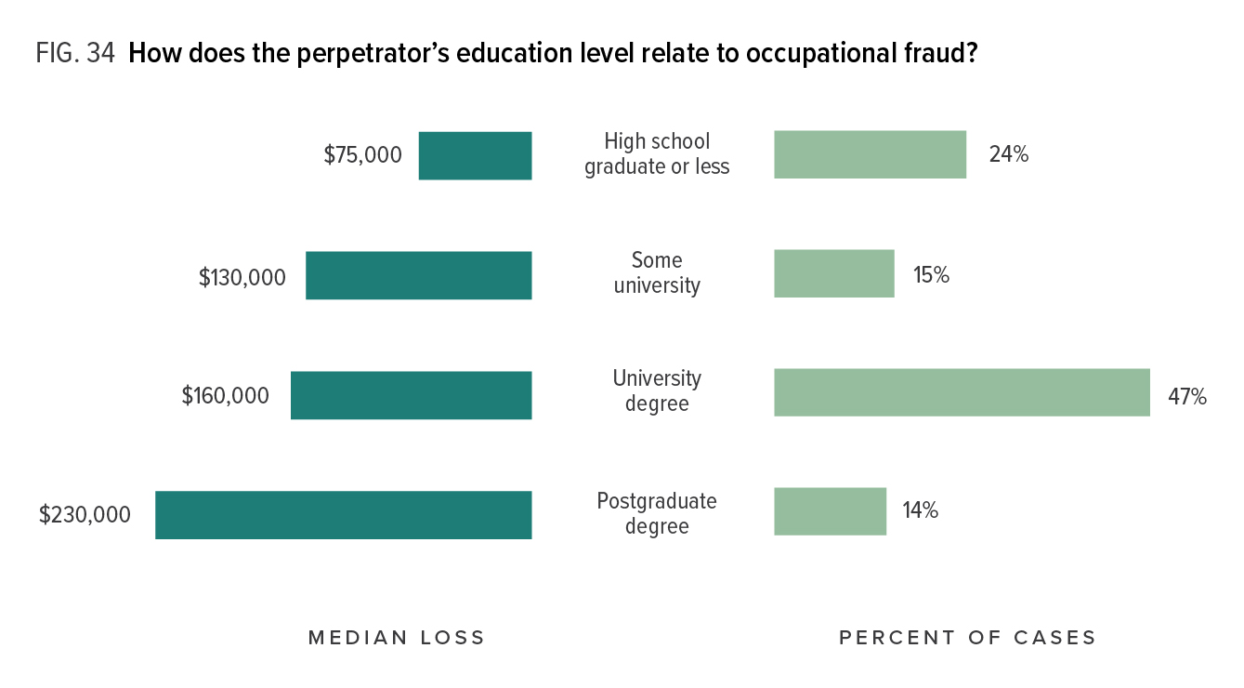
Notes:
Figure 34 shows there is also a correlation between the fraudster’s education level and the size of the fraud. Those with a postgraduate degree caused a median loss of USD 230,000 and those with a university degree caused a median loss of USD 160,000. Both of these figures were much higher than the median loss of schemes by fraudsters with a high school degree or less.
This data might indicate that highly educated fraudsters have superior technical abilities or knowledge that make them more effective at committing fraud, but it is also probably influenced by the fraudster’s position of authority. More highly educated individuals tend to occupy higher positions within an organization. For example, in our study approximately 68% of those with a university or postgraduate degree were either managers or owners/executives.

Slide 39
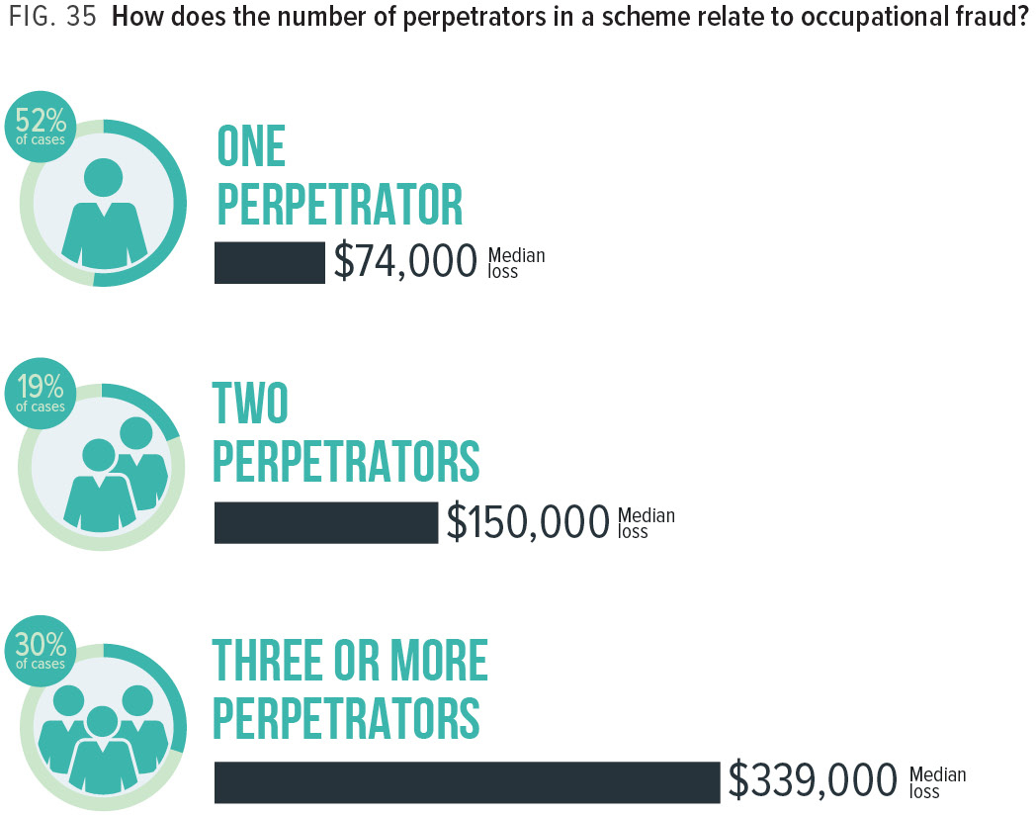
Notes:
Approximately half of the cases in our study involved multiple perpetrators who colluded with one another to commit fraud. As Figure 35 illustrates, fraud losses rose significantly when more than one fraudster was involved in a scheme. One likely explanation for this finding is that many anti-fraud controls work on the principles of separation of duties and independent checks. When multiple perpetrators conspire in a fraud scheme, they can circum-vent the system of independent verification that might otherwise detect fraud.

Slide 40
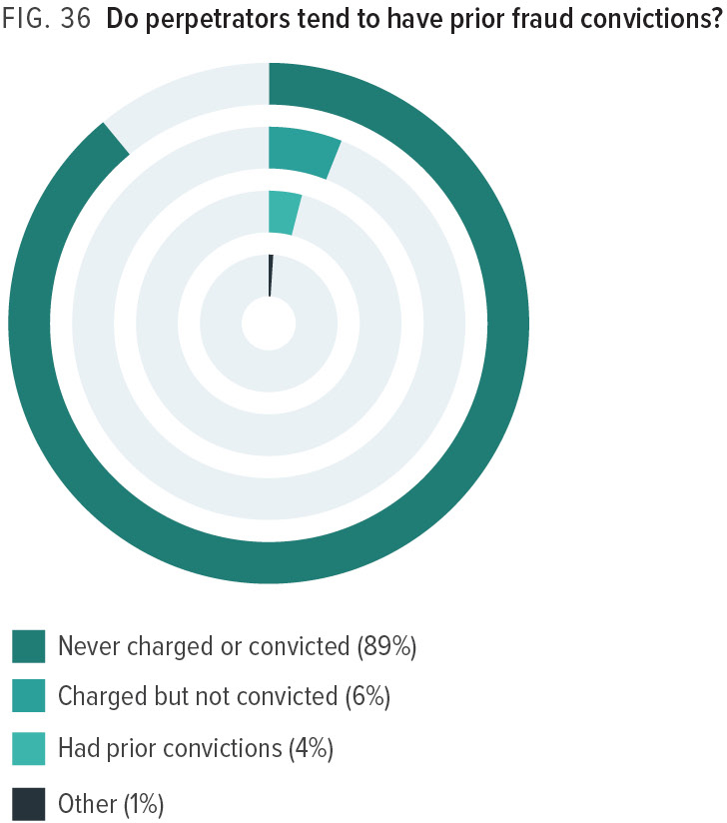
Notes:
The vast majority of occupational fraudsters have no prior history of criminal fraud convictions. Only 4% of the perpetrators in our 2018 study had previously been convicted of a fraud-related offense, which is consistent with our findings in every study dating back to 1996. This suggests that most occupational fraudsters are first-time offenders. However, according to Figure 43, between 58% and 69% of occupational fraud cases in our past studies were never referred to law enforcement, which indicates that the actual number of repeat offenders is probably higher than what can be identified through conviction records.

Slide 41
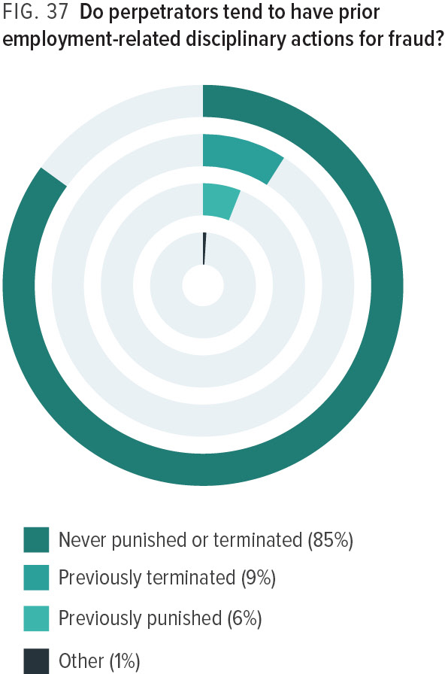
Notes:
Figure 37 shows that 85% of occupational fraud perpetrators had never been punished or terminated for fraud-related conduct prior to the crimes in this study. This also tends to indicate that most occupational fraudsters are first-time offenders, but as with criminal conviction data discussed earlier, this data might understate the real number of repeat offenders. According to Figure 41, 28% of fraudsters in our study either received no punishment from their employers, were permit-ted to resign, or entered into private settlement agreements (which are typically confidential). Therefore, the true number of repeat offenders may be higher than what is indicated by employment background checks.

Slide 42
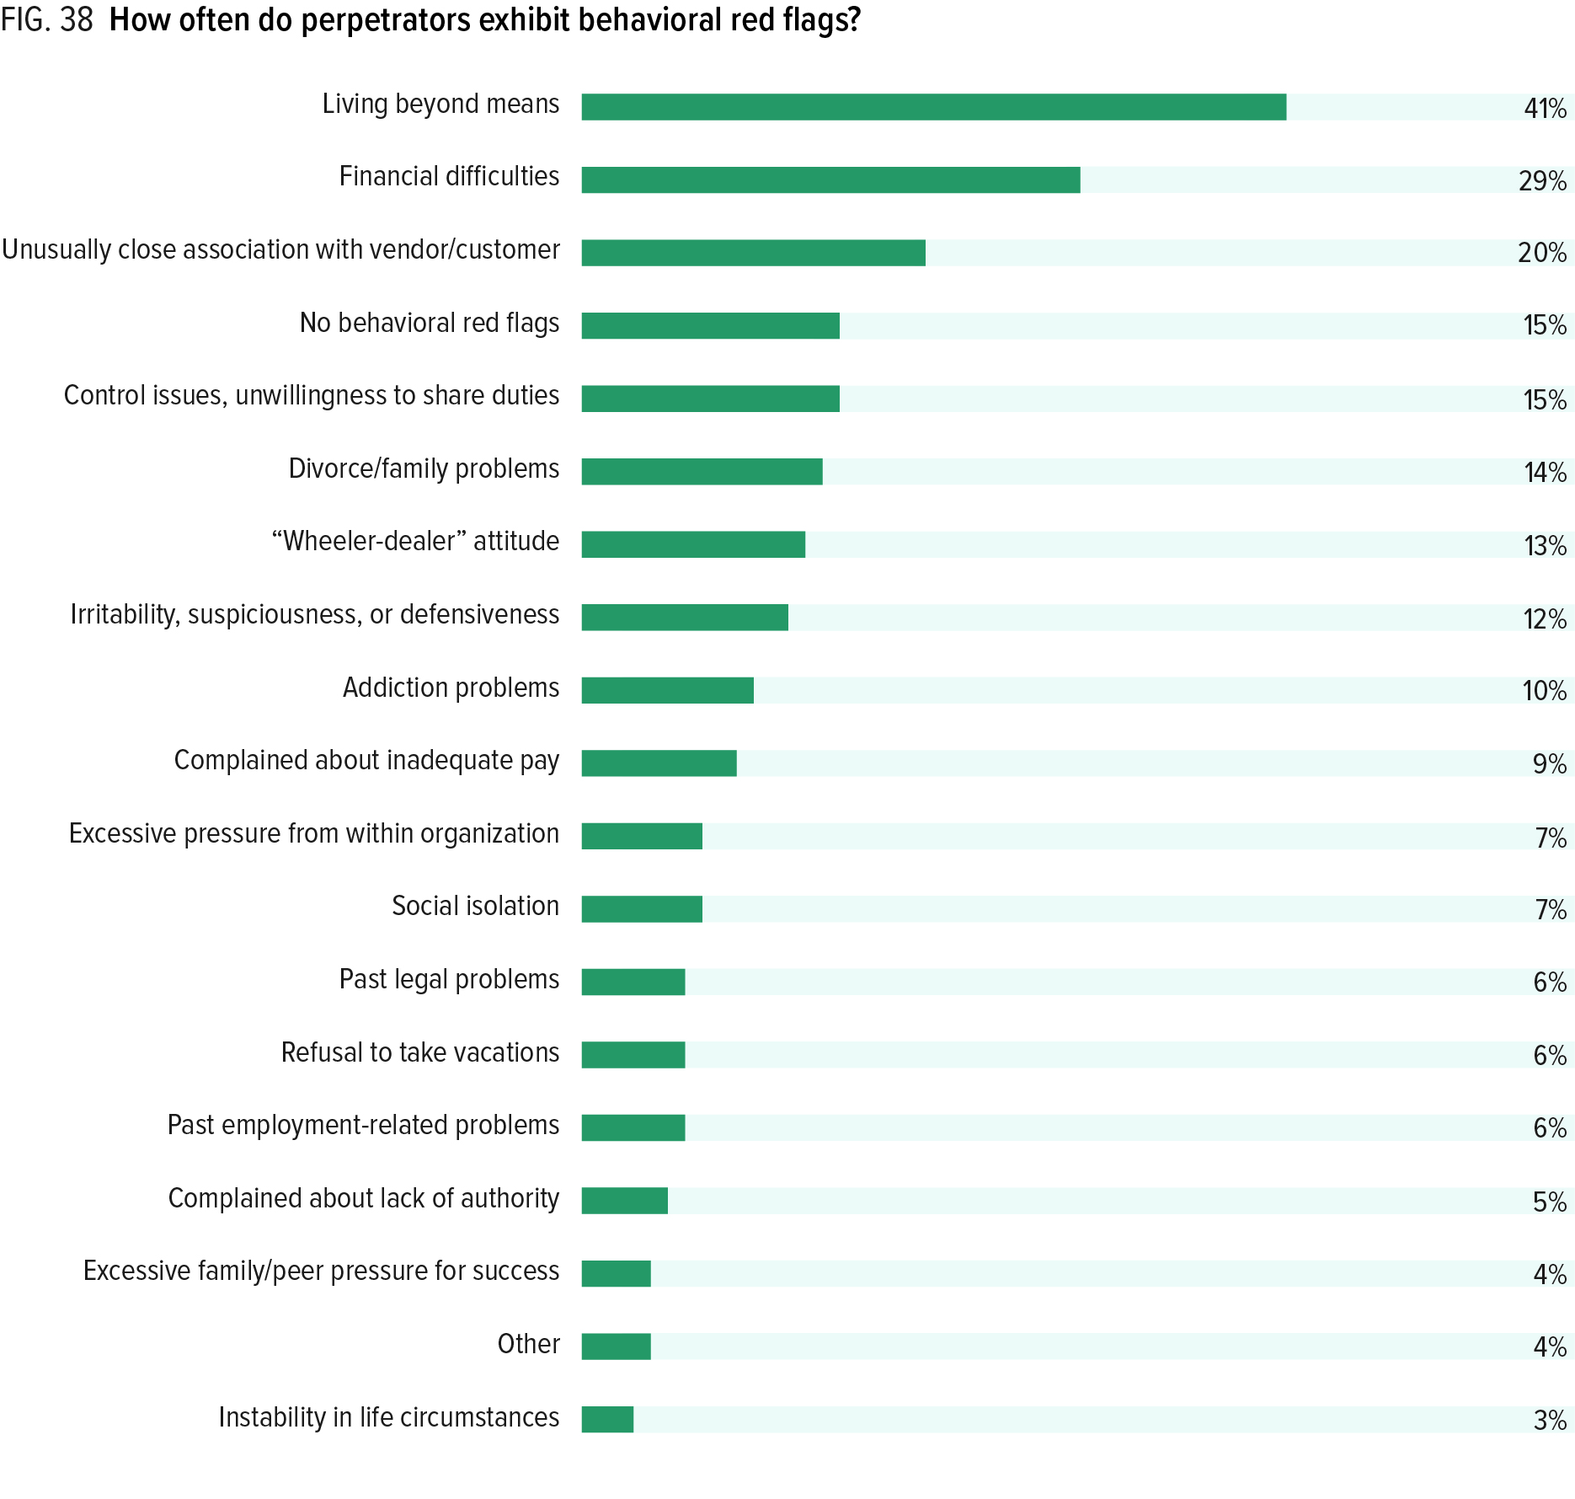
Notes:
Individuals who are engaged in occupational fraud schemes often exhibit certain behavioral traits or warning signs associated with their illegal activity. We presented survey respondents with a list of 17 common behavioral red flags and asked them to tell us which, if any, of these red flags had been displayed by the perpetrator before the fraud was discovered.
Figure 38 shows the frequency of behavioral red flags in our 2018 cases. The six most common behavioral indicators of occupational fraud were: (1) living beyond means; (2) financial difficulties; (3) unusually close association with a vendor or customer; (4) excessive control issues or unwillingness to share duties; (5) recent divorce or family problems; and (6) a general “wheeler-dealer” attitude involving shrewd or unscrupulous behavior. These six red flags have been the six most common behavioral indicators in every report since we began tracking this data in 2008. (See “The Red Flags of Fraud”).

Slide 43
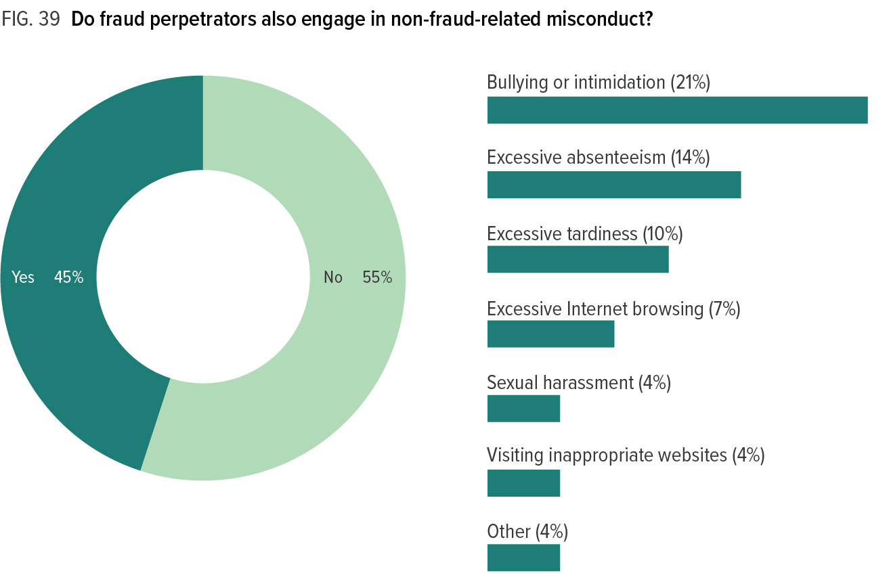
Notes:
We presented survey respondents with a list of com-mon non-fraud workplace violations and asked them to identify any that the fraudster had been engaged in prior to or during the time of the fraud. As Figure 39 shows, 45% of fraud offenders had committed some form of non-fraud workplace violation, which could potentially indicate a link between occupational fraud and other forms of workplace misconduct. The most common non-fraud violation was bullying or intimidation, which was observed in 21% of all cases.

Slide 44
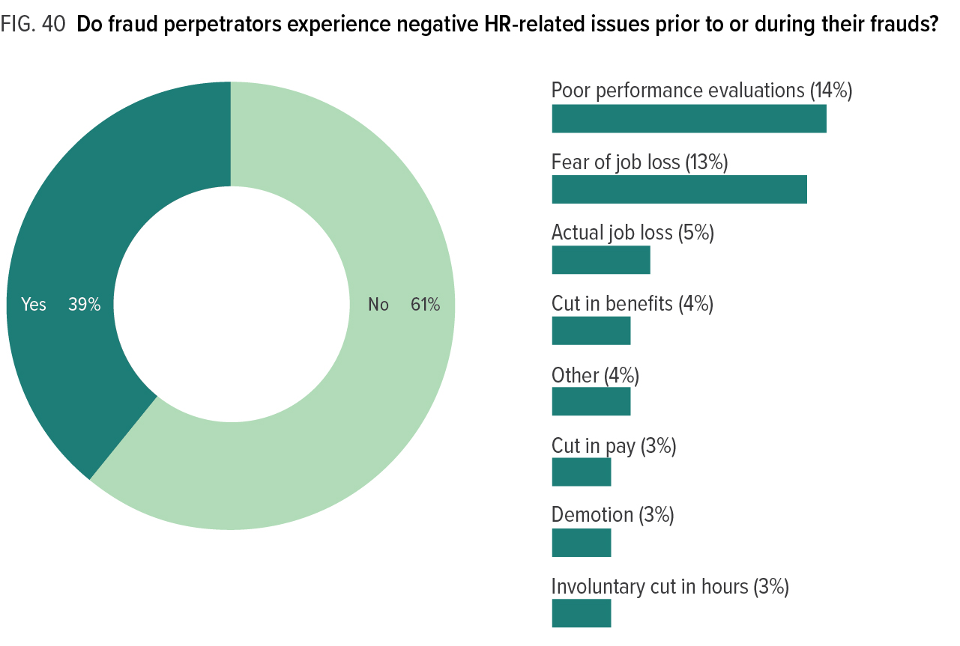
Notes:
In some circumstances, negative events surrounding a person’s conditions of employment (such as poor performance evaluations, loss of pay or benefits, fear of job loss, etc.) can cause financial stress or resentment toward the employer, which might play a role in the decision to commit fraud. We refer to these events as “human resources-related red flags.” As Figure 40 shows, 39% of fraudsters had experienced some form of HR-related red flags prior to or during the time of their frauds. The most common of these were negative performance evaluations (14% of cases) and fear of job loss (13%).

Slide 45
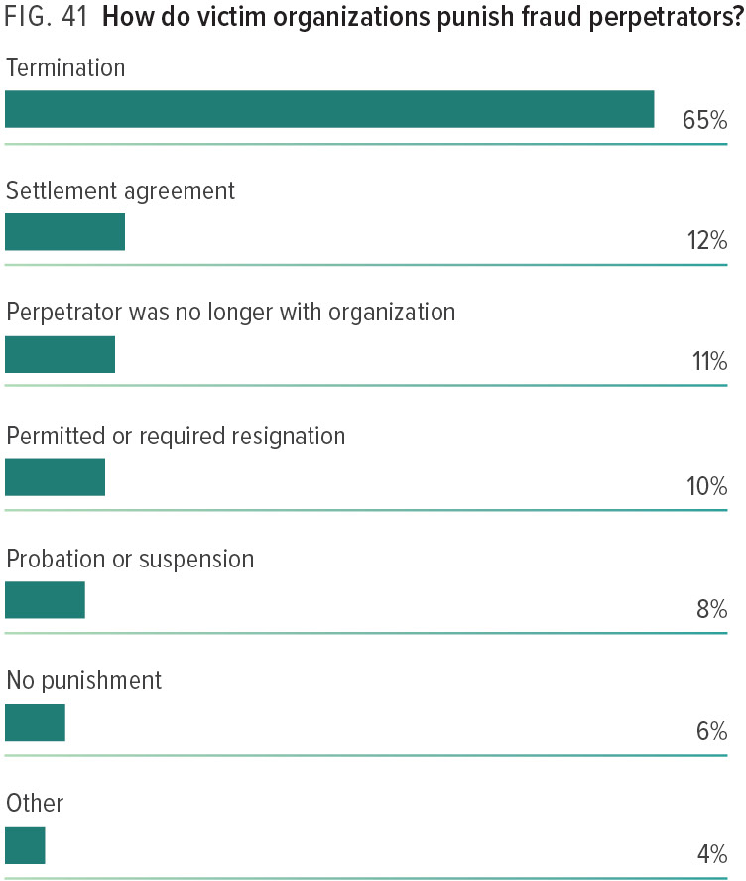
Notes:
Survey respondents pro-vided information about how perpetrators were internally punished or dealt with. Not surprisingly, termination was the most common disciplinary action taken in occupational fraud cases (65%). It is noteworthy that over one-third of perpetrators were not terminated as a direct result of committing fraud. In some cases the victim organization imposed lighter punishments such as permitting the offender to resign (10% of cases) or placing him or her on probation (8% of cases), while in 6% of cases the fraudster received no punishment at all.

Slide 46
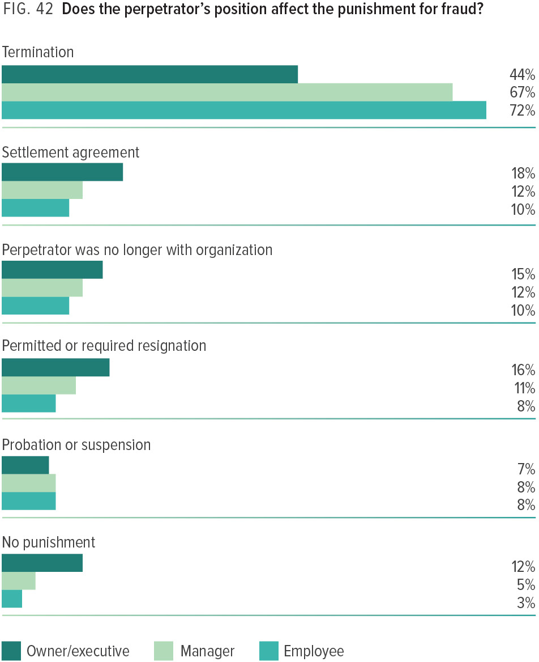
Notes:
From the perspective of ethics and fair-ness, there might be no reason to treat a high-level fraud perpetrator more leniently than an entry-level employee. However, our data shows that punishment is substantially dependent on the perpetrator’s position at the organization. While employees and mid-level managers are more likely than not to be terminated (72% and 67%, respectively), fewer than half of owners/executives were terminated (44%). Generally, the higher up the perpetrators were at the organization, the more likely they were to receive lighter punishments (e.g., permitted or required resignation) or no punishment at all.

Slide 47
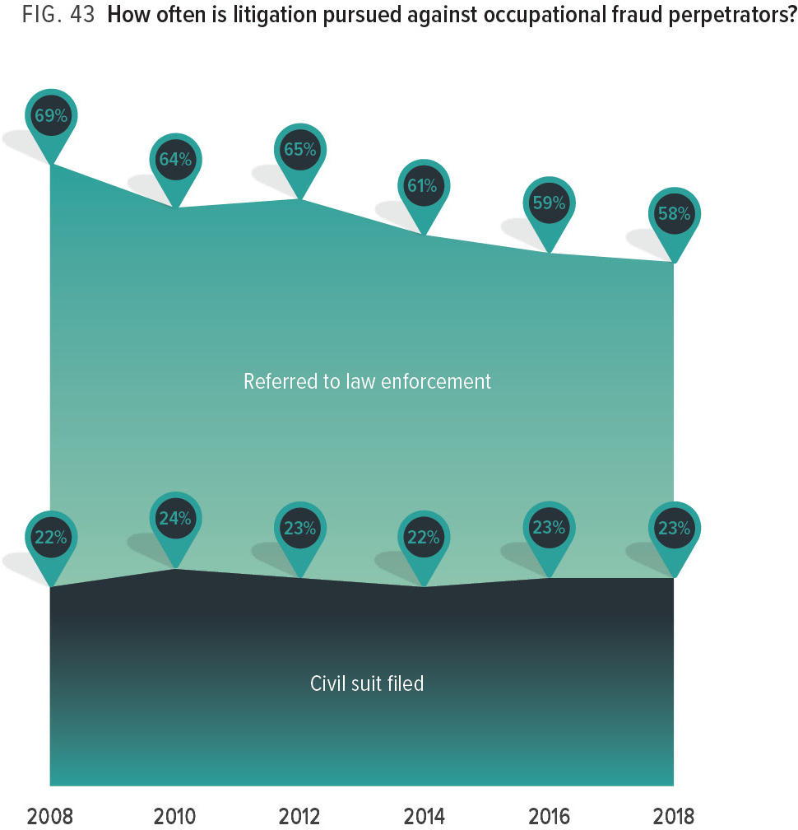
Notes:
After a fraud has been discovered and investigated, the case might proceed to prosecution, civil litigation, both, or neither. There are many factors that can affect this result, such as the amount of the financial loss, the strength of evidence, and prosecutorial discretion. Figure 43 shows the percent of cases that were referred to law enforcement or resulted in a civil suit being filed for each of our studies dating back to 2008. This chart illustrates that the rate of criminal referrals has gradually decreased over that time, from 69% in 2008 to 58% in 2018. In contrast, the rate at which civil suits are filed has stayed consistent, ranging from 22% to 24% within the same timeframe.

Slide 48
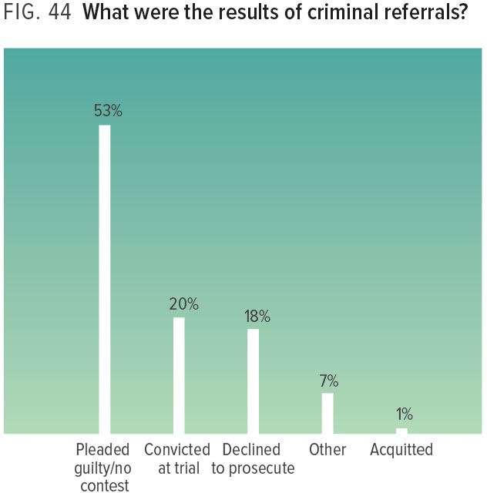
Notes:
We also asked respondents about the results of any litigation pursued; this data is shown in Figures 44 and 45. On the criminal side, most cases that were referred to law enforcement ended in a plea agreement or a conviction at trial (73% combined). If a case referred to law enforcement did not end in a conviction, it was most likely because law enforcement declined to prosecute (18%). The results suggest that once law enforcement decides that it will proceed with prosecution, it has an overwhelming chance of securing a conviction; only 1% of defendants obtained an acquittal.
In addition, more than half of judgments in civil suits were favorable to victims, with an additional 27% of cases being settled. Perpetrators obtained a favorable judgment in only 15% of civil cases that went to trial.

Slide 49
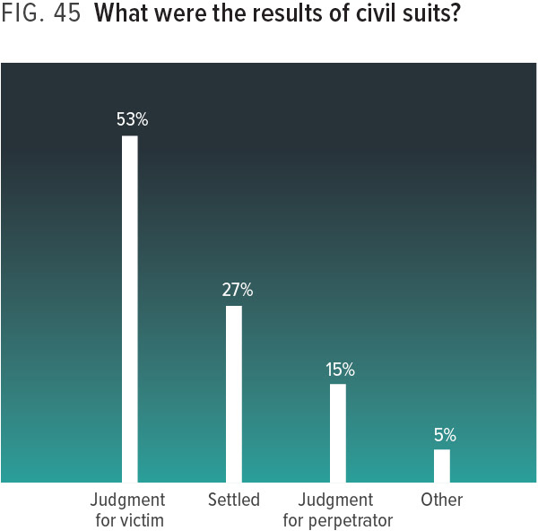
Notes:
We also asked respondents about the results of any litigation pursued; this data is shown in Figures 44 and 45. On the criminal side, most cases that were referred to law enforcement ended in a plea agreement or a conviction at trial (73% combined). If a case referred to law enforcement did not end in a conviction, it was most likely because law enforcement declined to prosecute (18%). The results suggest that once law enforcement decides that it will proceed with prosecution, it has an overwhelming chance of securing a conviction; only 1% of defendants obtained an acquittal.
In addition, more than half of judgments in civil suits were favorable to victims, with an additional 27% of cases being settled. Perpetrators obtained a favorable judgment in only 15% of civil cases that went to trial.

Slide 50
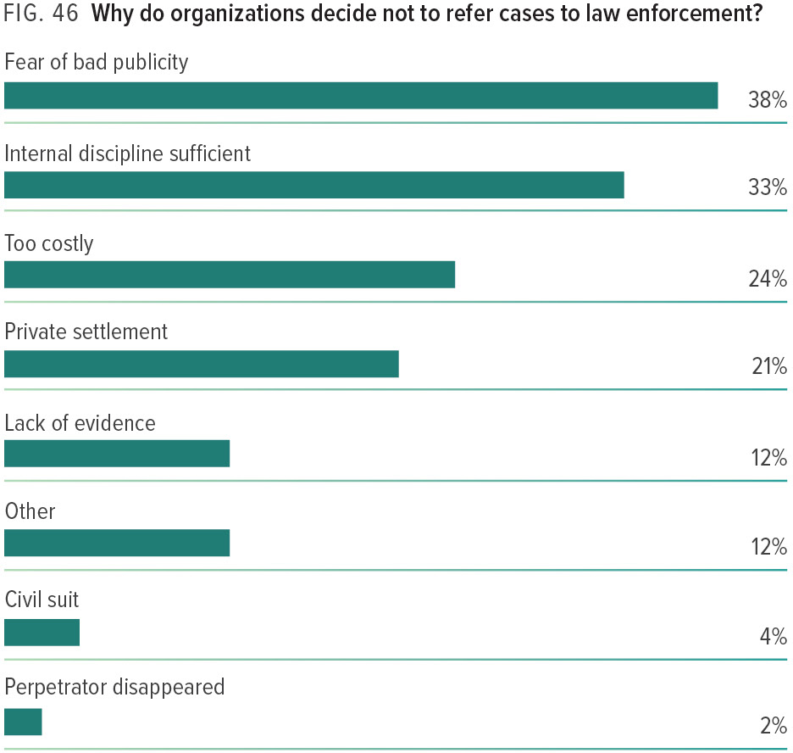
Notes:
We know that the rate of victim organizations reporting occupational fraud to law enforcement has decreased in recent years (see Figure 43). There are many reasons why organizations might decline to refer cases for prosecution. In our study, the top cause cited was fear of bad publicity (38%), followed by internal discipline being sufficient (33%) and costliness (24%).

Slide 51
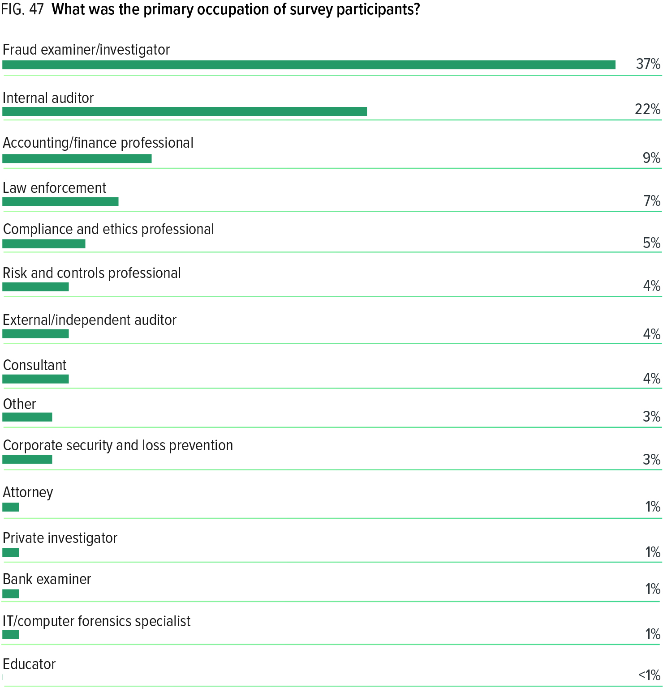
Notes:
As noted in Figure 47, 37% of survey respondents indicated that their primary occupation is as a fraud examiner/investigator, followed by 22% who indicated they are internal auditors.

Slide 52

Notes:
More than half of the CFEs who participated in our study work in-house, conducting fraud examinations on behalf of a single company or agency. Twenty-seven percent work for a professional services firm that conducts fraud examinations for client organizations, while 18% work in law enforcement and conduct fraud examinations under the authority of their agency.

Slide 53

Notes:
The CFEs who participated in our study had a median 11 years of experience in the fraud examination field, with over 30% having more than 15 years of experience.

Slide 54

Notes:
Respondents also provided information on the total number of fraud cases they worked on in the prior two years. As shown in Figure 50, one-quarter investigated more than 20 cases, while 41% investigated five or fewer cases during that time.

Slide 55


Slide 56


Slide 57


Slide 58


Slide 59


Slide 60


Slide 61


Slide 62


Slide 63


Slide 64


Slide 65


Slide 66


Slide 67


Slide 68


Slide 69


Slide 70


Slide 71


Slide 72


Slide 73


Slide 74


Slide 75


Slide 76


Slide 77


Slide 78


Slide 79


Slide 80


Slide 81


Slide 82


Slide 83


Slide 84


Slide 85


Slide 86


Slide 87


Slide 88


Slide 89


Slide 90


Slide 91


Slide 92


Slide 93


Slide 94


Slide 95


Slide 96


Slide 97


