Slide 2
Fig. 1 reported cases by Region

Slide 3
Fig. 2 How is occupational fraud committed?

Slide 4
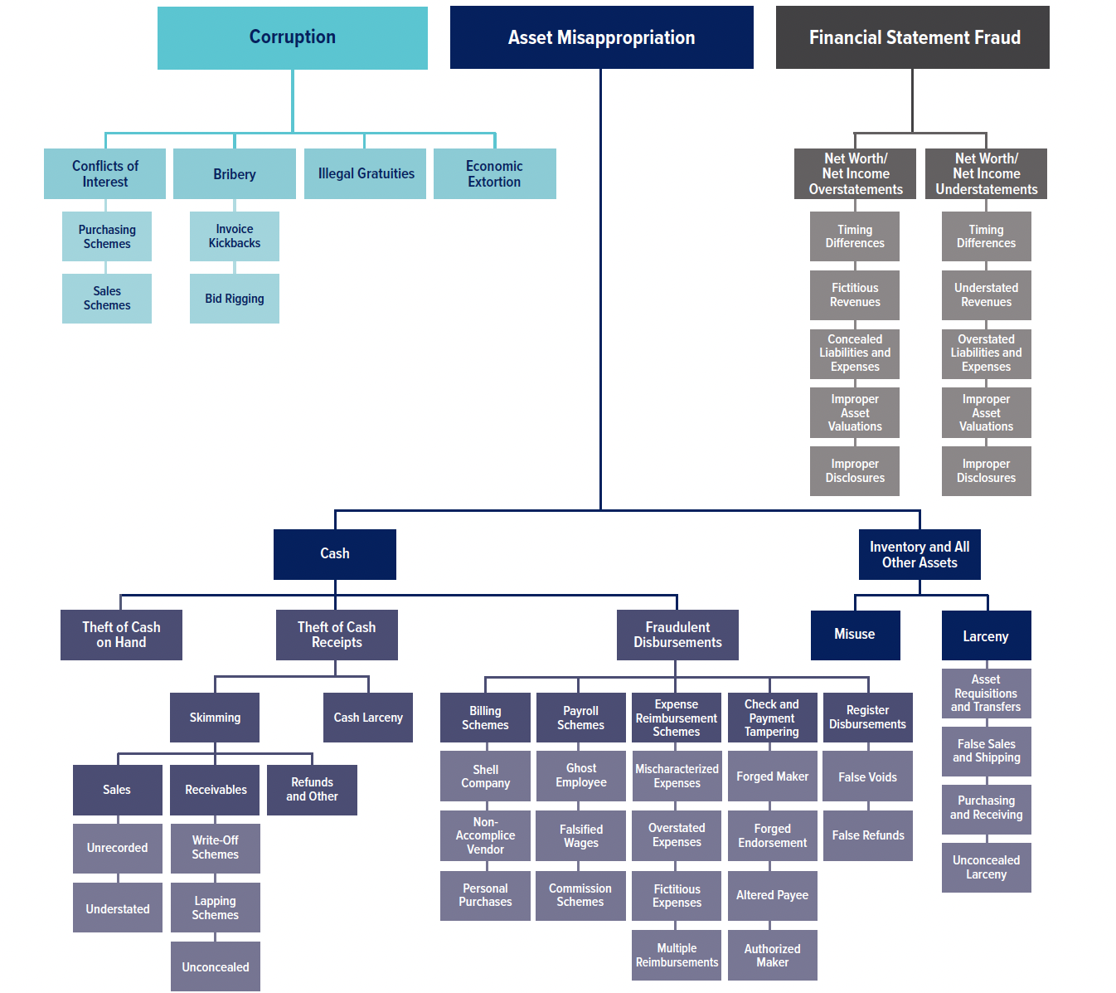
Fig. 3 occupational fraud and abuse classification system (The Fraud Tree)

Slide 5
Fig. 4 How often do fraudsters commit more than one type of occupational Fraud?

Slide 6
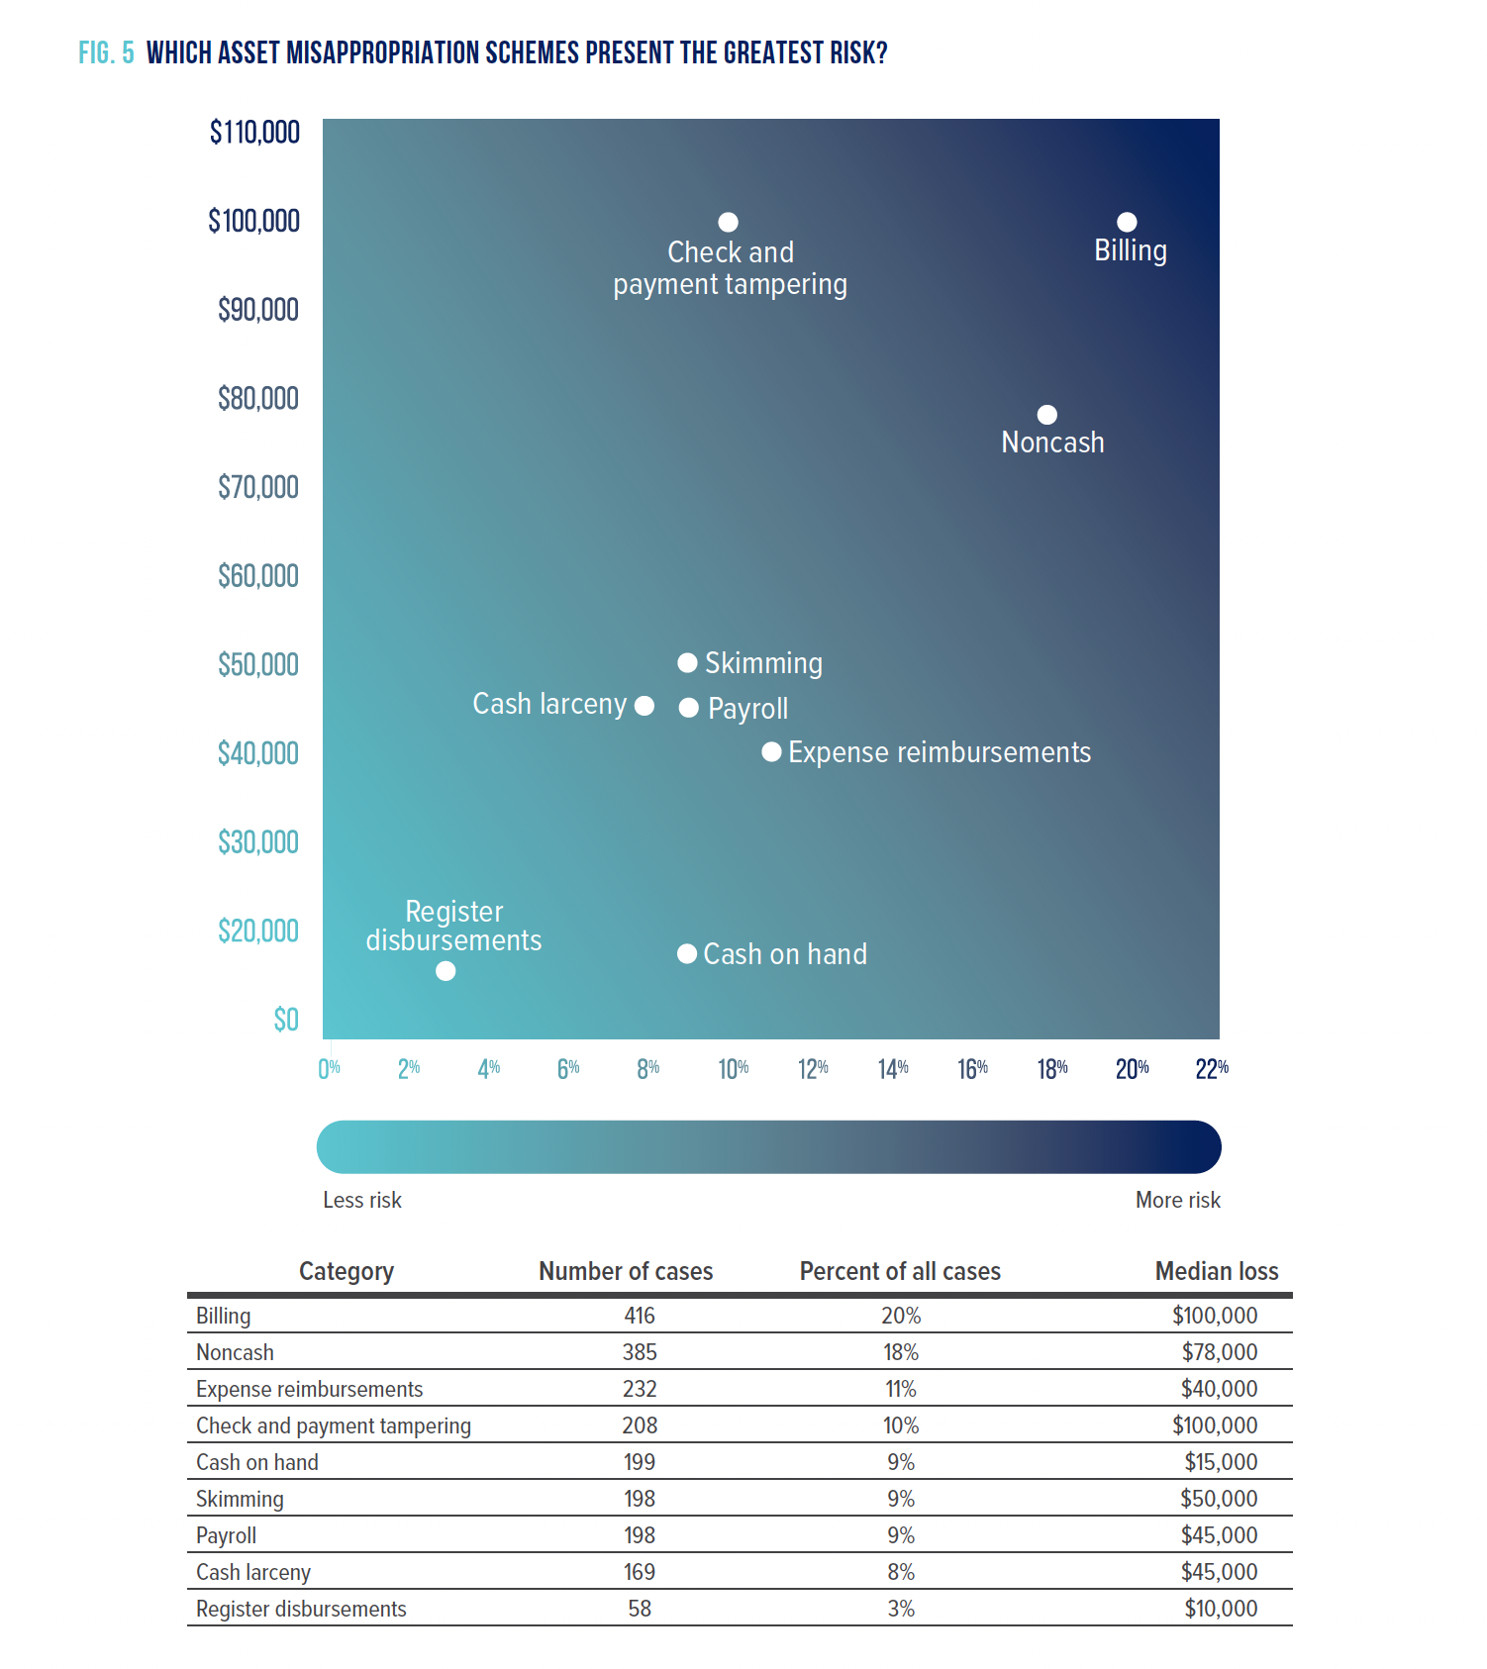
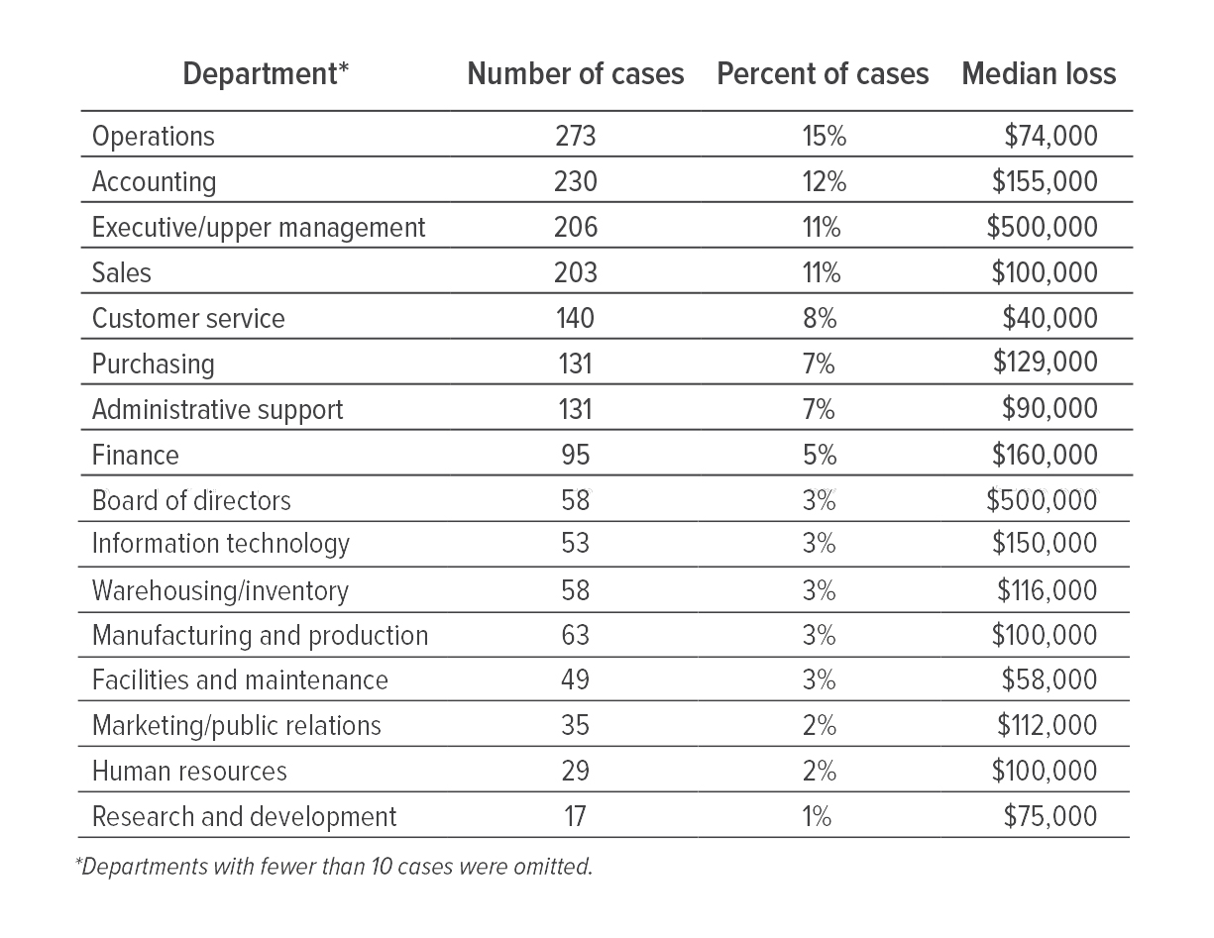
Fig. 5 Which asset misappropriation schemes present the greatest risk?

Slide 7
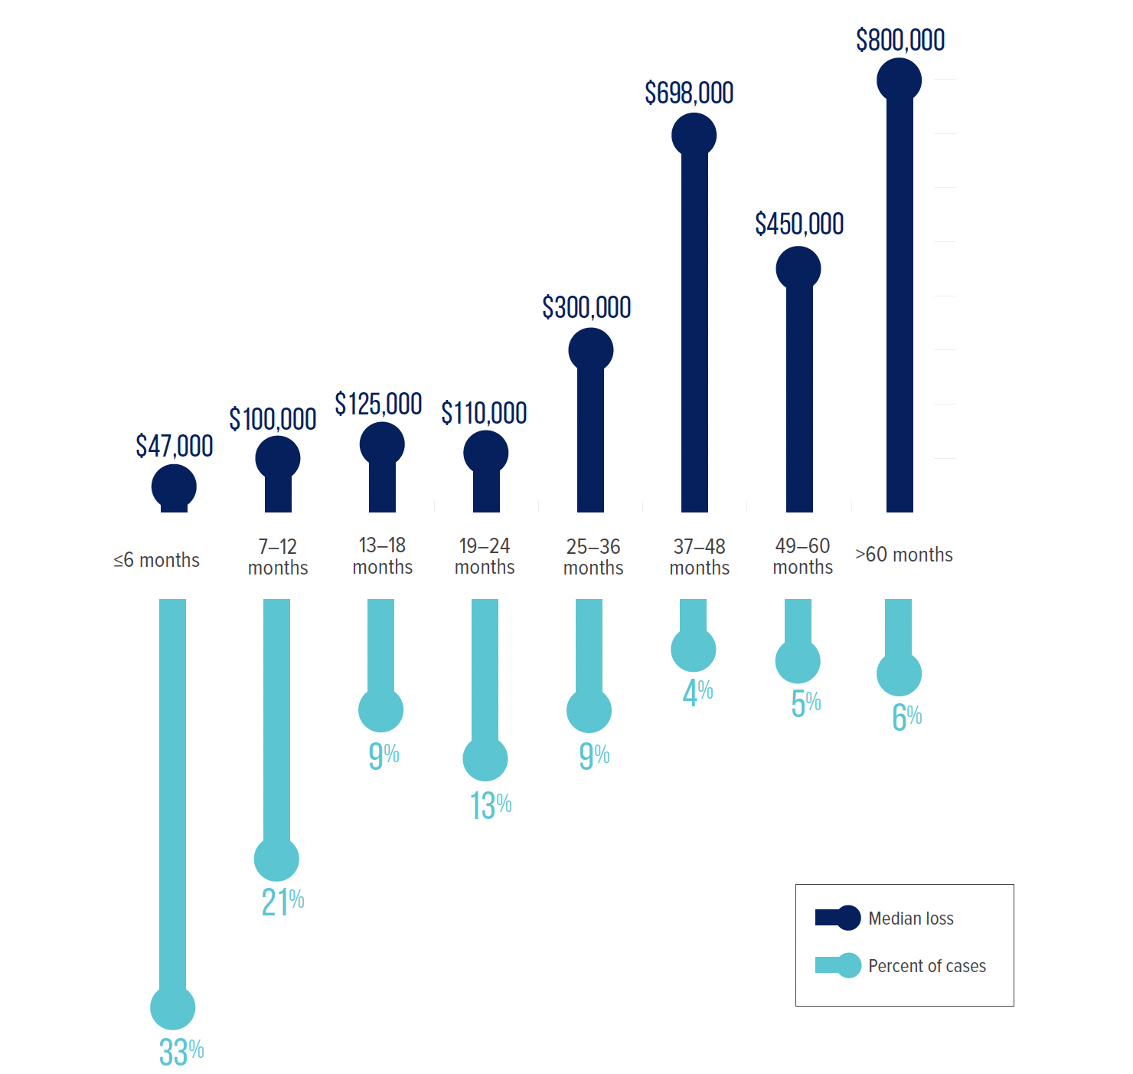
Fig. 6 How does the duration of a fraud relate to median loss?

Slide 8
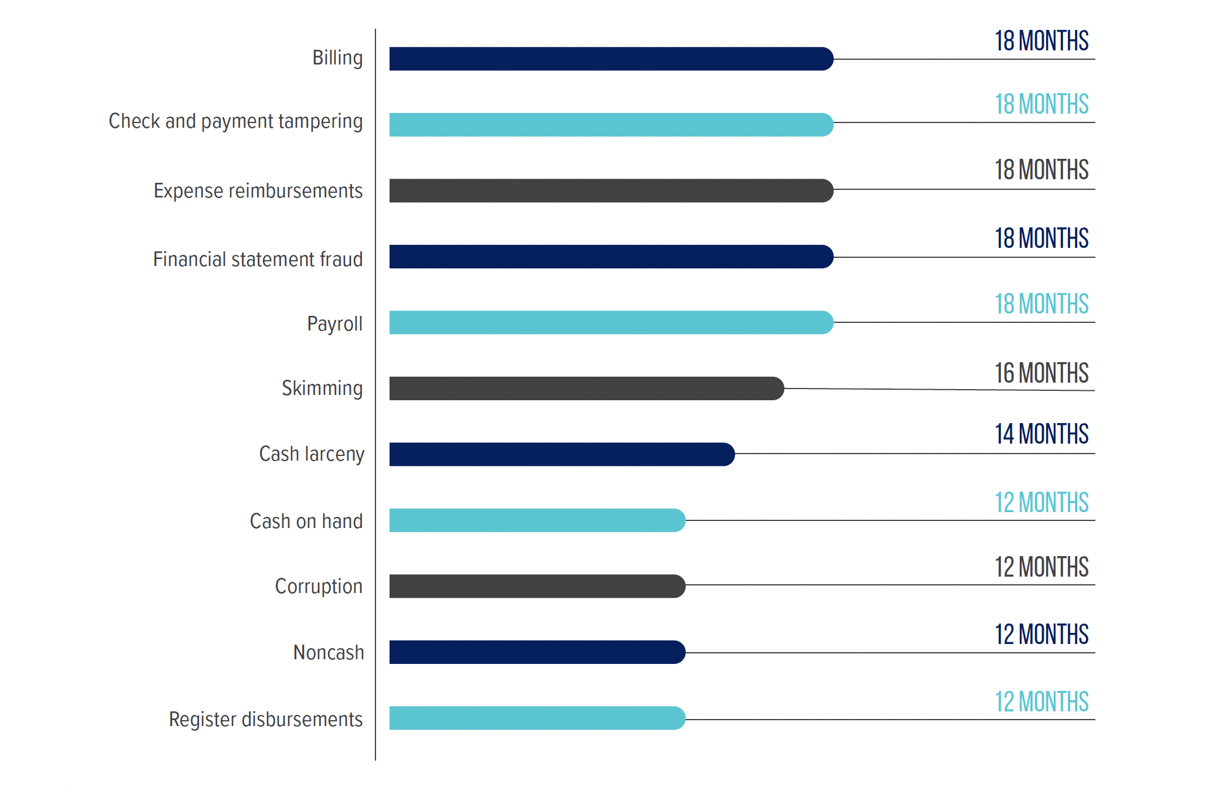
Fig. 7 How long do different occupational fraud schemes last?

Slide 9
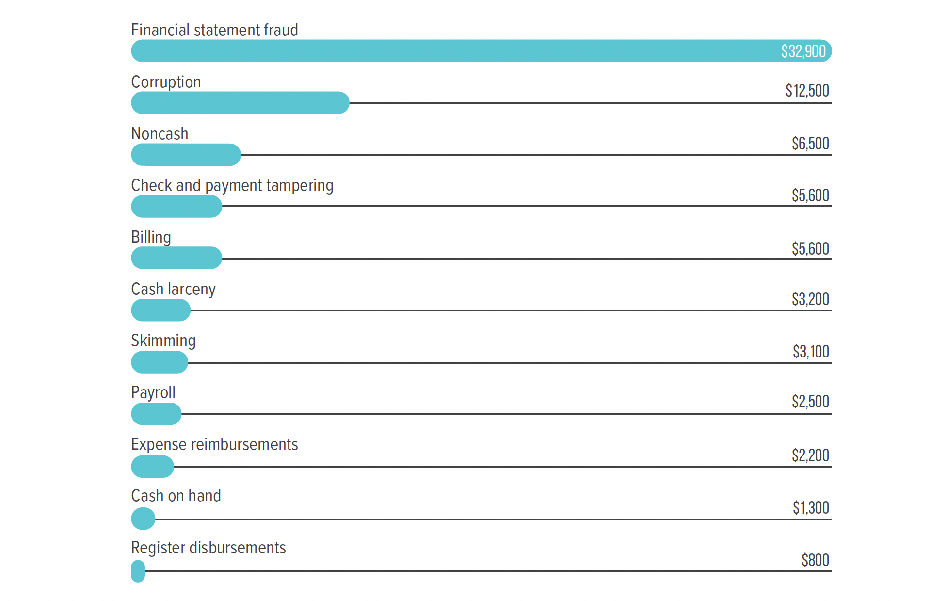
Fig. 8 what is the typical velocity (median loss per month) of different occupational fraud schemes?

Slide 10
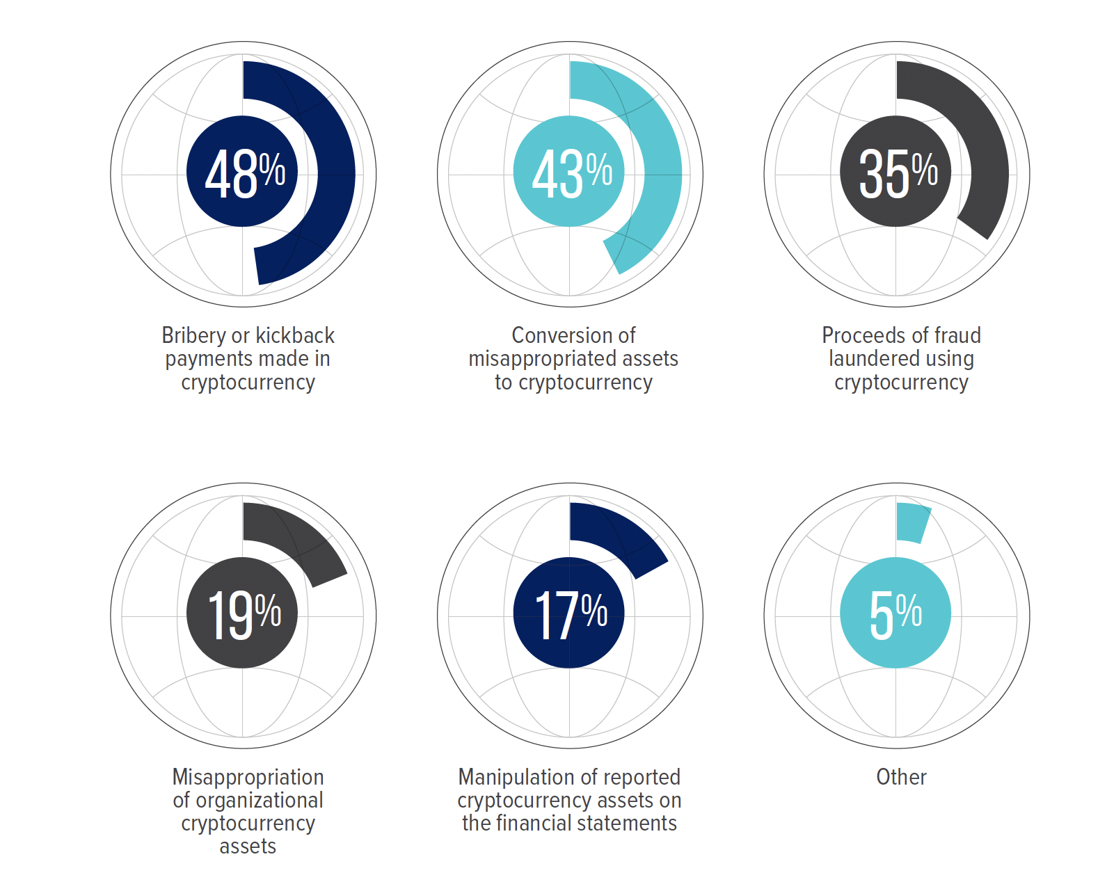
Fig. 9 among frauds involving cryptocurrency, how was it used?

Slide 11
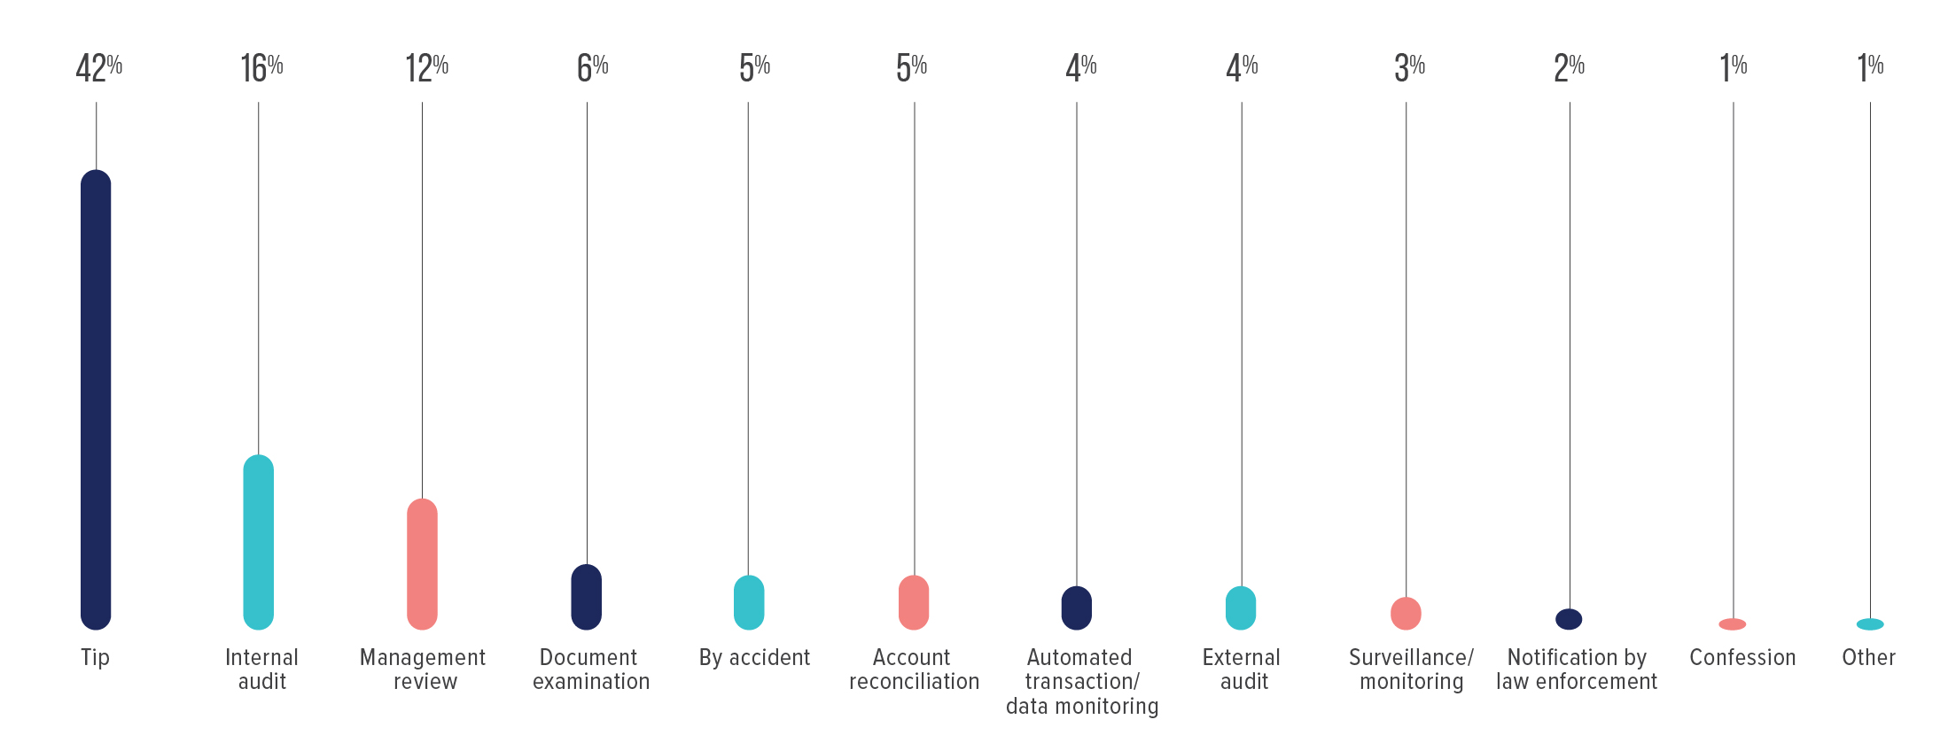
Fig. 10 How is occupational fraud initially detected?

Slide 12
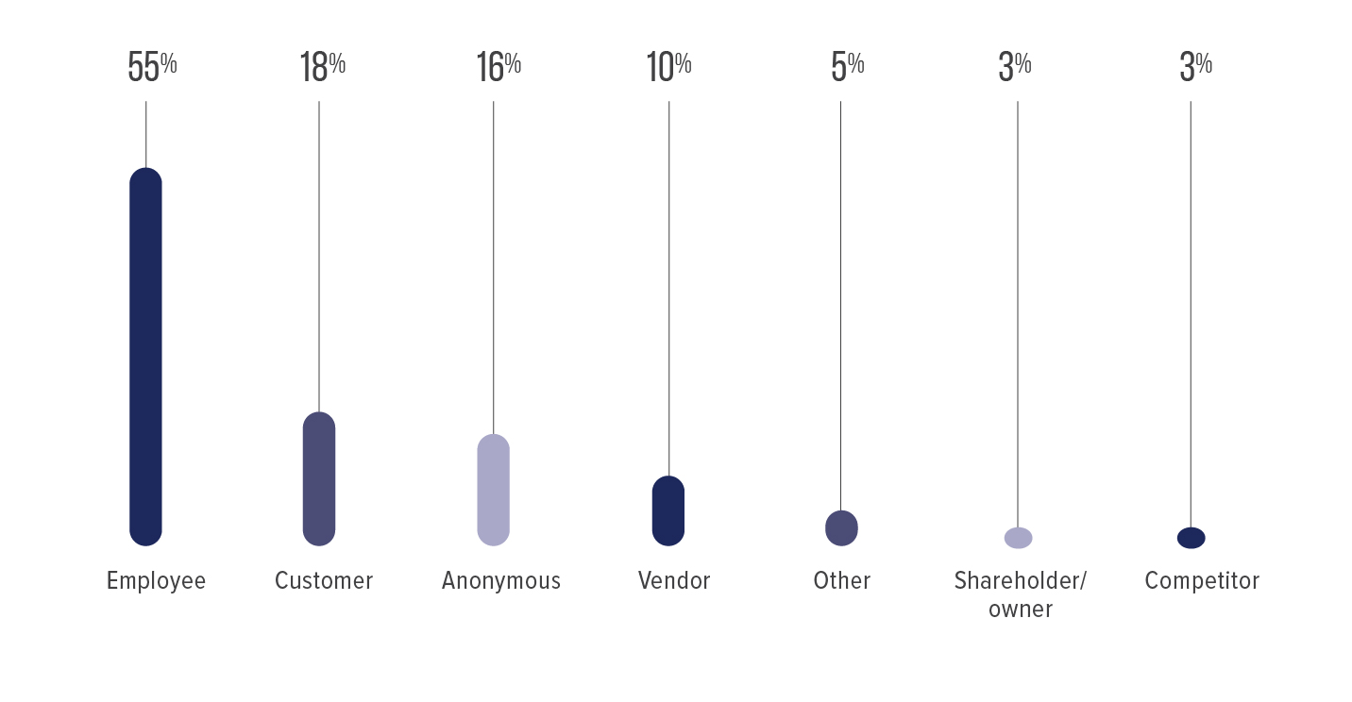
Fig. 11 who reports occupational fraud?

Slide 13
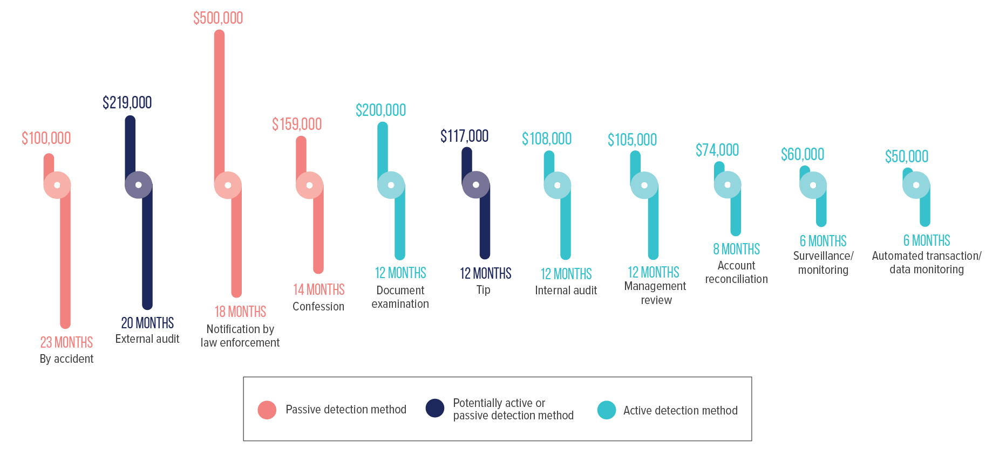
Fig. 12 how does detection method relate to fraud loss and duration?

Slide 14
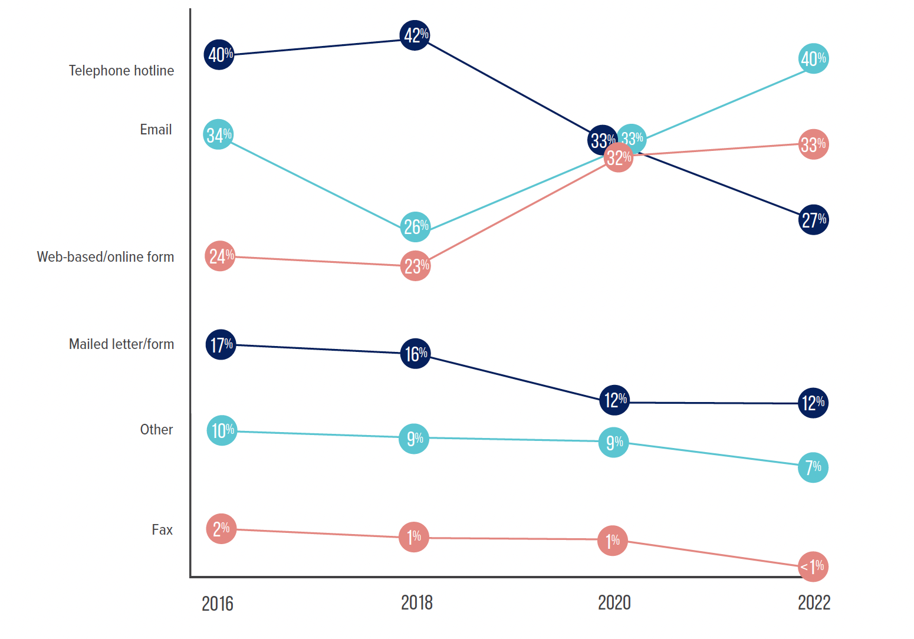
Fig. 13 What formal reporting mechanisms did whistleblowers use?

Slide 15
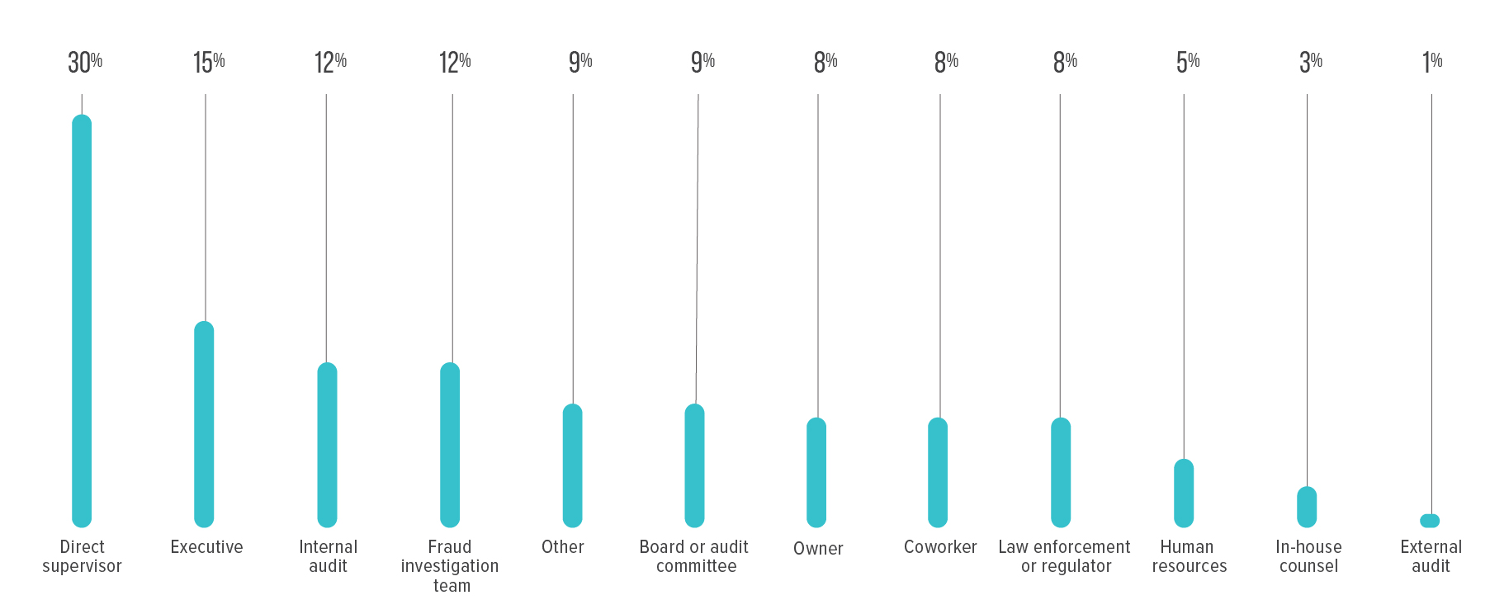
Fig. 14 to whom did whistleblowers initially report?

Slide 16
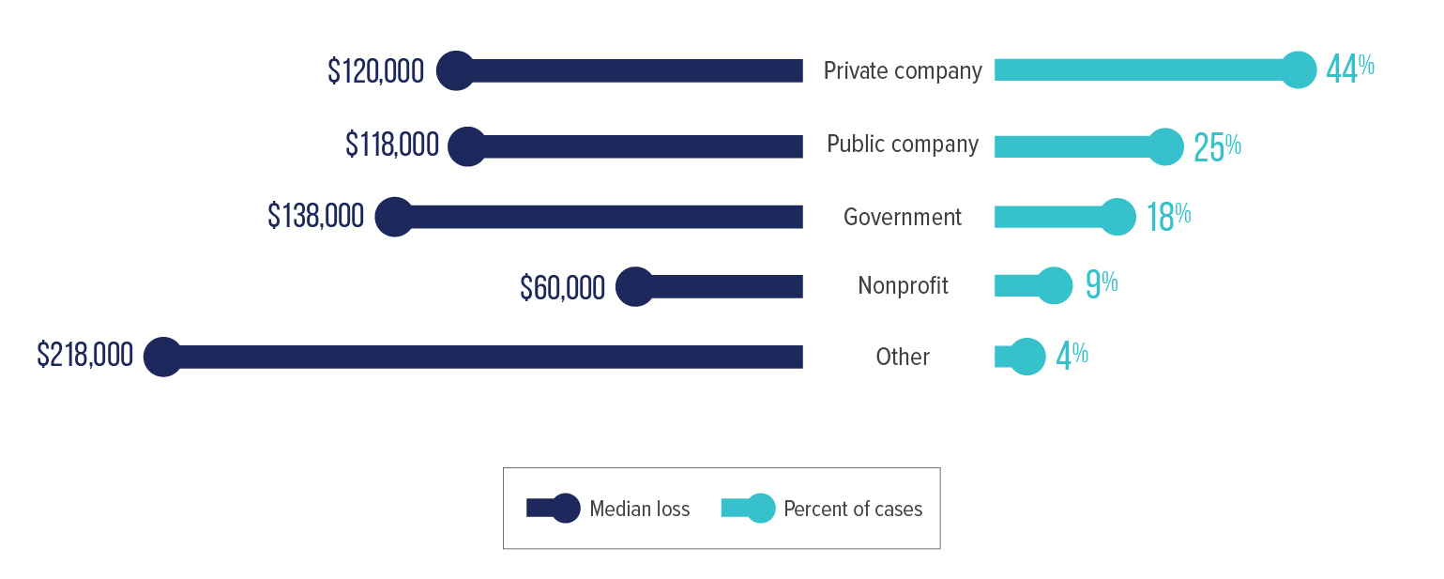
Fig. 15 what types of organizations are victimized by occupational fraud?

Slide 17
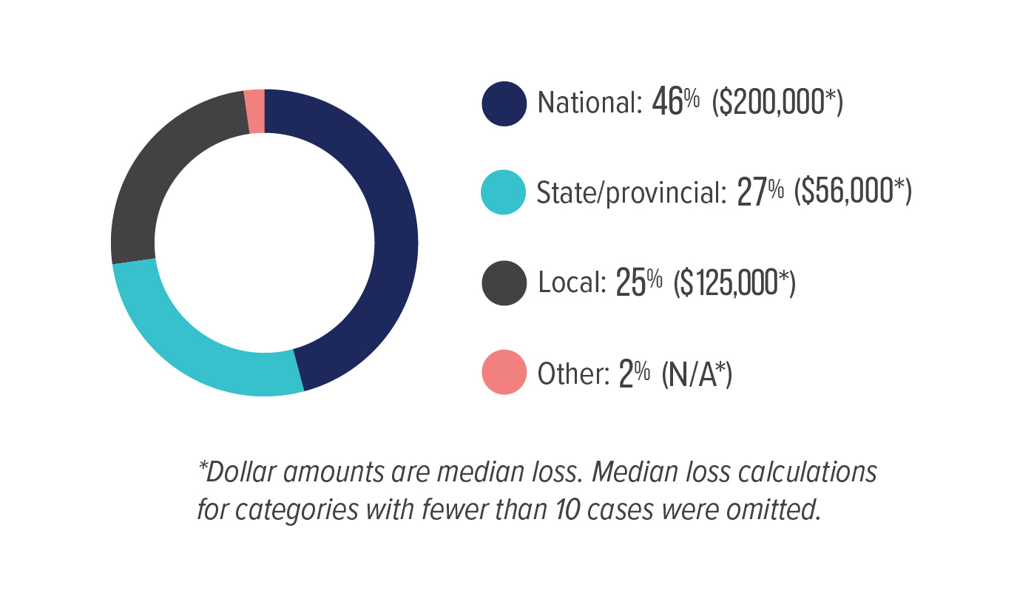
Fig. 16 what levels of government are victimized by occupational fraud?

Slide 18
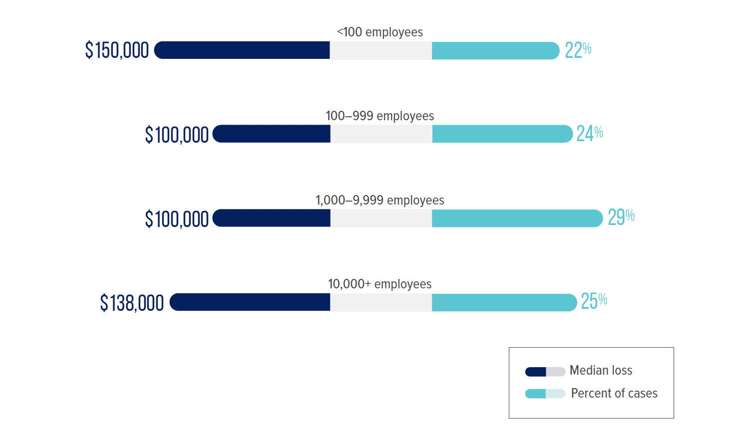
Fig. 17 how does an organization’s size relate to its occupational fraud risk?

Slide 19
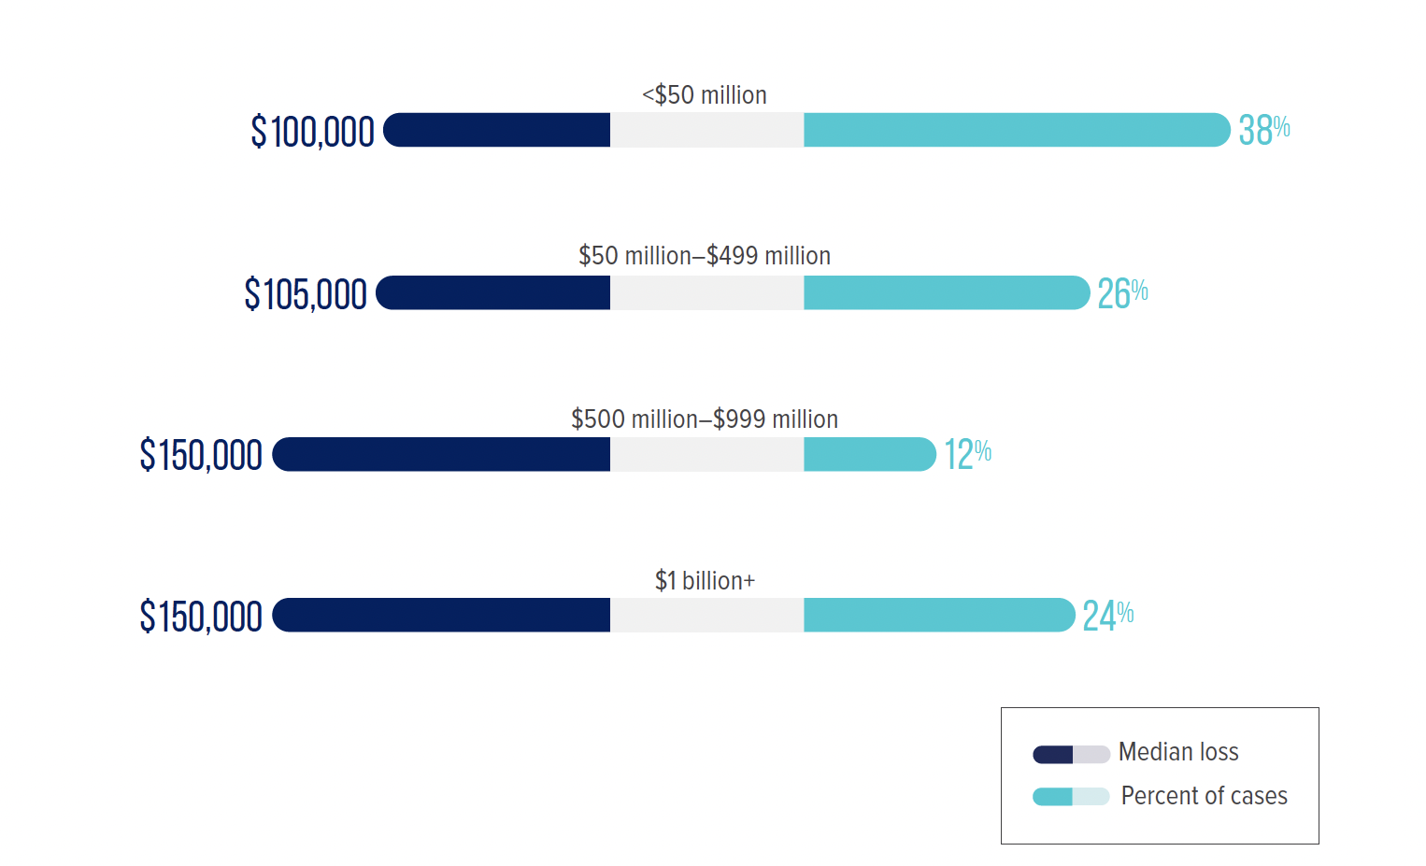
Fig. 18 how does an organization’s gross annual revenue relate to its occupational fraud risk?

Slide 20
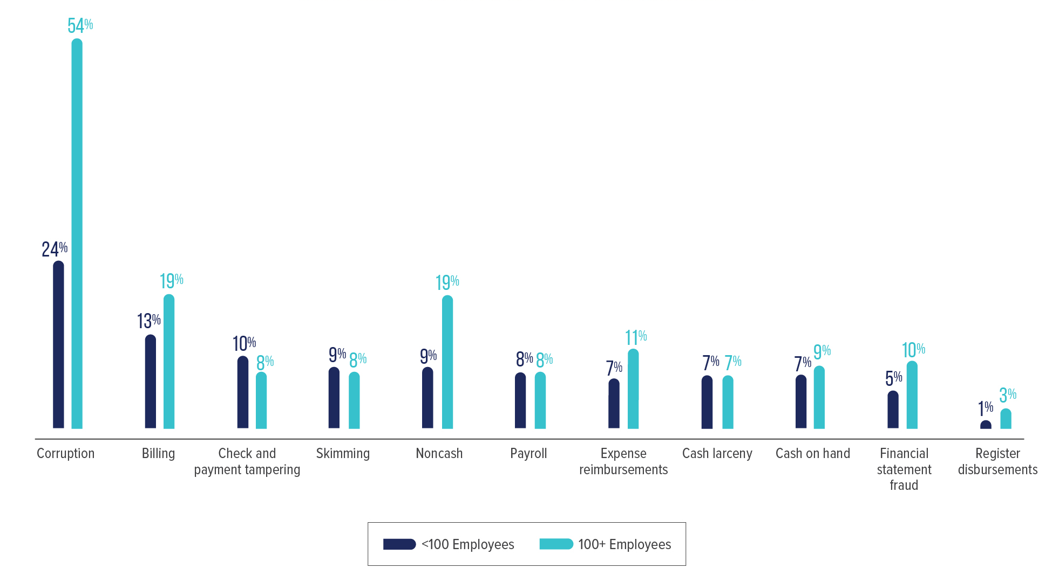
Fig. 19 how do fraud schemes vary by organization size?

Slide 21
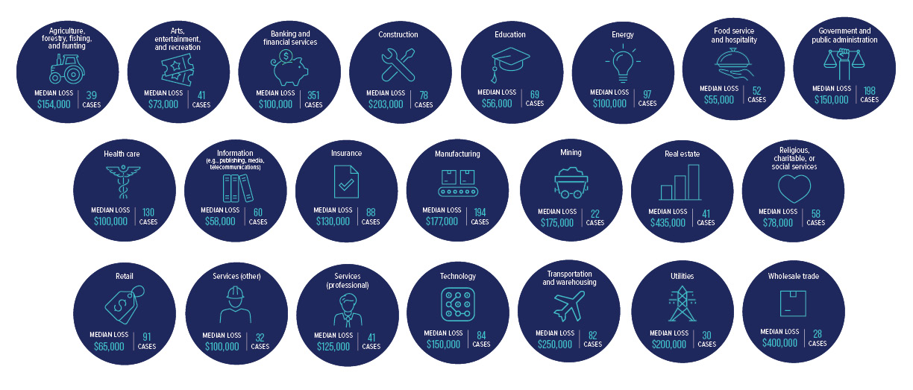
Fig. 20 how does occupational fraud affect organizations in different industries?

Slide 22
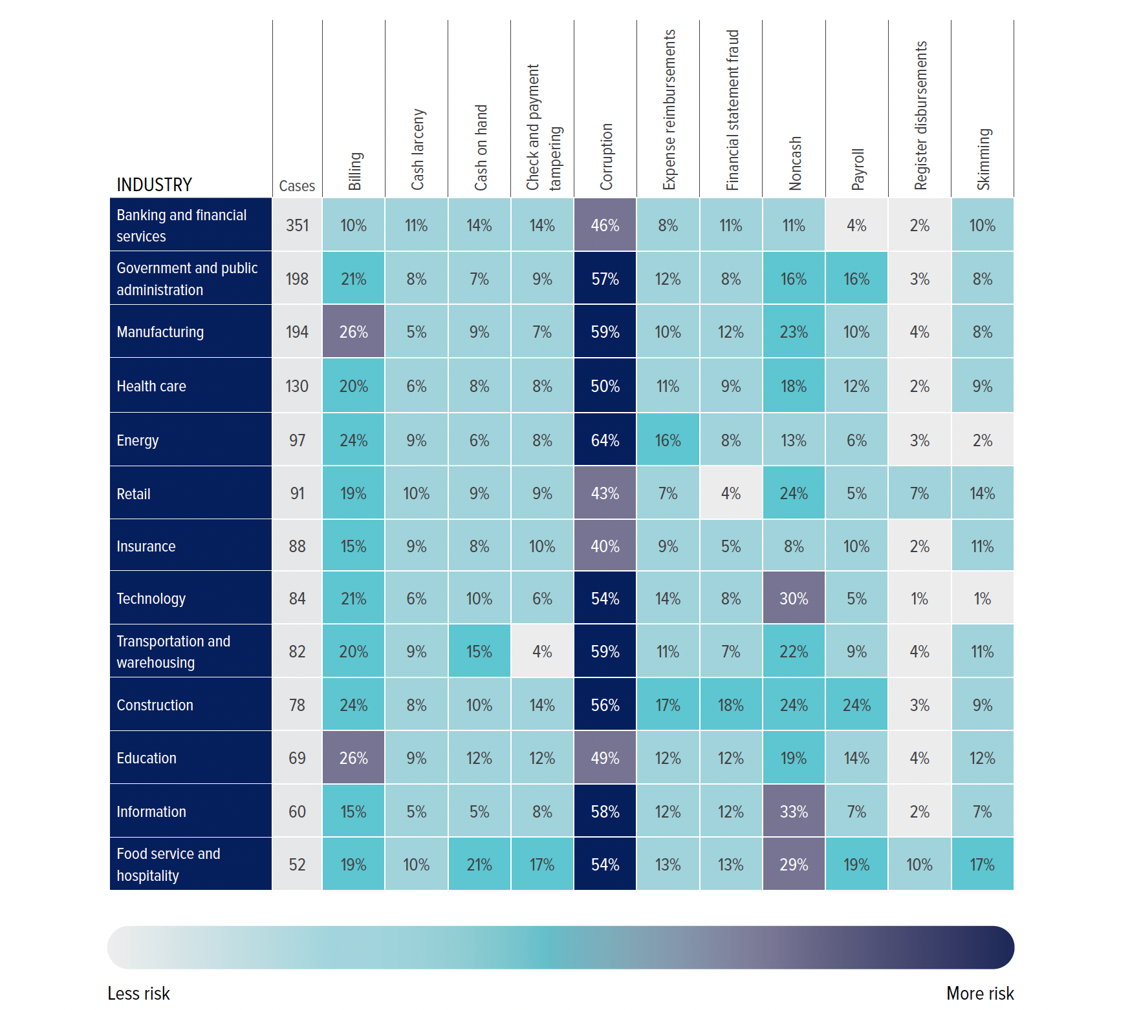
Fig. 21 what are the most common occupational fraud schemes in various industries?

Slide 23
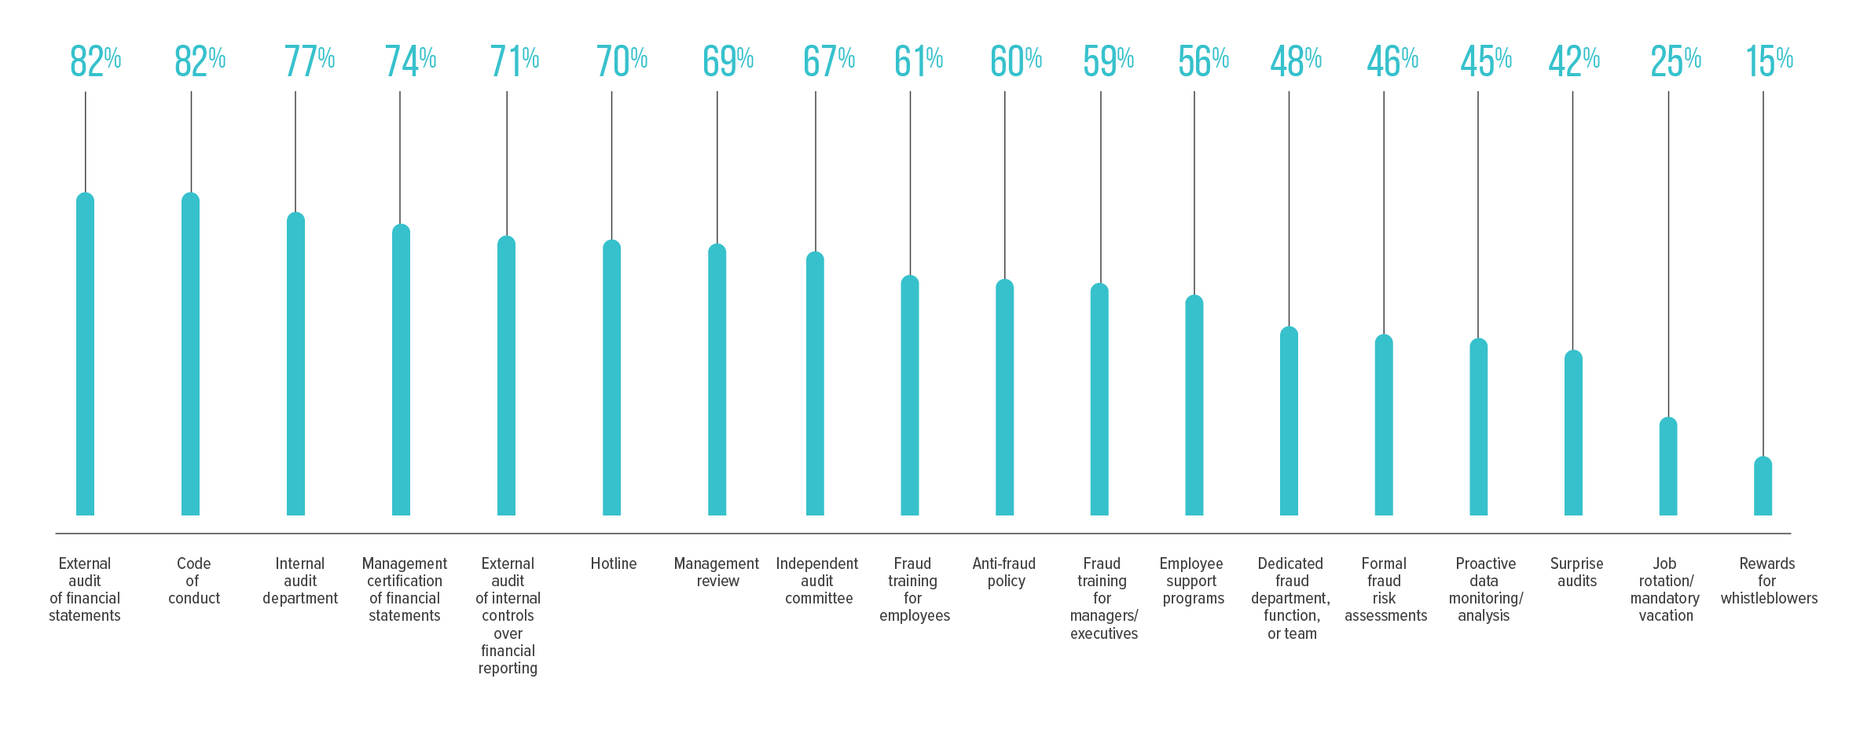
Fig. 22 what anti-fraud controls are most common?

Slide 24
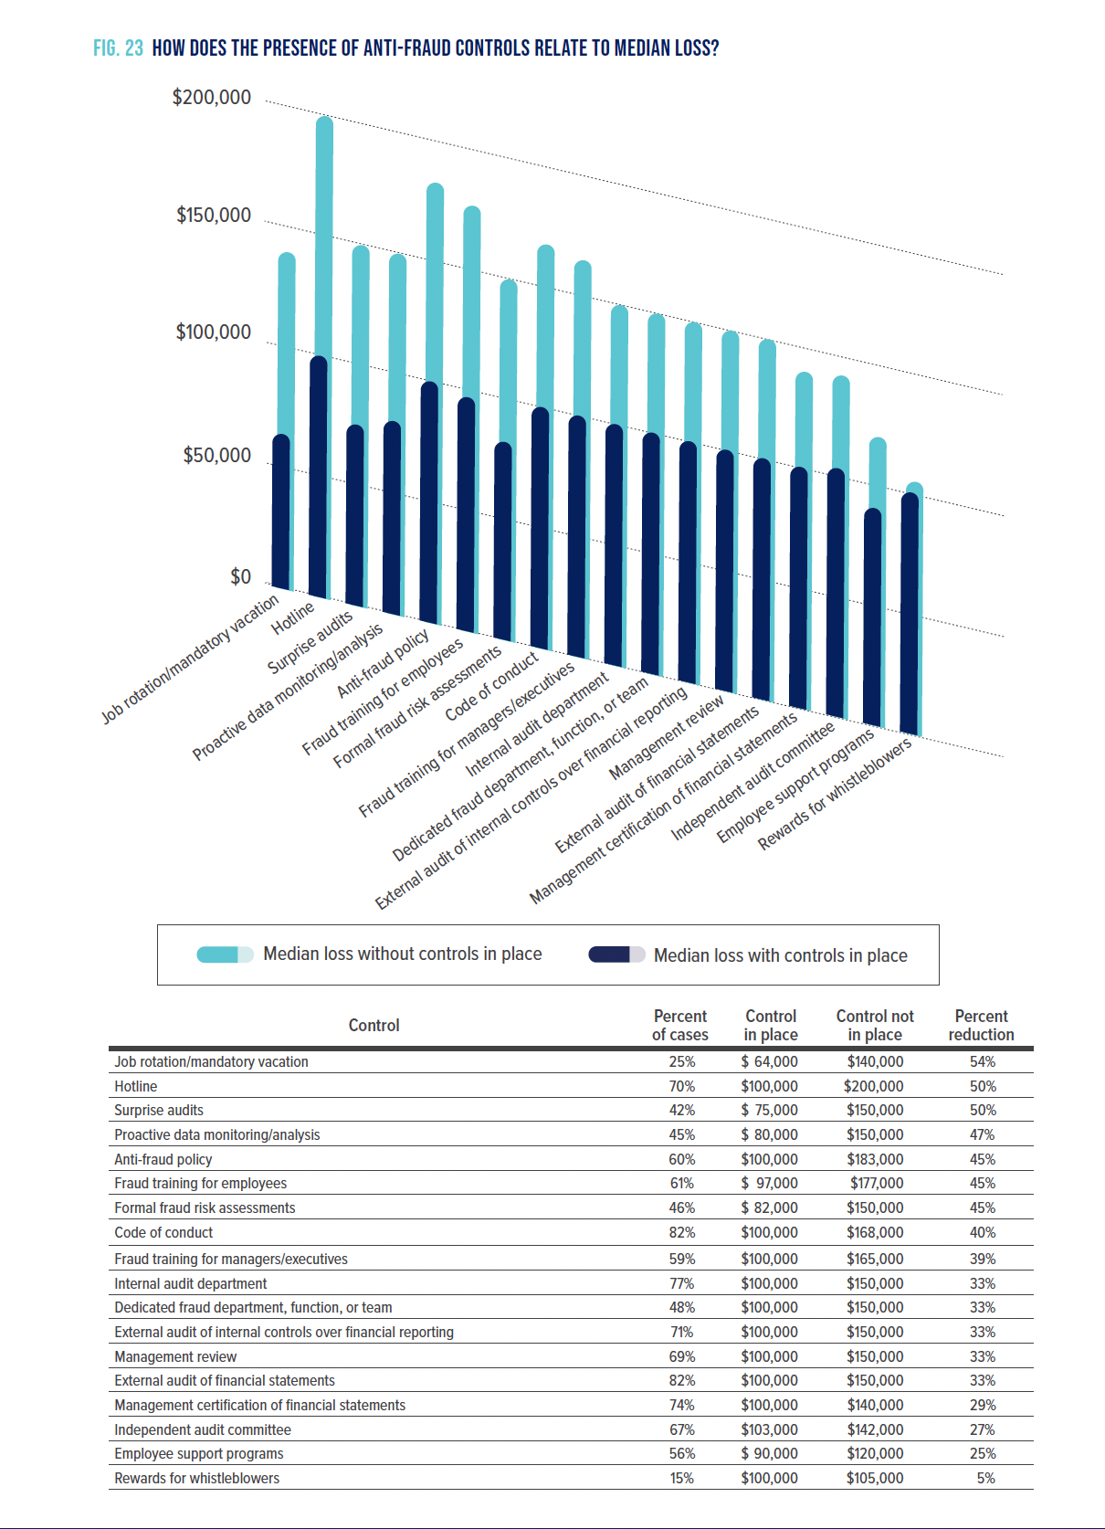
Fig. 23 how does the presence of anti-fraud controls relate to median loss?

Slide 25
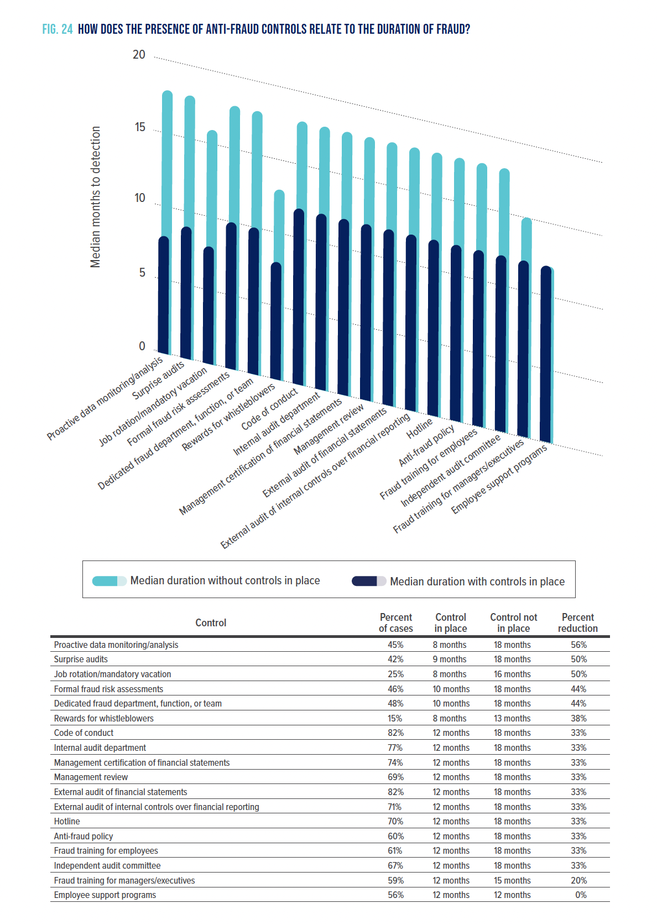
Fig. 24 how does the presence of anti-fraud controls
relate to the duration of fraud?

Slide 26
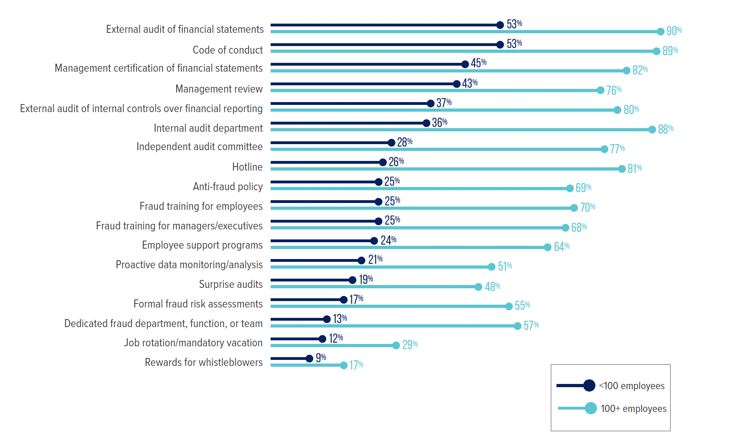
Fig. 25 how do anti-fraud controls vary by size of victim organization?

Slide 27
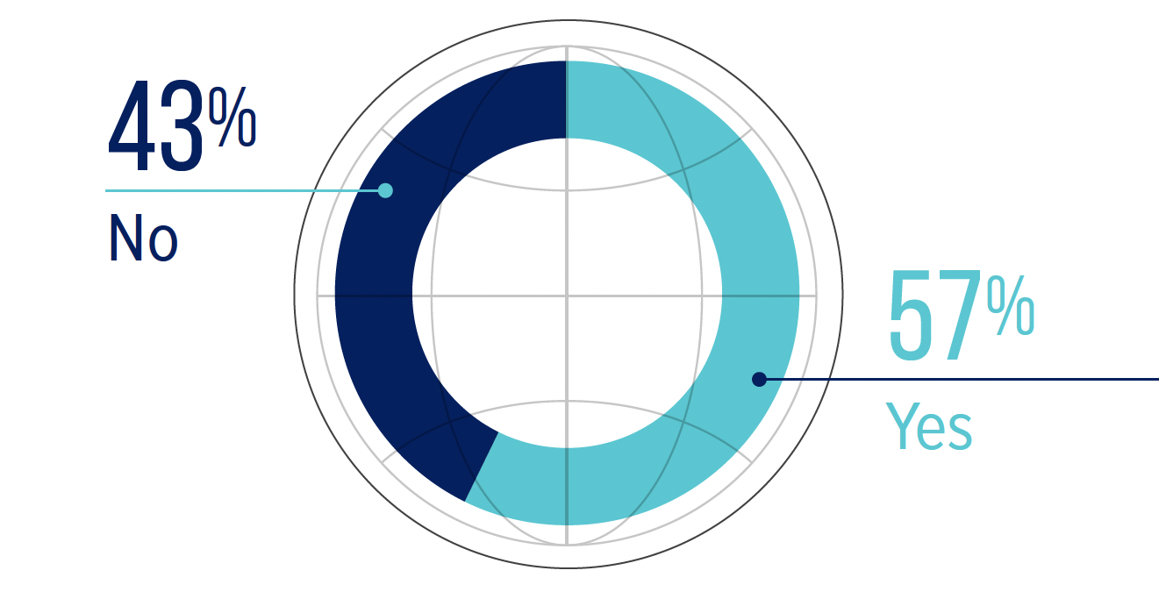
Fig. 26 was a background check run on the perpetrator prior to hiring?

Slide 28
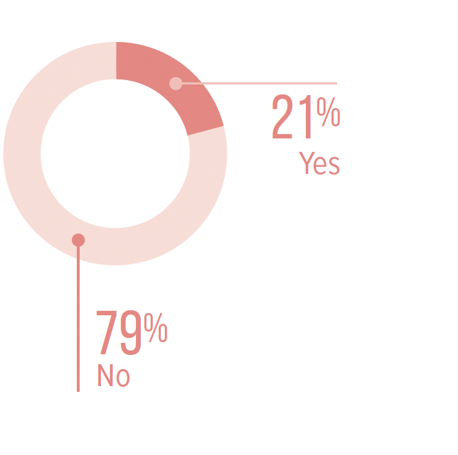
Fig. 27 did the background checks reveal existing red flags?

Slide 29
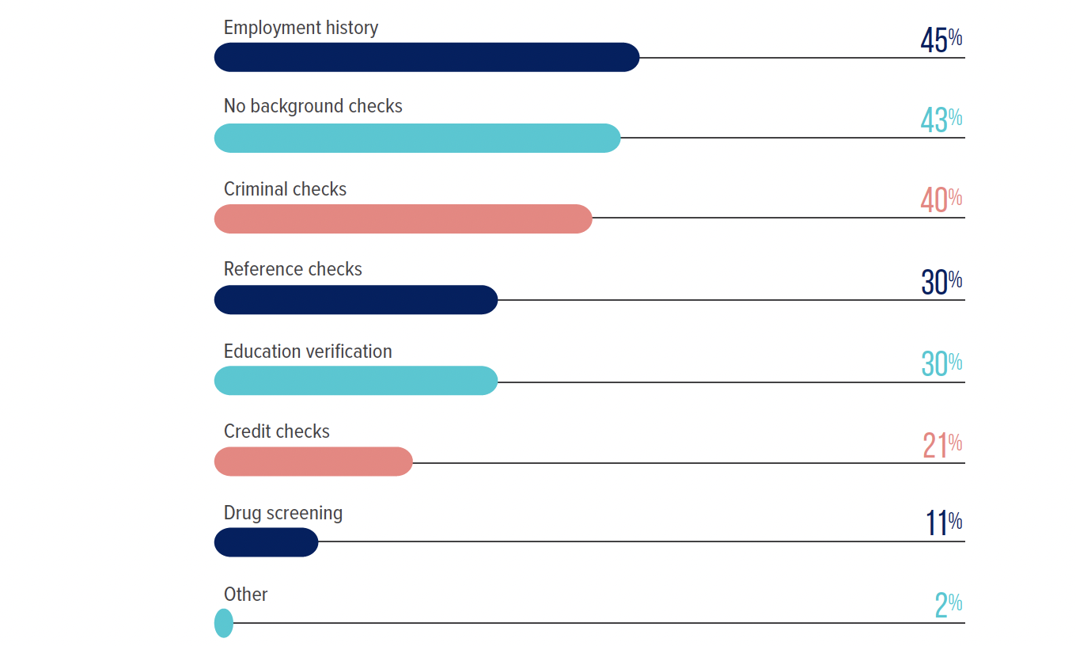
Fig. 28 what types of background checks were run on the perpetrator prior hiring?

Slide 30
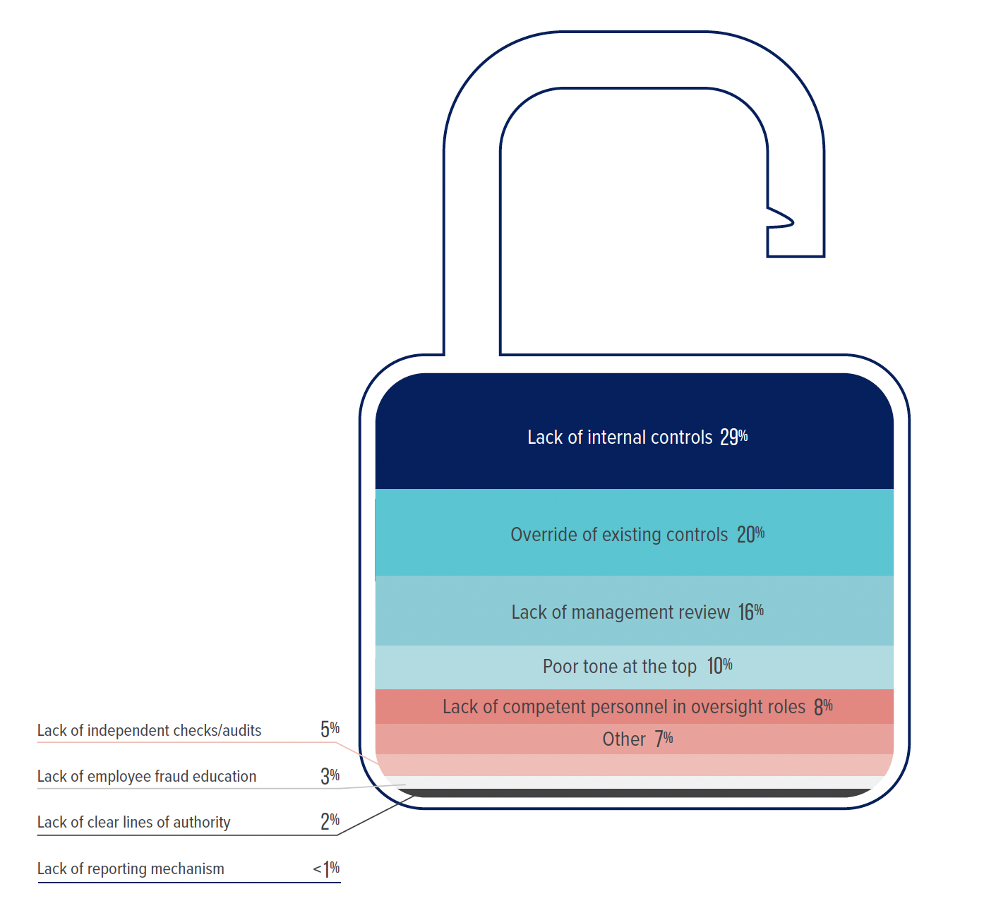
Fig. 29 what are the primary internal control weaknesses that contribute to occupational fraud?

Slide 31
Fig. 30 top 3 internal control weaknesses based on the perpetrator’s position

Slide 32
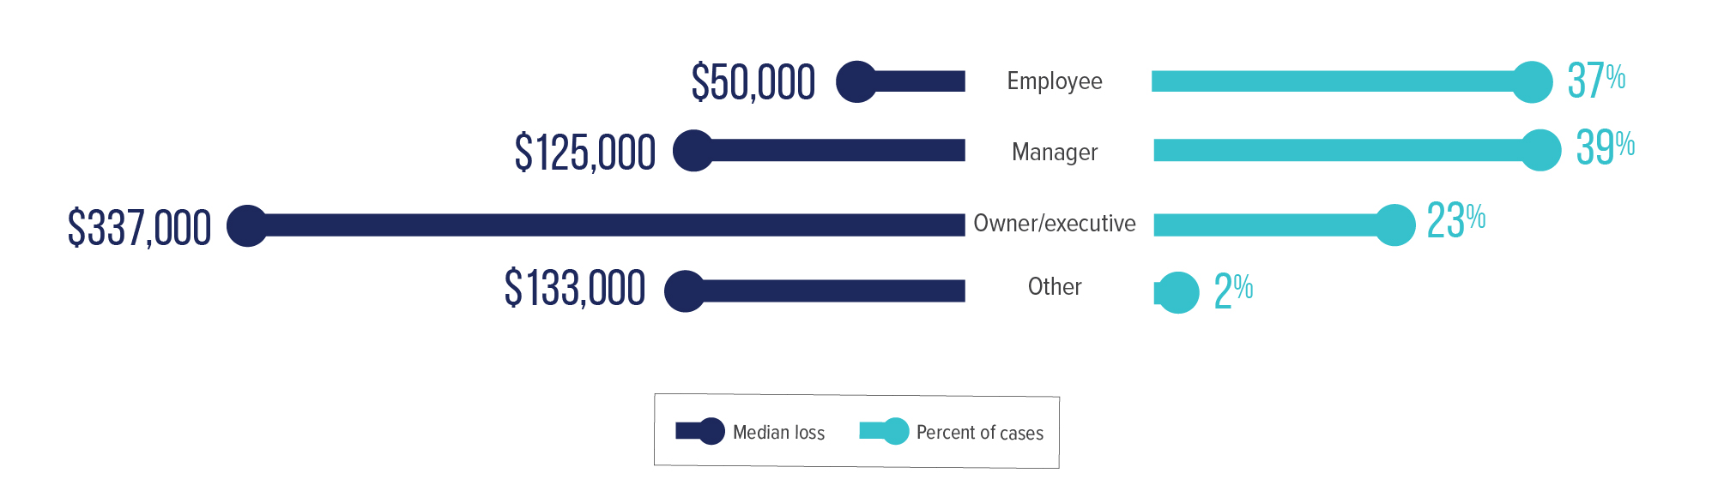
Fig. 31 How does the perpetrator’s level of authority relate to occupational fraud?

Slide 33
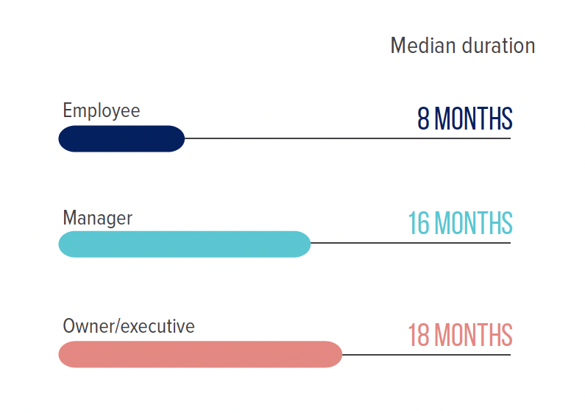
Fig. 32 how does the perpetrator’s level of authority relate to scheme duration?

Slide 34
Fig. 33 How does the perpetrator’s tenure relate to occupational fraud?

Slide 35
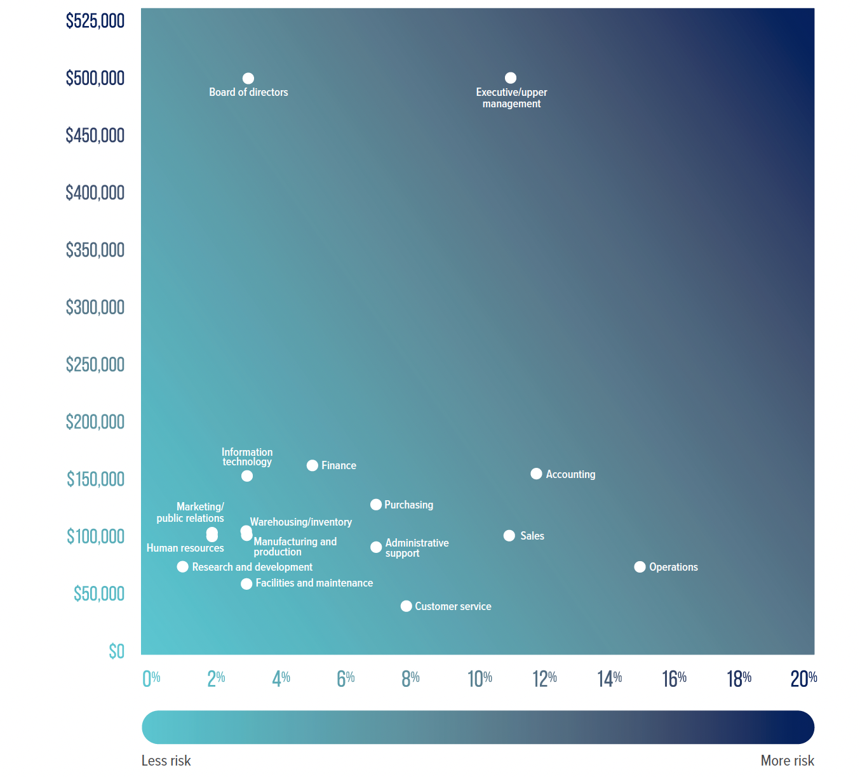
Fig. 34 what departments pose the greatest risk for occupational fraud?

Slide 36
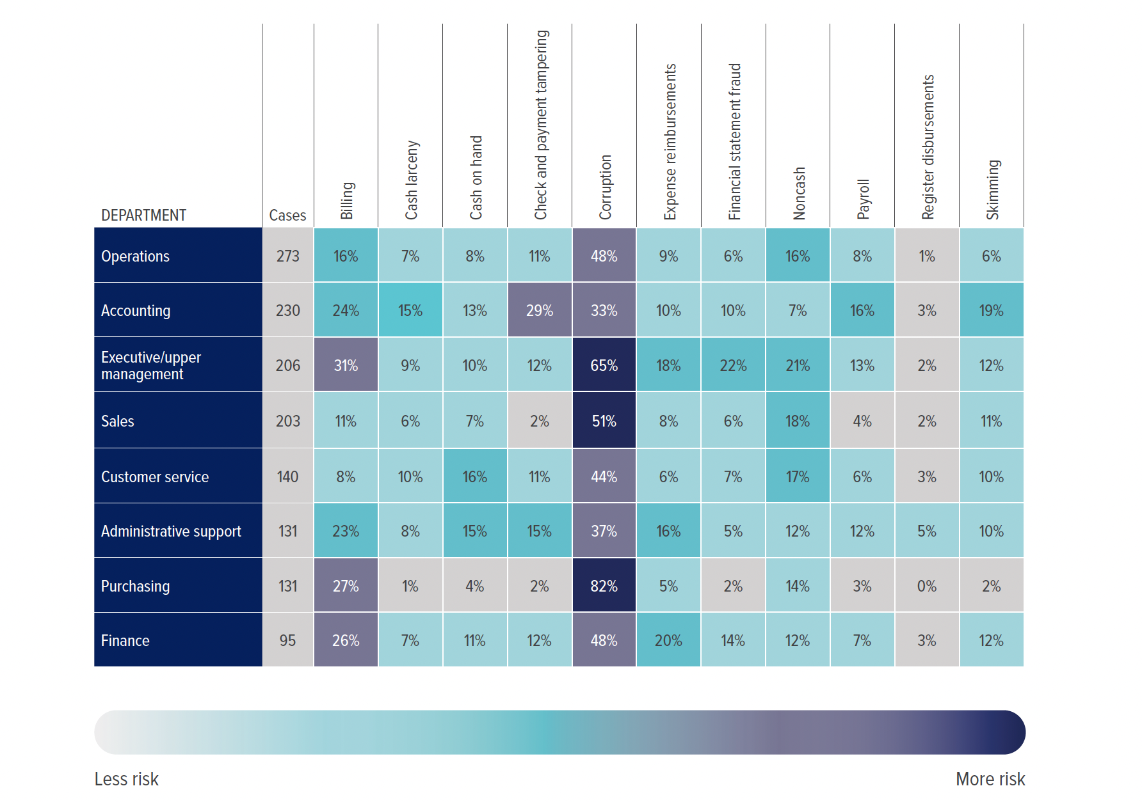
Fig. 35 what are the most common occupational fraud schemes
in high-risk departments?

Slide 37
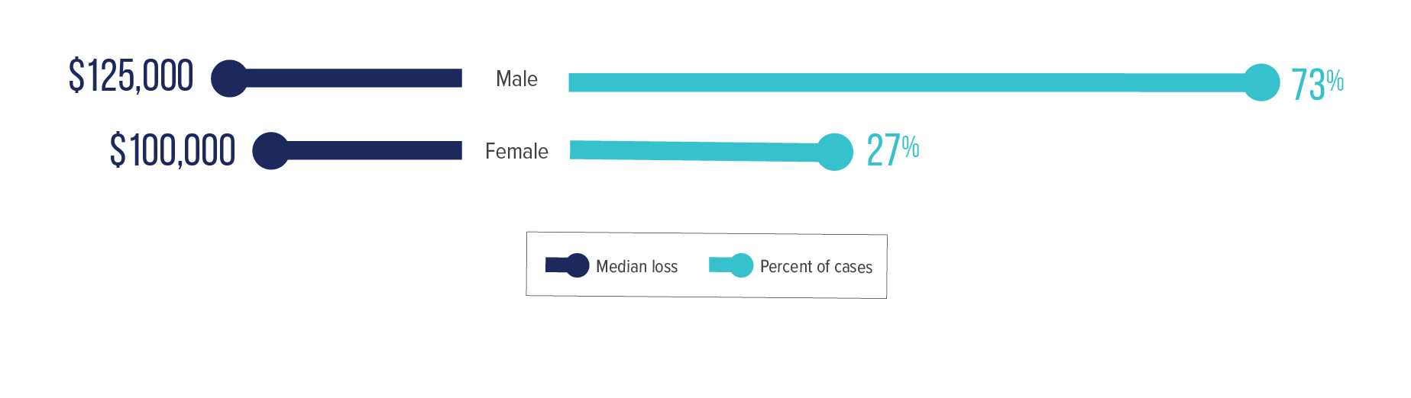
Fig. 36 How does the perpetrator’s gender relate to occupational fraud?

Slide 38
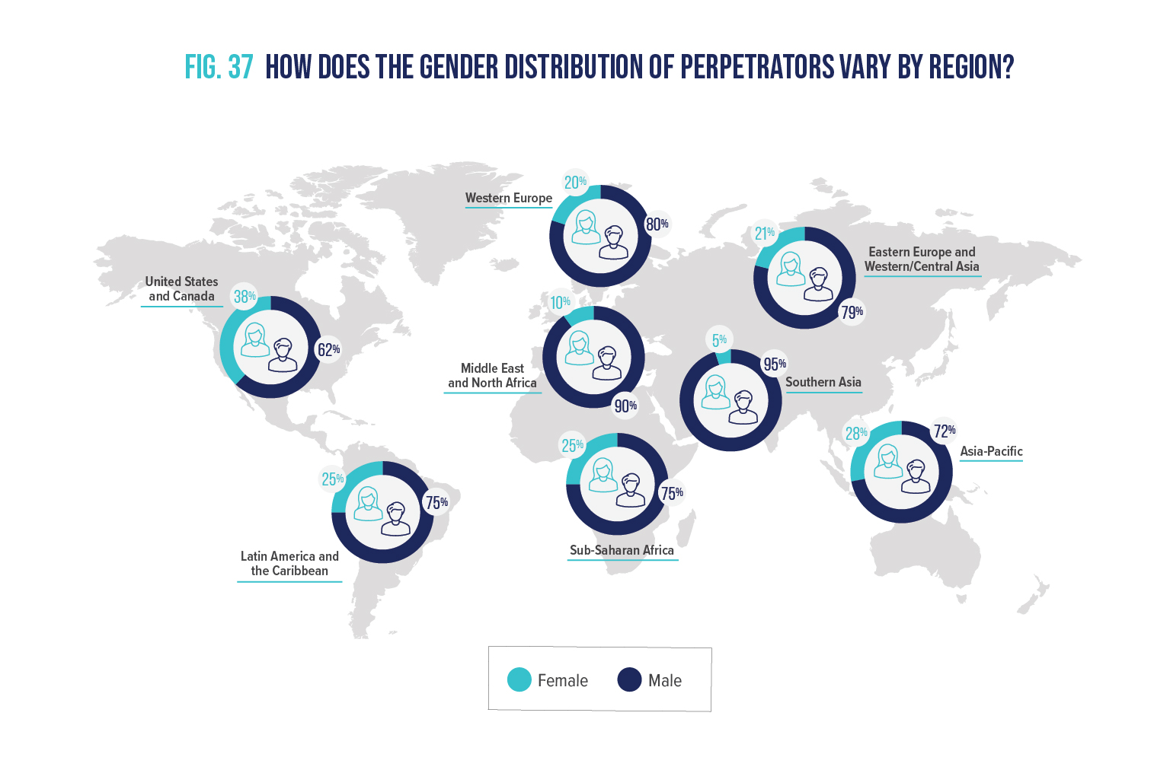
Fig. 37 how does the gender distribution of perpetrators vary by region?

Slide 39
Fig. 38 how do gender distribution and median loss vary based on the perpetrator’s level of authority?

Slide 40
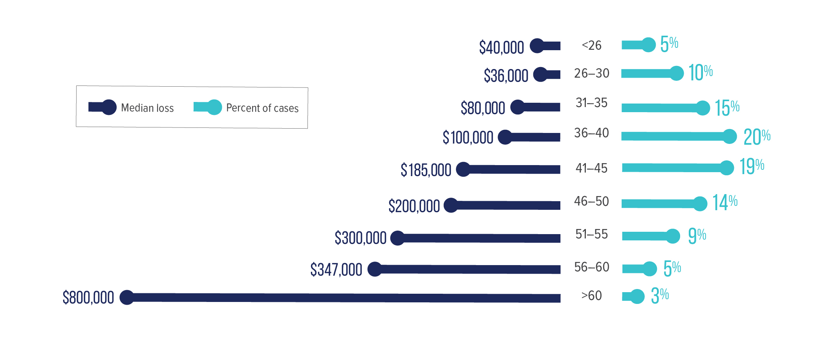
Fig. 39 how does the perpetrator’s age relate to occupational fraud?

Slide 41
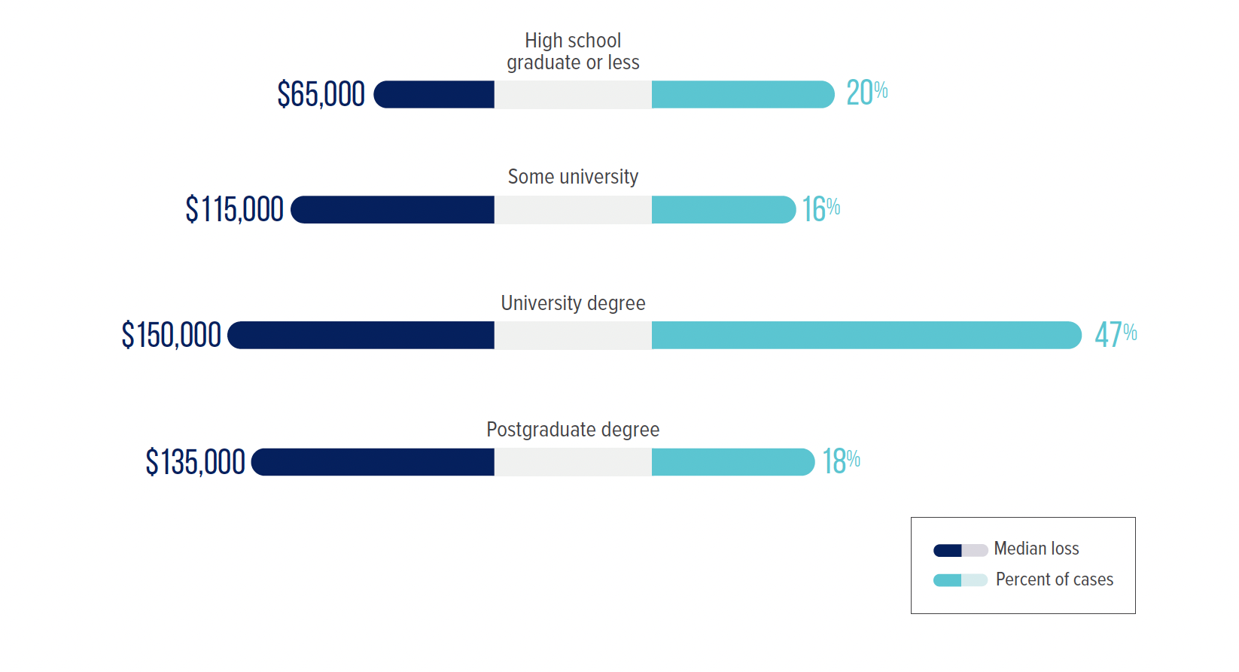
Fig. 40 how does the perpetrator’s education level relate to occupational fraud?

Slide 42
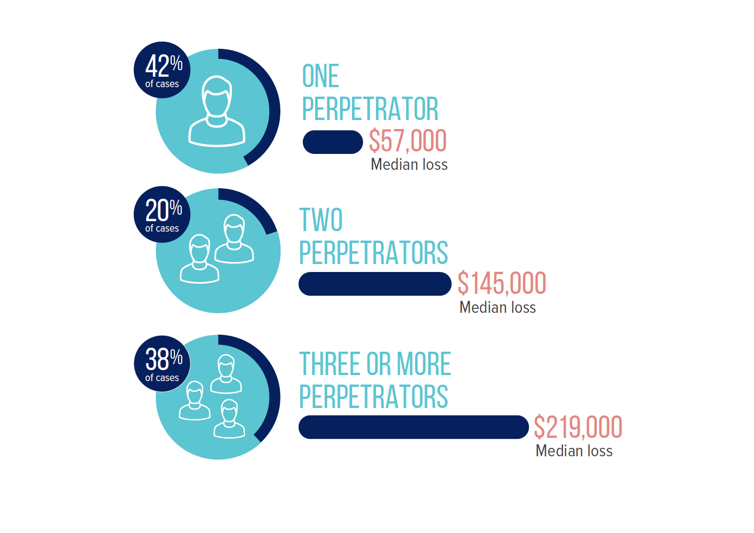
Fig. 41 how does the number or perpetrators in a scheme
relate to occupational fraud?

Slide 43
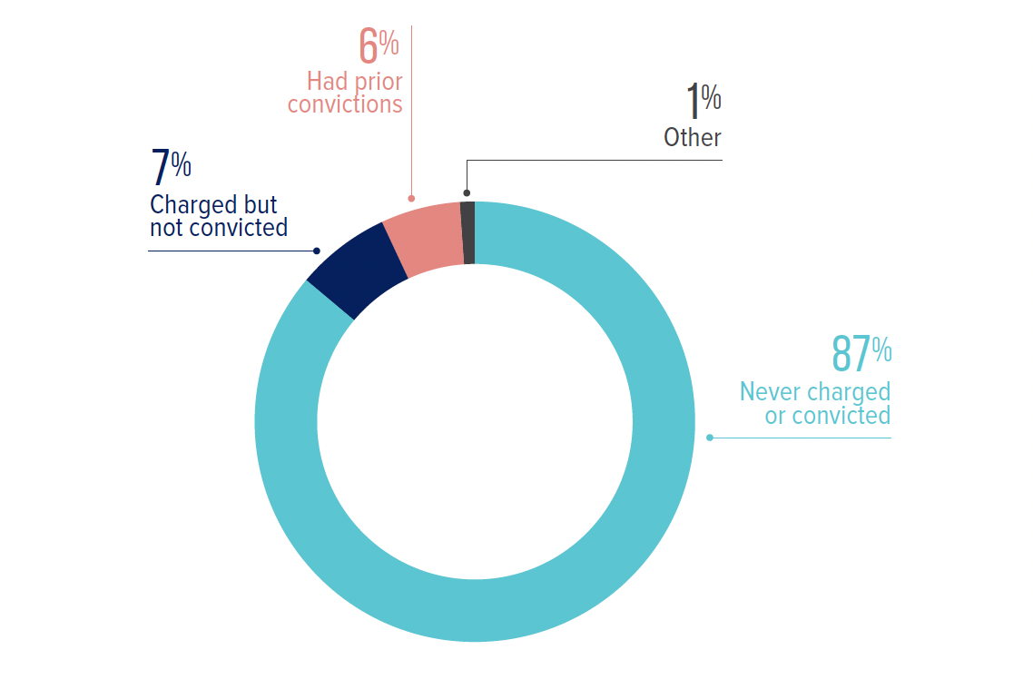
Fig. 42 do perpetrators tend to have prior fraud convictions?

Slide 44
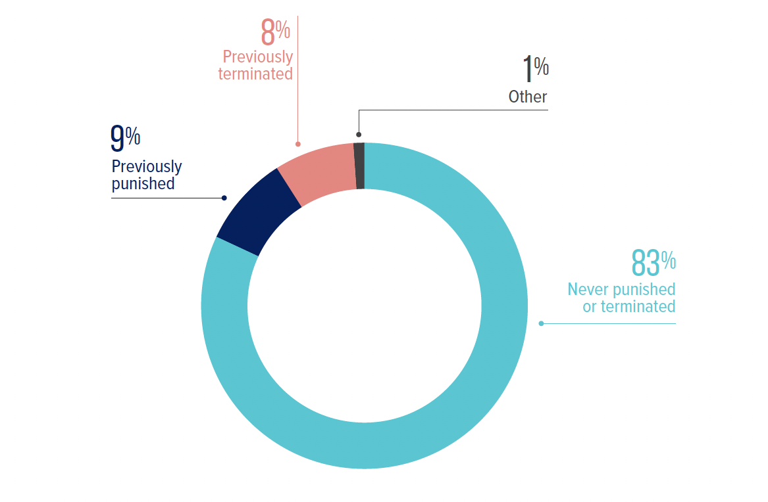
Fig. 43 do perpetrators tend to have prior employment-related disciplinary actions for fraud?

Slide 45
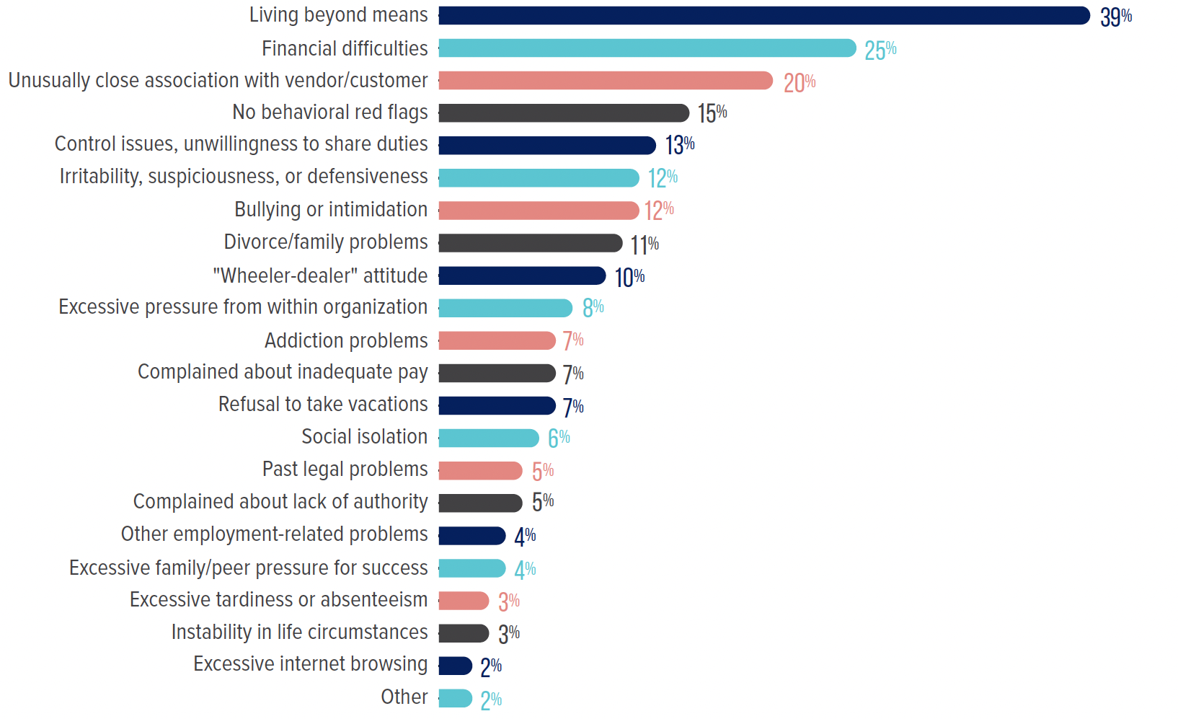
Fig. 44 how often do perpetrators exhibit behavioral red flags ?

Slide 46
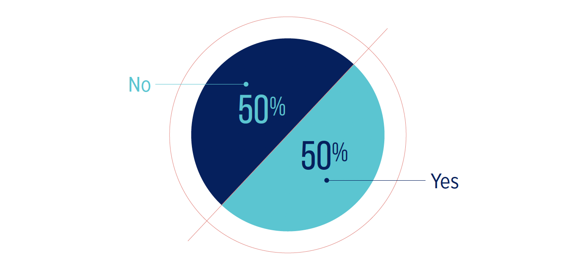
Fig. 45 do fraud perpetrators experience negative hr-related issues prior to or during their frauds?

Slide 47
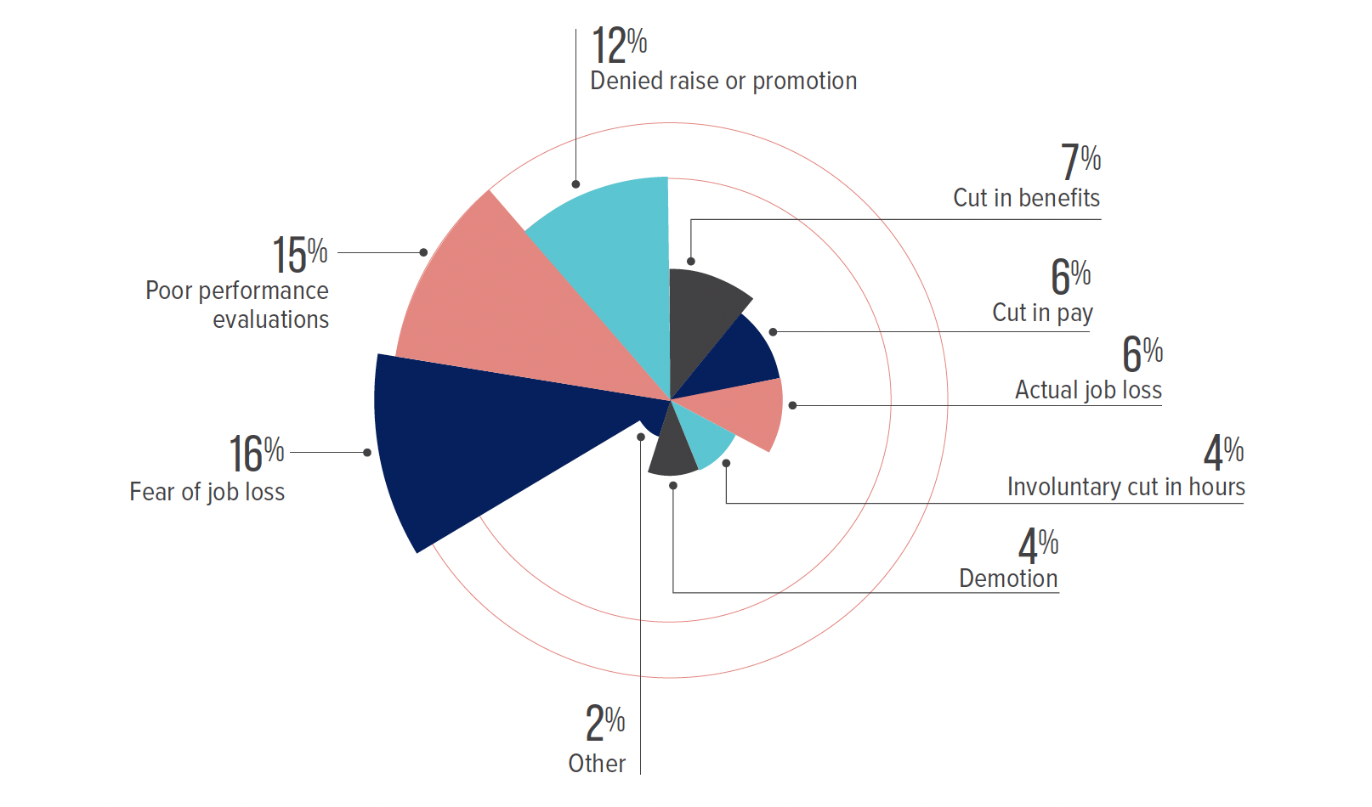
Fig. 46 which hr-related issues are most commonly experienced by fraud perpetrators?

Slide 48
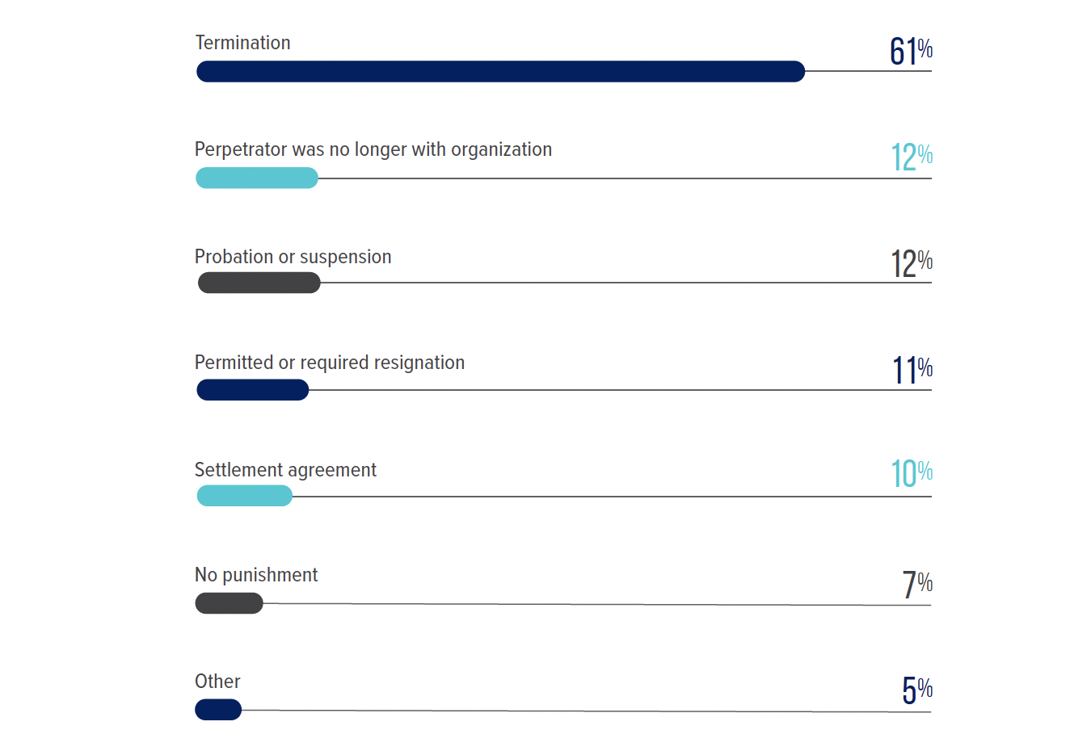
Fig. 47 how do victim organizations punish fraud perpetrators?

Slide 49
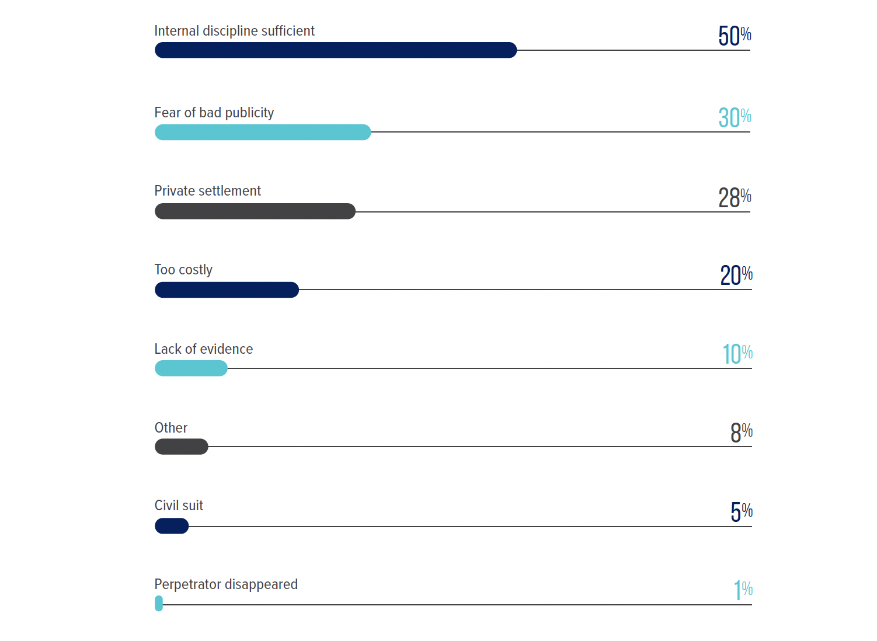
Fig. 48 why do organizations decline to refer cases to law enforcement?

Slide 50
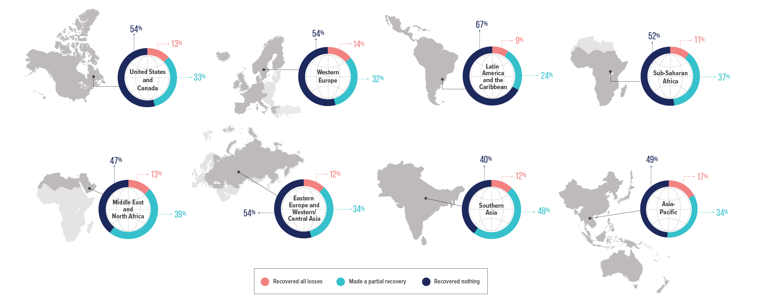
Fig. 49 how did the recovery of fraud Losses vary by region?

Slide 51
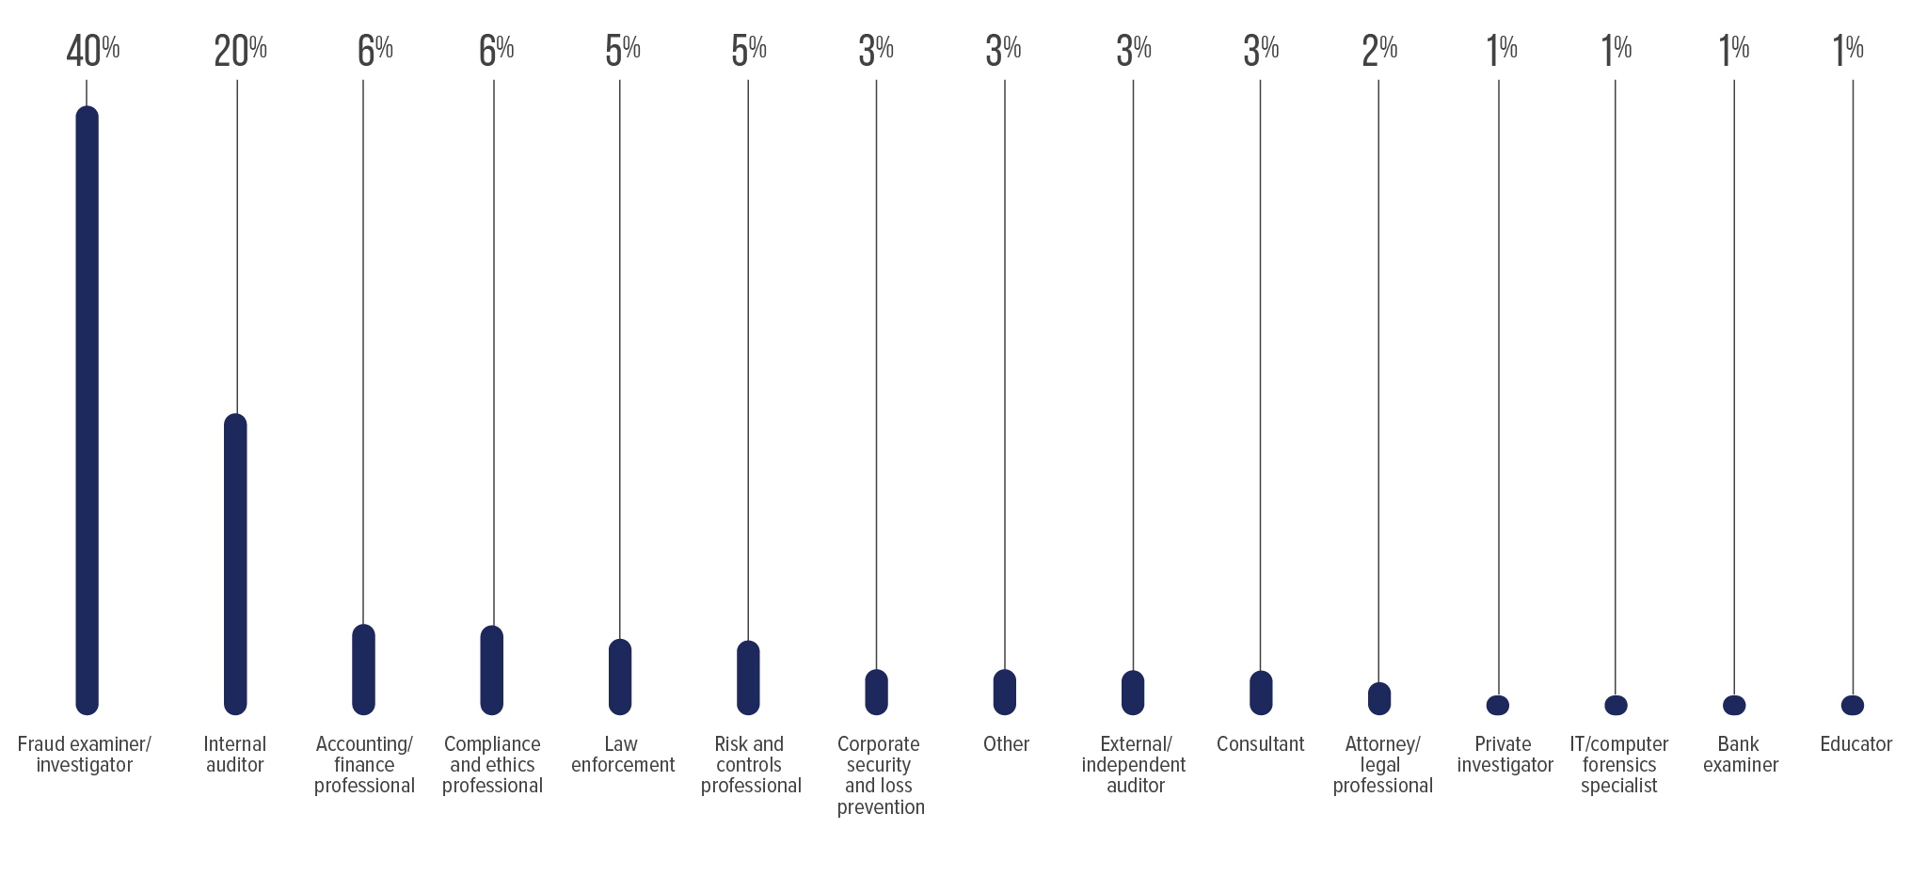
Fig. 50 what was the primary occupation of survey participants?

Slide 52
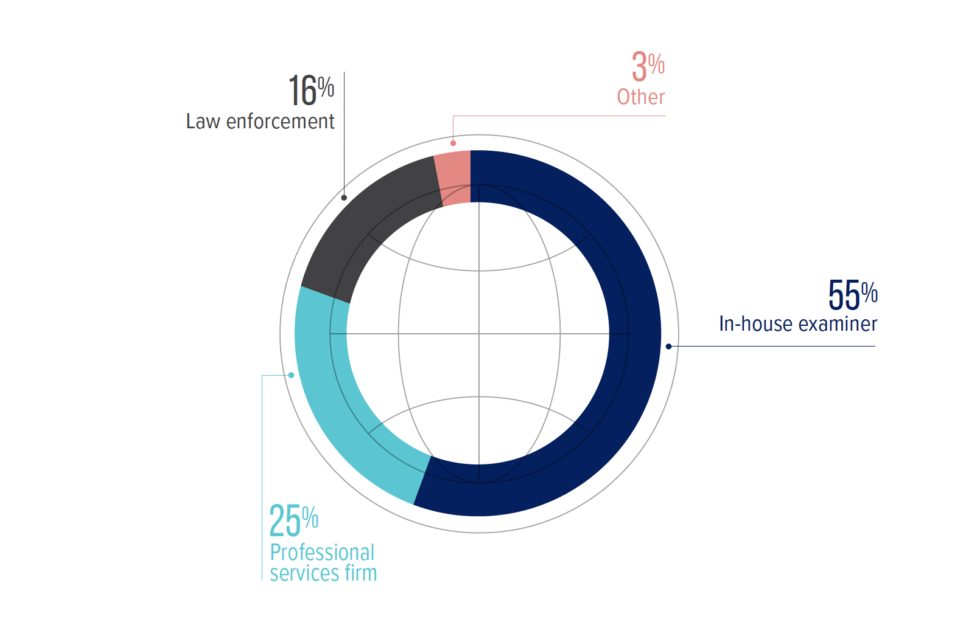
Fig. 51 what was the professional role of the survey participants?

Slide 53
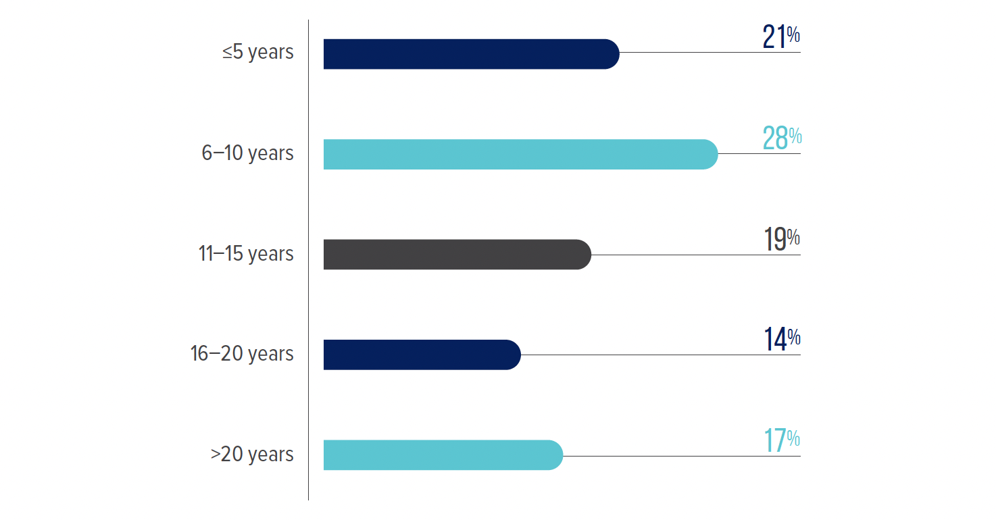
Fig. 52 how much fraud examination experience did survey participants have?

Slide 54
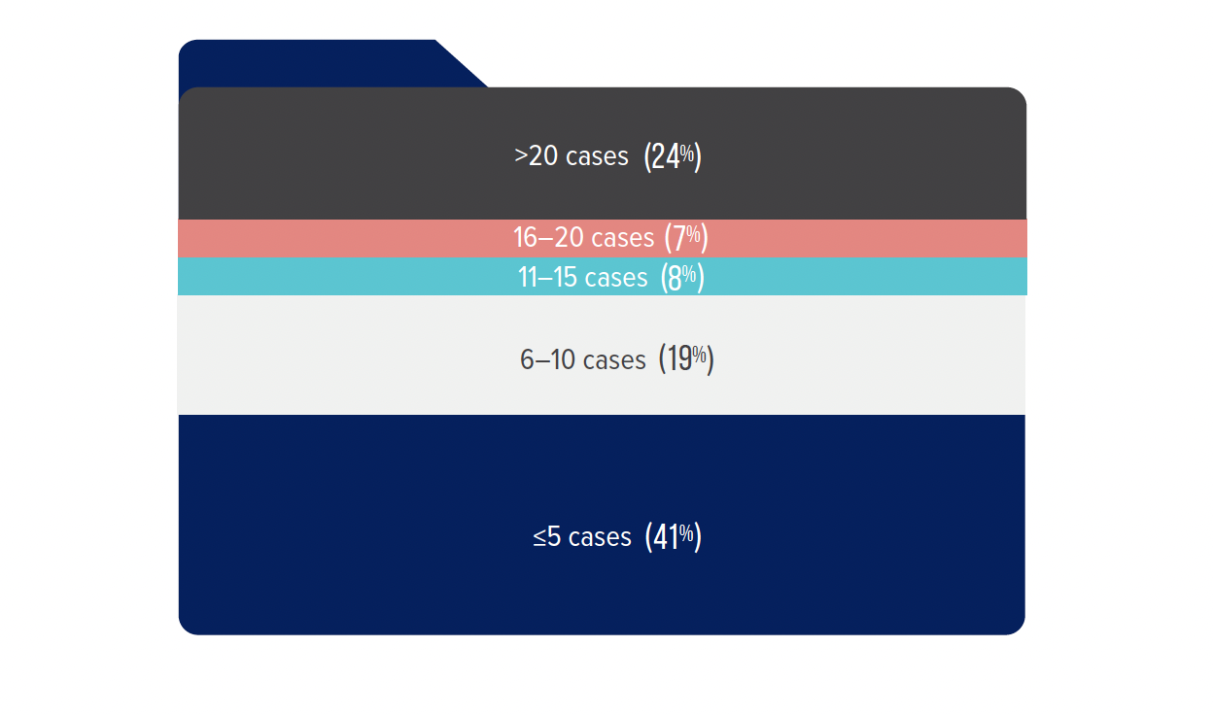
Fig. 53 how many fraud cases have survey participants investigated in the past two years?

Slide 57
